Slide 1


Slide 2

مدیریت انواع بیماریهای فشار خون در بارداری
Dr. Sedigheh Hantoushzade
Professor of Obstetrics and Gynecology(perinatology)
Tehran University of Medical Sciences

Slide 3

DEFINITIONS
Normal blood pressure
  Systolic <120 mmHg and diastolic <80 mmHg
Elevated blood pressure
  Systolic 120 to 129 mmHg and diastolic <80 mmHg
Hypertension:
  Stage 1 – Systolic 130 to 139 mmHg or diastolic 80 to 89 mmHg
  Stage 2 – Systolic at least 140 mmHg or diastolic at least 90 mmHg
If there is a disparity in category between the systolic and diastolic pressures, the higher value determines the stage

Slide 4


Checklist for accurate measurement of blood pressure

Slide 5
Step 1: Properly prepare the patient
1
Have the patient relax, sitting in a chair (feet on floor, back supported) for >5 minutes.
The patient should avoid caffeine, exercise, and smoking for at least 30 minutes before measurement.
Ensure patient has emptied their bladder.
Neither the patient nor the observer should talk during the rest period or during the measurement.
Remove all clothing covering the location of cuff placement.
Measurements made while the patient is sitting or lying on an examining table do not fulfill these criteria.

Slide 6
Step 2: Use proper technique for BP measurements
2
Use a BP measurement device that has been validated, and ensure that the device is calibrated periodically.
Support the patient's arm (eg, resting on a desk).
Position the middle of the cuff on the patient's upper arm at the level of the right atrium (the midpoint of the sternum).
Use the correct cuff size, such that the bladder encircles 80% of the arm, and note if a larger- or smaller-than-normal cuff size is used.
Either the stethoscope diaphragm or bell may be used for auscultatory readings.

Slide 7
Step 3: Take the proper measurements needed for diagnosis and treatment of elevated BP/hypertension
3
At the first visit, record BP in both arms. Use the arm that gives the higher reading for subsequent readings.
Separate repeated measurements by 1 to 2 minutes.
For auscultatory determinations, use a palpated estimate of radial pulse obliteration pressure to estimate SBP. Inflate the cuff 20 to 30 mmHg above this level for an auscultatory determination of the BP level.
For auscultatory readings, deflate the cuff pressure 2 mmHg per second, and listen for Korotkoff sounds

Slide 8
Step 4: Properly document accurate BP readings
4
Record SBP and DBP. If using the auscultatory technique, record SBP and DBP as onset of the first Korotkoff sound and disappearance of all Korotkoff sounds, respectively, using the nearest even number.
Note the time of most recent BP medication taken before measurements

Slide 9
Step 5: Average the readings
5
Use an average of ≥2 readings obtained on ≥2 occasions to estimate the individual's level of BP.

Slide 10
Step 6: Provide BP readings to patient
6
Provide patients the SBP/DBP readings both verbally and in writing.

Slide 11


Isolated systolic hypertension is defined
  as a blood pressure ≥130 mmHg systolic and <80 mmHg diastolic
Isolated diastolic hypertension is defined
  as a blood pressure <130 mmHg systolic and ≥80 mmHg diastolic.
Patients with a blood pressure ≥130 mmHg systolic and ≥80 mmHg diastolic are considered to have mixed systolic/diastolic hypertension.

Slide 12
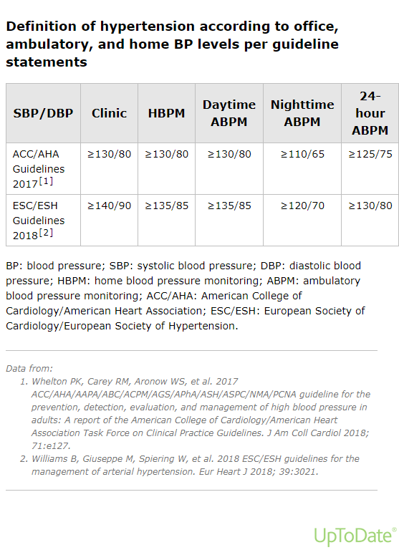

Slide 13


ABPM

Slide 14
ABPM
The following diagnostic criteria were suggested by the 2017 ACC/AHA guidelines; meeting one or more of these criteria using ABPM qualifies as confirmation of hypertension .
  A 24-hour mean of ≥125 mmHg systolic or ≥75 mmHg diastolic
  Daytime (awake) mean of ≥130 mmHg systolic or ≥80 mmHg diastolic
  Nighttime (asleep) mean of ≥110 mmHg systolic or ≥65 mmHg diastolic
We find the daytime (awake) average of ≥130 mmHg systolic or ≥80 mmHg diastolic to be the most useful of these definitions.

Slide 15
ABPM should be considered in the following circumstances:
Suspected episodic hypertension (eg, pheochromocytoma)
Determining therapeutic response (ie, blood pressure control) in patients who are known to have a substantial white coat effect)
Hypotensive symptoms while taking antihypertensive medications
Resistant hypertension
Autonomic dysfunction
Suspected masked hypertension

Slide 16

Key points
Systolic blood pressure readings in the left and right arms should be roughly equivalent.
A discrepancy of more than 15 mmHg may indicate subclavian stenosis and, hence, peripheral arterial disease.
If there is a significant difference in blood pressure between the two arms, the higher of the two should be used for measurement at subsequent visits

Slide 17
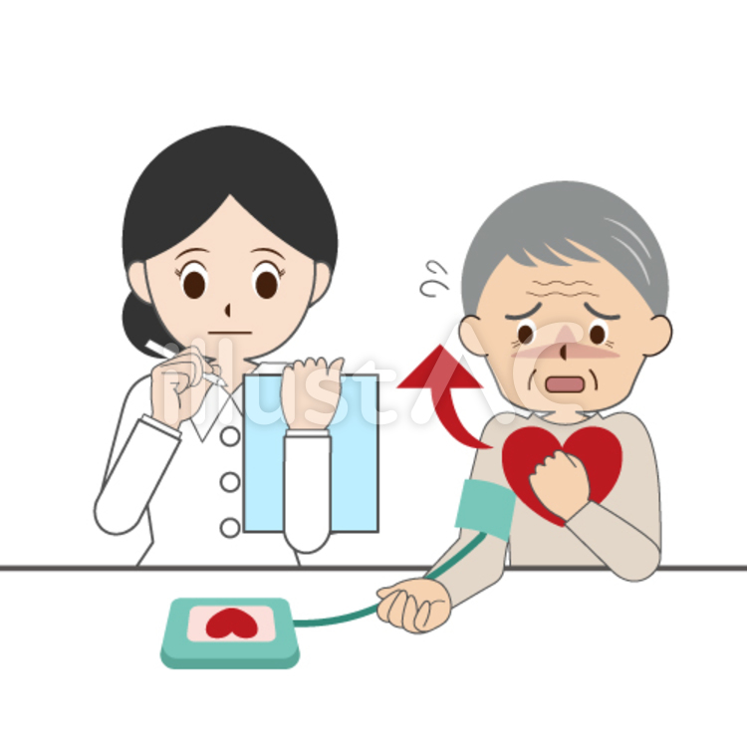
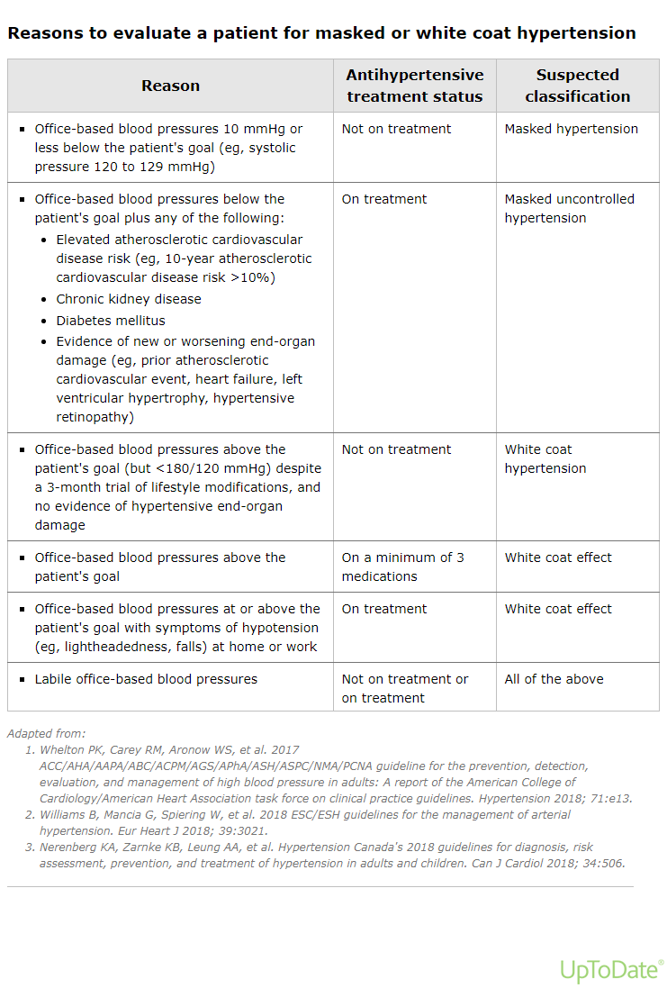

Slide 18
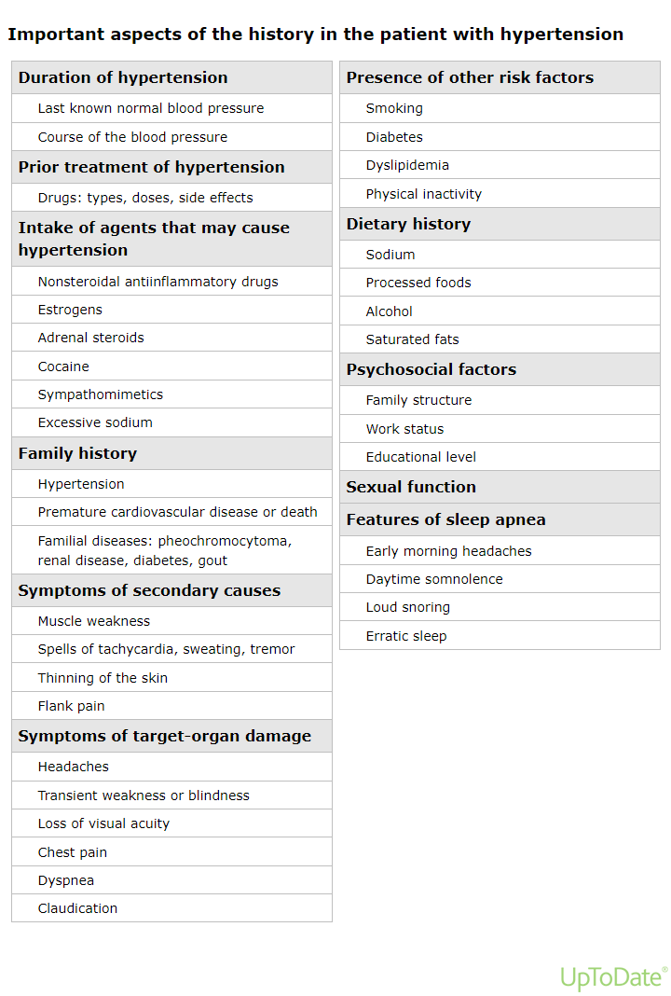


Slide 19
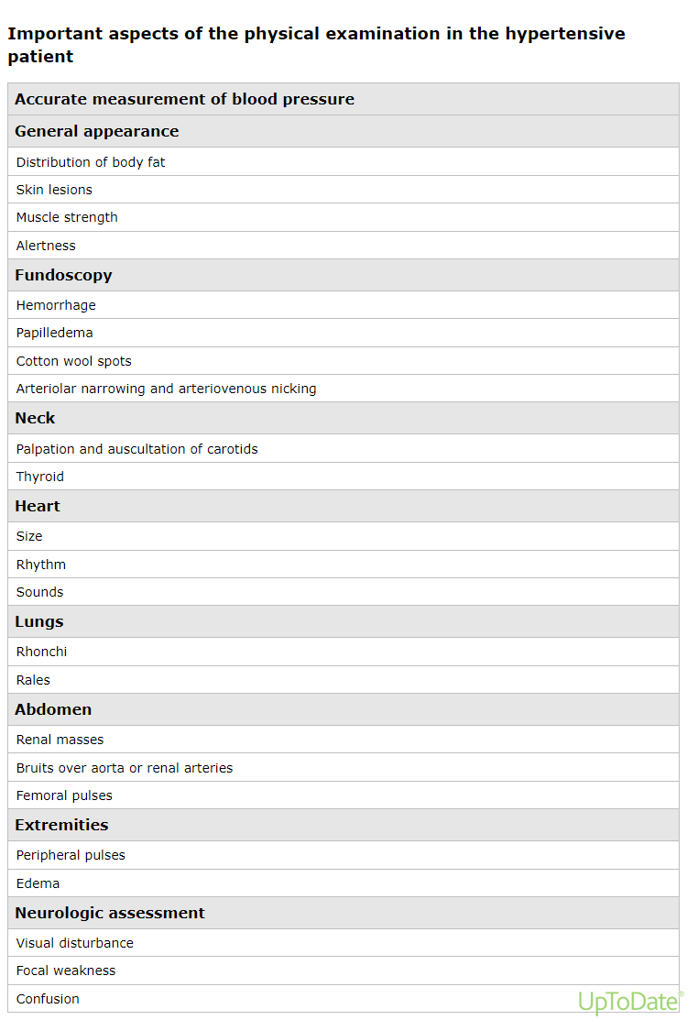


Slide 20


Laboratory testing
Electrolytes (including calcium) and serum creatinine (to calculate the estimated glomerular filtration rate)
Fasting glucose
Urinalysis
Complete blood count
Thyroid-stimulating hormone
Lipid profile
Electrocardiogram
Calculate 10-year atherosclerotic cardiovascular disease risk (calculator 1)

Slide 21

Hypertensive disorders in pregnancy: Approach to differential diagnosis

Slide 22

The four major hypertensive disorders that occur in pregnant women
  Preeclampsia/eclampsia/HELLP syndrome (Hemolysis, Elevated Liver enzymes, Low Platelets)
  Gestational hypertension
  Chronic hypertension
  Preeclampsia superimposed on chronic hypertension

Slide 23

ANTIHYPERTENSIVE DRUG OPTIONS

Slide 24
All antihypertensive drugs cross the placenta.

Slide 25
Drug options
The following drugs are effective antihypertensive agents with an acceptable safety profile in pregnancy.
The choice of drug depends on the acuity and severity of hypertension and whether parenteral or oral therapy is appropriate.
Response to antihypertensive medication is variable, and generalizations about comparative efficacy in overall or specific hypertensive populations are difficult to make.

Slide 26

Beta blockers
Beta blockers are widely used in pregnancy.
Asthma is a common contraindication as bronchospasm may occur
Choice of beta blocker

Slide 27
Labetalol
  has both alpha- and beta-adrenergic blocking activity.
  maternal hepatotoxicity
metoprolol and pindolol are acceptable alternative agents

Slide 28
Evidence of the safety of beta blockers
preterm birth
fetal growth restriction/small for gestational age infant
perinatal mortality
neonatal
  apnea
  bradycardia, and
  hypoglycemia

Slide 29

Calcium channel blockers
Choice of calcium channel blocker
  Nifedipine is the most widely used drug in this class in pregnancy
  Amlodipine is widely used in nonpregnant individuals with hypertension, there are sparse data on its use in pregnancy
  Nondihydropyridine calcium antagonists, such as verapamil and diltiazem, have been used as well
Evidence of safety of calcium channel blockers
  stillbirth
  preterm birth
  CHD

Slide 30
Hydralazine
Intravenous hydralazine has been widely used for many years for treatment of acute severe hypertension in pregnancy and is an acceptable antihypertensive drug in this setting .
However, the hypotensive response to intravenous hydralazine is less predictable than that seen with labetalol.
Although hydralazine can be taken orally, it causes reflex tachycardia and fluid retention, which limit its usefulness in pregnancy.

Slide 31
Methyldopa
widely used in pregnant women
its long-term safety for the fetus has been demonstrated, but it is only a mild antihypertensive agent and has a slow onset of action (three to six hours).
Many women will not achieve blood pressure goals on this oral agent or are bothered by its sedative effect at high doses.
Clinical trials (eg, Control of Hypertension in Pregnancy Study [CHIPS]) utilized this agent and demonstrated that women treated with methyldopa may have had better outcomes compared with those treated with labetalol, although these data may be biased by residual confounding

Slide 32
Thiazide diuretics
Diuretics are generally not used in pregnancy except for treatment of pulmonary edema.
The role of thiazide diuretics has been a source of controversy for decades, although some guidelines suggest that these agents can be continued in women with chronic hypertension who were taking them prior to pregnancy .
Significant volume depletion is not likely in this setting since most of the fluid loss occurs within the first two weeks of use, assuming that drug dose and dietary sodium intake are relatively constant.

Slide 33
Clonidine
Clonidine has a similar mechanism of action as methyldopa and can be an effective drug for treatment of non severe hypertension in pregnancy .
However, it has bothersome side effects and the possibility of rebound hypertension if it is stopped suddenly, so other agents are preferred.
Prescribed clonidine for rare patients in whom methyldopa, labetalol, and nifedipine could not be used.
Because clonidine is available as a transdermal patch, it is particularly useful for patients who cannot take an oral antihypertensive drug

Slide 34

Drugs to avoid in pregnancy
ACE inhibitors, ARBs, direct renin inhibitors
Mineralocorticoid receptor antagonists
Nitroprusside

Slide 35

Drug options during breastfeeding
Beta blockers and alpha/beta blockers
Calcium channel blockers
ACE inhibitors
Diuretics
Methyldopa and hydralazine

Slide 36
Choice of drug and dosing

Slide 37
Acute therapy of severe hypertension
First-line drugs
  Labetalol
    We recommend intravenous labetalol for first-line therapy because it is effective, has a rapid onset of action, and a good safety profile .
    Asthma is a contraindication to use
  Hydralazine
  Nifedipine

Slide 38
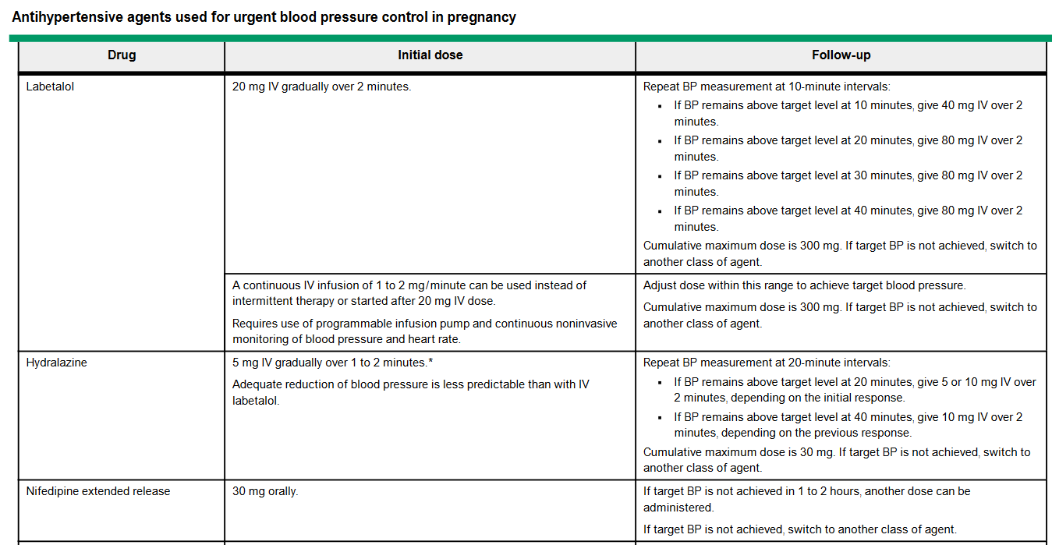

Slide 40
Nifedipine
An extended-release tablet (30 mg), which lasts 24 hours and is known as nifedipine XL or CR or ER.
  This formulation is less likely to result in a rapid and severe fall in blood pressure than the short-acting capsule and provides antihypertensive effects over several hours.
  If target blood pressure is not achieved in one to two hours, another dose can be administered.
An intermediate-acting tablet (10 or 20 mg; in some countries,
  this is known as nifedipine retard), which has a more delayed onset and is usually prescribed two or three times a day.

Slide 41
An immediate-releaserapid-acting capsule (10 mg), which lowers blood pressure within 30 to 60 minutes.
  In the United States, the US Food and Drug Administration/packageinsert notes that "Nifedipine capsules should not be used for the acute reduction of blood pressure" .
  A common dose is 10 mg orally initially; if target blood pressure is not achieved in 20 minutes, administer 10 to 20 mg depending on initial response and repeat bloodpressure 20 minutes later.
  If target blood pressure is still not achieved, administer another 10 to 20 mg depending on previous responses.
  If target blood pressure is still not achieved in 20 minutes, then switch to another agent

Slide 42
Target blood pressure
reduce mean arterial pressure by no more than 25 percent over two hours to achieve target blood pressuresof 130 to 150 mmHg systolic and 80 to 100 mmHg diastolic.

Slide 43
Hypertension refractory to first-line acute therapy
Nicardipine
  The initial dose of nicardipine is 5 mg/hour intravenously by infusion pump and can be increased to a maximum of 15 mg/hour.
Esmolol
  A reasonable dose is 250 to 500 mcg/kg over one minute, then initiate intravenous infusion at 25 to 50 mcg/kg per minute; titrate incrementally up to a maximum of 300mcg/kg per minute
Nitroglycerin
  It may be given as an intravenous infusion of 5 mcg/minute and gradually increased every three to five minutes to a maximum dose of 100 mcg/minute
Nitroprusside
  A reasonable dose is 0.25 to 10 mcg/kg per minute as an intravenous infusion for as short a time as possible and not to exceed2 mcg/kg per minute

Slide 44
Acute oral therapy of severe hypertension in resource-limited areas
In some parts of the world, oral therapy is available, but access to parenteral therapy is limited.
Oral nifedipine, oral nifedipine retard, oral labetalol, and oral methyldopa have been used successfully when parenteral therapy was not possible

Slide 45
Nonpharmacologic interventions
Physical activity
  Bedrest
  Restricted activity
  Recommendations for level of activity should be individualized;
      for example, a woman with stable chronic hypertension early in pregnancy is unlikely to benefit from limited physical activity, while a woman with newly diagnosed preeclampsia in the third trimester may have more stable blood pressure if she limits physical activity while being managed as anoutpatient.
Diet

Slide 46

chronic hypertension

Slide 47
chronic hypertension
In pregnant women, chronic hypertension (also called preexisting hypertension) can be defined as hypertension known to be present before conception or firstrecognized before 20 weeks of gestation.
In women with a previous pregnancy complicated by gestational hypertension, hypertension that persists 12 or more weeks post-delivery is also considered chronic.

Slide 48
DEFINITION/DIAGNOSTIC CRITERIA
Blood pressure criteria for hypertension in pregnancy are systolic blood pressure ≥140 mmHg, diastolic blood pressure ≥90 mmHg, or both.
Severe hypertension is defined as systolic blood pressure ≥160 mmHg, diastolic blood pressure ≥110 mmHg, or both
chronic hypertension

Slide 49
DEFINITION/DIAGNOSTIC CRITERIA
In pregnant women who first present for prenatal care in the second trimester without recent pre pregnancy blood pressure measurements for comparison, the diagnosis of chronic hypertension can be missed due to the normal physiologic decrease in blood pressure between 12 and 19 weeks of gestation: systolic and diastolic blood pressures are approximately 5 to 10 mmHg below baseline at this time.

Slide 50
Risks of chronic hypertension in pregnancy
Maternal | Fetal/neonatal
Severe hypertension Superimposed preeclampsia Abruption Cesarean delivery Postpartum hemorrhage Renal insufficiency/failure Stroke Myocardial infarction Pulmonary edema Death | Fetal growth restriction/small for gestational age infant Preterm delivery Congenital anomalies Stillbirth Neonatal death

Slide 51
PRECONCEPTION CARE
Counseling
Need for heightened maternal and fetal surveillance, and likely need for more frequent obstetric visits and possibly hospitalization

Slide 52
Consideration of secondary causes of hypertension
Laboratory tests
  Creatinine
  Urine protein/creatinine ratio or 24-hour urine protein

Slide 53
Cardiac evaluation
Blood pressure management
  Angiotensin converting enzyme inhibitors and angiotensin receptor blockers should be avoided
  Labetalol and nifedipine have a good fetal safety profile and are first-line options.
  Methyldopa is considered safe in pregnancy but may be less effective in controlling blood pressures.

Slide 54
Modifiable risk factors
Weight loss in overweight and obese patients,
smoking cessation in smokers,
increased exercise for sedentary individuals,
dietary changes (eg, sodium restriction, Dietary Approaches to Stop Hypertension[DASH] diet)

Slide 55



Slide 56

PRENATAL CARE AND DELIVERY

Slide 57
Baseline clinical evaluation and laboratory testing
Creatinine
Urine protein/creatinine ratio or 24-hour urine protein
liver transaminases (Aspartate Aminotransferase And Alanine Aminotransferase)
Platelet Count As A Baseline
Electrolytes in patients with renal dysfunction.

Slide 58
Baseline clinical evaluation and laboratory testing
Baseline blood pressure
Heart rate
A general physical examination, including cardiopulmonary auscultation and evaluation for any signs of cardiac dysfunction (ie, cyanosis, hepatomegaly, jugular venous distention, pulmonary edema)

Slide 59
Transthoracic echocardiography or twelve-lead electrocardiogram are suggested for women with
  Long-standing hypertension, based on age
  Poorly controlled hypertension for more than four years

Slide 60
perform an ultrasound examination in the first trimester or wait until the time of the 18- to 20-week fetal anatomic survey depends on the clinician's confidence in the menstrual dates.

Slide 61
Low-dose aspirin
Excessive gestational weight gain should be avoided because increased adiposity is strongly associated with higher blood pressure.

Slide 62
Blood pressure management
Severe hypertension
Non-severe hypertension
  Patients not on antihypertensive therapy and without end-organ disease
  Patients on antihypertensive therapy and without end-organ disease
  Patients with end-organ disease

Slide 63

Choice of drug and dosing

Slide 64
Choice of drug and dosing

Slide 67
Recommendations of selected medical organizations
ACOG recommends not initiating medication therapy for mild chronic hypertension in pregnancy (>140/90 mmHg and <160/110 mmHg) given the limited evidence for a clear benefit and safety of treatment
NICE guidelines recommend offering treatment for systolic blood pressure ≥140 mmHg or diastolic blood pressure ≥90 mmHg, with goal blood pressures of <135/85 mmHg
The ISSHP recommends pharmacologic therapy to keep blood pressures in the range of 110 to 140 mmHg/80 to 85 mmHg during pregnancy

Slide 68

Screening for fetal growth restriction
Tests to monitor fetal well-being
  fetal kick counts
  Non-stress tests
  BPPs
  Doppler ultrasound

Slide 69
Delivery
Timing
ACOG suggested the following approach for delivery of women with chronic hypertension :
  ≥38+0 to 39+6 weeks of gestation for women not requiring medicatio
  ≥37+0 to 39+0 weeks for women with hypertension controlled with medication
  34+0 to 36+6 weeks for women with severe hypertension that is difficult to control

Slide 70

Intrapartum care
Intrapartum magnesium sulfate therapy
The goal of intrapartum blood pressure management
Volume status (fluid intake and output)

Slide 71

superimposed preeclampsia

Slide 72
Women with superimposed preeclampsia
Definition/diagnostic criteria
  Sudden increase in blood pressure that was previously well-controlled or a need for a rapid escalation of antihypertensive medications to control blood pressure.
  The new onset of proteinuria or a sudden increase in proteinuria in a woman with known pre-pregnancy or early pregnancy proteinuria. A sudden increase in proteinuria is not precisely defined by various societies or in the existing literature.

Slide 73
The presence of any of the following severe features of preeclampsia supports the diagnosis of superimposed preeclampsia with severe features:
  Severely elevated blood pressure despite increasing antihypertensive therapy.
  Thrombocytopenia (platelet count <100,000/microliter).
  Elevated transaminases (two times the upper limit of the normal concentration for a particular laboratory) or severe persistent right upper quadrant or epigastric pain unresponsive to medication and not accounted for by alternative diagnoses, or both
  New-onset or worsening renal insufficiency.
  Pulmonary edema.
  Persistent cerebral or visual disturbances

Slide 74
Management
Women with superimposed preeclampsia should initially be monitored in the inpatient setting
Betamethasone
Timing and indications for delivery with superimposed preeclampsia are based on gestational age, disease severity, progression of disease, and results of ongoing assessment of maternal and fetal well-being.
Magnesium sulfate

Slide 75
Incidence and risk factors
Superimposed preeclampsia develops in 13 to 40 percent of pregnant women with chronic hypertension
long-standing, severe, or secondary hypertension; obesity; Black race; history of preeclampsia; and smoking

Slide 76
POSTPARTUM CARE
Analgesia
Blood pressure management
Family planning
Referral for primary care

Slide 77

Gestational Hypertension

Slide 78
DEFINITION AND PROVISIONAL DIAGNOSIS
Gestational hypertension is a clinical diagnosis defined by the new onset of hypertension (defined as systolic blood pressure ≥140mmHg and/or diastolic blood pressure ≥90 mmHg) at ≥20 weeks of gestation in the absence of proteinuria or new signs of end-organ dysfunction

Slide 79
PREVALENCE
Gestational hypertension is the most common cause of hypertension during pregnancy.
It occurs in 6 to 17 percent of healthy nulliparous women and 2 to 4 percent of multiparous women

Slide 80
RISK FACTORS
Risk factors are similar to those for preeclampsia

Slide 81
DIAGNOSTIC EVALUATION
Measure protein excretion
Evaluate for features of severe disease
Rule out other causes of acute hypertension
Perform laboratory evaluation
Determine the severity of hypertension
Assess fetal well-being

Slide 82
Risk Of Progression To Preeclampsia
Gestational age less than 34 weeks at diagnosis (sensitivity 85 percent, specificity 60 percent).
Mean systolic blood pressure >135 mmHg on 24 hour blood pressure monitoring (sensitivity 61 percent, specificity 76 percent).
Elevated serum uric acid level (>5.2 mg/dL [0.309 mmol/L]) (sensitivity 88 percent, specificity 93 percent)
Abnormal uterine artery Doppler velocimetry
elevated serum levels of anti-angiogenic markers (eg, sFlt-1),
reduced levels of proangiogenic placental growth factor,
higher total vascular resistance (>1340 dyne seconds/cm

Slide 83
MANAGEMENT
Blood pressure less than 160/110 mmHg
  Site of care
  Patient education and counseling
  Level of physical activity
  Low-dose aspirin
  Maternal blood pressure and laboratory monitoring
  Fetal assessment
  Antihypertensive therapy
  Antenatal corticosteroids
  Timing of delivery
  Intrapartum management

Slide 84
Blood pressure greater than 160/110 mmHg
Women who develop severe gestational hypertension have rates of pregnancy complications comparable to those with preeclampsia with severe features, and thus, ACOG recommends managing these patients similarly.
Delivery after maternal stabilization is advised for pregnancies ≥34+0 weeks

Slide 85
MATERNAL PROGNOSIS
Postpartum course
  nonsteroidal anti-inflammatory agents for postpartum analgesia
Recurrence risk
Long-term prognosis
  development of hypertension later in life, and also with development of diseases related to hypertension(cardiovascular disease, hyperlipidemia, chronic kidney disease, diabetes mellitus)

Slide 86

Preeclampsia

Slide 87

Preeclampsia
a progressive, multisystem disorder characterized by new-onset hypertension and end-organ dysfunction in the last half of pregnancy

Slide 88
RISK FACTORS
A past history of preeclampsia
Preexisting medical conditions
  Pregestational diabetes
  Chronic hypertension
  systemic lupus erythematosus and antiphospholipid syndrome
  Prepregnancy overweight or obesity
  Chronic kidney disease
Multifetal pregnancy
Nulliparity
A family history of preeclampsia
Prior pregnancy complications associated with placental insufficiency
Advanced maternal age
Use of assisted reproductive technology

Slide 89
CLINICAL PRESENTATION
Typical presentation
Rare and atypical presentations

Slide 90
Typical presentation
New-onset hypertension and proteinuria at ≥34 weeks of gestation
Persistent and/or severe headache
Visual abnormalities (scotomata, photophobia, blurred vision, or temporary blindness [rare])
Upper abdominal, retrosternal, or epigastric pain
Altered mental status
New dyspnea, orthopnea

Slide 91
Rare and atypical presentations
Onset <20 weeks
Onset or exacerbation of symptoms >2 days postpartum
Severe features of preeclampsia without hypertension
Isolated hypertension
Isolated proteinuria

Slide 92
PATIENT EVALUATION
Accurate assessment of blood pressure
Laboratory tests
  Complete blood count with platelets
  Serum creatinine level
  Liver chemistries (aspartate aminotransferase [AST], alanine aminotransferase [ALT]
  Urinary protein determination (protein to creatinine ratio in a random urine specimen or 24-hour urine collection for total protein)

Slide 93
Assessment of fetal status
  nonstress test or biophysical profile
  Ultrasound is indicated to evaluate amniotic fluid volume and estimate fetal weight Indications for
Neurology consultation
  women with neurologic deficits/abnormal neurologic examination,
  ocular signs andsymptoms,
  a severe persistent headache that does not respond to repeat doses of acetaminophen
  initial routine management of preeclampsia.
Measurement of angiogenic factors
  antiangiogenic factors soluble fms-like tyrosine kinase-1 (sFlt-1), and
  angiogenic factors, such as placental growth factor (PlGF)

Slide 94
SPECTRUM OF DISEASE
Potential clinical findings
Potential laboratory findings
Potential sonographic findings
Potential histologic findings

Slide 95
Potential clinical findings
Hypertension
Epigastric, upper abdominal, or retrosternal pain
Neurologic
  Headache
    temporal, frontal, occipital, or diffuse
    Acetaminophen is commonly used to treat headache. Doses ≤2 g/day can be administered to women with mild hepatic or renal insufficiency, but it is contraindicated in patientswith severe hepatic or renal impairment

Slide 96

Potential clinical findings
  Visual symptoms
    They are caused,
    retinal arteriolar spasm,
    impaired cerebrovascular autoregulation, and
    cerebral edema .
  Symptoms include blurred vision, photopsia (flashing lights or sparks), and scotomata (dark areas or gaps in the visual field) .
  Diplopia or amaurosis fugax (blindness in one or both eyes) may also occur.
  Visual disturbances in preeclampsia may be manifestations of PRES.

Slide 97
Potential clinical findings
  Cortical blindness is rare and typically transient .
  Blindness related to retinal pathology, such as
    retinal artery or vein occlusion,
    retinal detachment,
    optic nerve damage,
    retinal artery spasm, and
    retinal ischemia,
    may be permanent

Slide 98
Neurologic
  Stroke
    hemorrhagic and preceded by severe headache and severe and fluctuating blood pressure levels, but ischemic strokes also occur
  Generalized hyperreflexia
    Sustained ankle clonus may be present
  Seizure
Pulmonary edema
  The etiology of pulmonary edema in preeclampsia is multifactorial

Slide 99

Oliguria
  transient oliguria (less than 100 mL over 4 hours) in labor or the first 24 hours postpartum.
  Patients at the severe end of the disease spectrum may have urine output <500 mL/24 hours.
  Oliguria in preeclampsia is due to contraction of the intravascular space secondary to vasospasm, leading to increased renal sodium and water retention, as well as intrarenal vasospasm .
  The glomerular filtration rate (GFR) may fall by over 25 percent.

Slide 100
Peripheral edema
  sudden and rapid weight gain (eg, >5 lb/week [2.3 kg/week]) and facial edema are more common in women who develop preeclampsia
Abruptio placentae

Slide 101
Potential laboratory findings
Proteinuria
  ≥0.3 g protein in a 24-hour urine specimen.
  Random urine protein to creatinine ratio ≥0.3 mg protein/mg creatinine (some clinicians opt to confirm presence of ≥0.3 g protein with a 24-hour collection).
  Protein ≥2+ (30 mg/dL) on a paper test strip dipped into a fresh, clean voided midstream urine specimen

Slide 102
Potential laboratory findings
Elevated creatinine
  A creatinine level >1.1 mg/dL (97.3 micromol/L) concentration indicates the severe end of the disease spectrum.
  Some guidelines also include doubling of the patient's baseline creatinine in the absence of other renal disease as indicative of the severe end of the disease spectrum.

Slide 103
Thrombocytopenia
  less than 150,000/microL occurs in approximately 20 percent of patients with preeclampsia .
  The severe end of the disease spectrumis characterized by a platelet count less than 100,000/microL.
  Thrombocytopenia is the most common coagulation abnormality in preeclampsia.
  Microangiopathic endothelial injury and activation result in formation of platelet and fibrin thrombi in the microvasculature.
  Accelerated platelet consumption leads to thrombocytopenia; immune mechanisms may also play a role .

Slide 104
Hemolysis
  Schistocytes and helmet cells on the peripheral blood smear suggest microangiopathic hemolysis, which is a finding in severe disease.
  Elevation in the serum indirect bilirubin level also suggests hemolysis.
  Elevations in lactate dehydrogenase are usually related to liver dysfunction but can be due to hemolysis or both.
Hemoconcentration
  Hemoconcentration may result from contraction of the intravascular space secondary to vasospasm as well as capillary leaking.
  Hematocrit typically increases (range 36 to 43 percent in one study ).
  When both hemolysis and hemoconcentration occur concurrently, the effects on hematocrit may negate each other,resulting in a normal value.

Slide 105
Liver chemistries
  Liver chemistries are normal, except at the severe end of the disease spectrum, which is characterized by elevated transaminase levels (defined as twice the upper limit of normal for the local laboratory).
  Abnormalities in liver chemistries are due to reduced hepatic blood flow, potentially resulting in ischemia and periportal hemorrhage.
  Periportal and sinusoidal fibrin deposition and microvesicular fat deposition also occur and may affect hepatocyte function .
  Elevation in the serum indirect bilirubin level suggests hemolysis.

Slide 106
Coagulation studies
  The prothrombin time, partial thromboplastin time, and fibrinogen concentration are not usually affected by preeclampsia unless there are additional complications, such as severe thrombocytopenia, abruptio placentae, severe bleeding, or severe liver dysfunction .
Hyperuricemia
  The association between hyperuricemia and preeclampsia has been known for decades.
  The cause is most likely related to a reduction in GFR.
  However, the increase in serum uric acid is often greater than expected for mild reductions in GFR, leading to the hypothesis that decreased tubular secretion or increased reabsorption inthe proximal renal tubules plays a role

Slide 107
Other
Troponin
  can be elevated above the normal threshold .
  when clinically indicated, such as when the patient complains of chest pain suggestive of myocardial ischemia or new electrocardiogram changes are observed .
Urine sediment
  The urine sediment is typically benign.
Lipids
  Total cholesterol and triglyceride levels are higher than in normotensive pregnant women .
Neutrophilia
  The white blood count may be slightly higher due to neutrophilia.
Hypocalciuria
  Hypocalciuria has been attributed to increased tubular reabsorption of calcium

Slide 108
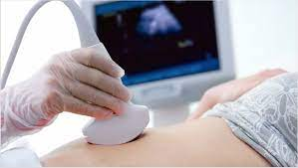
Potential sonographic findings
Fetal ultrasound
  Fetal growth restriction (FGR) may be accompanied by oligohydramnios
Uterine and umbilical artery Doppler
Maternal hemodynamic imaging studies
  Can be associated with a highly variable hemodynamic profile, including cardiac failure
  Left ventricular ejection fraction usually remains within normal limits
  Intravascular volume

Slide 109
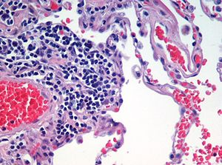
Potential histologic findings
Placenta
Kidney

Slide 110

Preeclampsia: Prevention

Slide 111
LOW-DOSE ASPIRIN
Candidates
  pregnant women with any one of these high risk factors
    Previous pregnancy with preeclampsia, especially early onset and with an adverse outcome.
    Multifetal gestation.
    Chronic hypertension.
    Type 1 or 2 diabetes mellitus.
    Chronic kidney disease.
    Autoimmune disease with potential vascular complications (antiphospholipid syndrome, systemic lupus erythematosus)

Slide 112
LOW-DOSE ASPIRIN
  with two or more of the following moderate risk factors
    Nulliparity.
    Obesity (body mass index >30 kg/m²).
    Family history of preeclampsia in mother or sister.
    Age ≥35 years.
    Sociodemographic characteristics (African American race, low socioeconomic level).
    Personal risk factors (eg, previous pregnancy with low birth weight or small for gestational age infant, previous adverse pregnancy outcome [eg, stillbirth], interval >10 years between pregnancies).

Slide 113
Timing of initiation
  We initiate low-dose aspirin for preeclampsia prevention at ≥12 weeks of gestation, and ideally prior to 16 weeks
Dose
  81 to 150 mg
  Morning versus evening administration
  Importance of good compliance
  Timing of discontinuation

Slide 114
Calcium supplementation
We recommend that pregnant women achieve the recommended daily allowance (RDA) for elemental calcium through diet and/or supplements. In the United States, the RDA forelemental calcium is 1000 mg/day in pregnant, lactating, or nonpregnant women 19 to 50 years of age (1300 mg for girls 14 to 18 years of age).

Slide 115
Weight loss
Statins
  Statins are currently contraindicated in pregnancy.
Anticoagulation
Vitamin C and E supplements
  We recommend not prescribing antioxidant supplementation with vitamin C and/or E for prevention of preeclampsia
Vitamin D supplements
Folic acid supplementation
Fish oil supplements
Diet
  protein and energy supplements, protein and energy restriction (in obese women), magnesium supplementation, and salt restriction
Antihypertensive drugs
  including diuretics) did not reduce the frequency of preeclampsia or improve fetal or pregnancy outcome

Slide 116

"Early pregnancy prediction of preeclampsia"
Screening tests
  We do not use blood or imaging tests to screen for preeclampsia.
  Biomarkers
    Angiogenic modulators
    PAPP-A
  Uterine artery Doppler velocimetry
  Ophthalmic artery Doppler

Slide 117
SCREENING TESTS NOT USEFUL FOR PREDICTING PREECLAMPSIA
Provocative biophysical tests
  None of these tests (angiotensin II challenge test , roll-over test [supine pressor test] , isometric exercise test [hand-grip test]) are currently being used
Serum uric acid
  Although hyperuricemia is commonly seen in women with preeclampsia,
  measurement of serum uric acid concentration before 25 weeks of gestation was not useful for predicting which women would develop preeclampsia
  above 3.5 to 4 mg/dL (0.21 to 0.24 mmol/L)
Screening for inherited thrombophilias
Screening for antiphospholipid antibodies

Slide 118
Differential Diagnosis Among Patients Whose Primary Finding Is Hyperten

Slide 119
Chronic hypertension versus preeclampsia
Hypertension occurring before the 20 week is usually due to chronic hypertension rather than preeclampsia.
The proteinuria is usually present and increases over time in preeclampsia, occasionally reaching the nephrotic range; by comparison, protein excretion is usually normal or less than 1 g/day in women with chronic hypertension.
  Hypertensive nephrosclerosis, a complication of poorly treated chronic hypertension, is associated with very modest proteinuria (1 to 2 g/day) but rarely occurs in young women

Slide 120
Chronic hypertension versus preeclampsia
Preeclampsia is more common in nulliparas than multiparas, and it is uncommon in multiparas with previously normotensive pregnancie
Preeclampsia is more common in older (>40 years) than younger nulliparas, although older women (nulliparous or multiparous) are also more likely to have chronic hypertension.

Slide 121
Chronic hypertension versus superimposed preeclampsia
Reproductive-age women with chronic hypertension typically have no proteinuria; therefore, new proteinuria suggests development of superimposed preeclampsia.
A serum urate level may also help to distinguish chronic hypertension (urate generally not elevated) from superimposed preeclampsia(urate often elevated)

Slide 122
Exacerbation of chronic renal disease versus preeclampsia
Laboratory evidence suggestive of exacerbation of CKD includes the presence of findings specific for disease activity (eg, low complement levels in a patient with systemic lupus erythematosus, urinalysis consistent with a proliferative glomerular disorder [red and white cells and/or cellular casts]).
An active urine sediment is not a feature of preeclampsia.
An elevated creatinine (>1.2 mg/dL [106 micromol/L]) without significant hypertension or proteinuria is suggestive of CKD and would be very atypical for preeclampsia.

Slide 123
Exacerbation of chronic renal disease versus preeclampsia
In the first half of pregnancy, worsening hypertension and/or proteinuria is likely due to CKD rather than preeclampsia, which typically develops after 20 weeks and usually in the third trimester.
In the last half of pregnancy, superimposed preeclampsia should be suspected when there is a significant worsening of hypertension (especially acutely) or development of signs/symptoms associated with the severe end of the preeclampsia spectrum

Slide 124
Acute fatty liver of pregnancy
In the authors' experience, serum fibrinogen level is the most important laboratory test to differentiate between the two conditions.
A fibrinogen level below 300 mg/dL is the rule in women with AFLP, whereas in the absence of abruption or massive hemorrhage, it is rare to have a fibrinogen level below 300 mg/dL in preeclampsia with severe features/HELLP.
Like preeclampsia with severe features/HELLP, AFLP typically presents in the third trimester, but the diagnosis has been made as early as 22 weeks and as late as four days after delivery.
Like preeclampsia with severe features/HELLP, the initial symptoms of AFLP are often nonspecific (eg, anorexia, nausea, vomiting, abdominal pain, malaise, and headache).
Many patients with AFLP have hypertension, with or without proteinuria, possibly due to coexistent preeclampsia; however, hypertension is more common in preeclampsia with severe features/HELLP than in AFLP.

Slide 125
Acute fatty liver of pregnancy
Low-grade fever can be present in AFLP but does not occur in preeclampsia with severe features/HELLP.
AFLP is associated with more serious liver dysfunction: Hypoglycemia (which may be severe), elevated serum ammonia level, and prolongation of the prothrombin time (PT) and activated partial thromboplastin time (aPTT) are common features, while unusual in preeclampsia with severe features/HELLP.
AFLP is also usually associated with more significant renal dysfunction compared with preeclampsia with severe features/HELLP.

Slide 126
Thrombotic microangiopathy: TTP
TTP is similar to preeclampsia with severe features/HELLP in that severe thrombocytopenia, severe anemia, and elevated LDH levels are common to both disorders .
Time of onset may suggest one disorder over the other.
  The onset of TTP tends to be earlier in gestation than the onset of preeclampsia with severe features/HELLP:
    Approximately 12 percent of TTP in pregnancy occurs in the first trimester,
    56 percent in the second trimester, and
    33 percent in the third trimester/postpartum, whereas preeclampsia with severe features/HELLP does not occur before 20 weeks of gestation and most cases are diagnosed in the third trimester . Early preeclampsia before 20 weeks is a characteristic of hereditary TTP.

Slide 127
The presence of proteinuria and hypertension prior to onset of laboratory abnormalities favors the diagnosis of preeclampsia with severe features/HELLP over TTP.
In TTP, aspartate aminotransferase and alanine aminotransferase are minimally elevated or normal, in contrast to significant elevations in preeclampsia with severe features/HELLP .
In TTP, the percentage of schistocytes on peripheral smear is often higher than in preeclampsia with severe features/HELLP (2 to 5 percent versus less than 1 percent).

Slide 128
TTP is always associated with severe platelet consumption whereas prolongation of the PT and aPTT are typically absent. Moderate to severe platelet consumption is a characteristic of HELLP and is often present in severe preeclampsia, and, like TTP, prolongation of the PT and aPTT is typically absent in both.
In TTP, LDH levels are markedly elevated (often >1000 IU/L and as high as 2000 or 3000 IU/L) [27], whereas they are usually modestly increased in preeclampsia with severe features/HELLP, although fulminant cases can have LDH levels that are as high as those seen in TTP.
Severe ADAMTS13 deficiency (activity <10 percent) is consistent with a diagnosis of TTP but not of preeclampsia with severe features/HELLP; however, this testing may take several days, and in patients with a presumptive diagnosis of TTP, urgent therapy with PEX should be initiated. Early involvement of the consulting hematologist to assist with diagnosis and management, including transfer to a facility capable of performing PEX, is advise

Slide 129
Hemolytic-uremic syndrome (HUS
In HUS, kidney injury is much more prominent: 71 percent of patients required dialysis at diagnosis in one series .
In HUS, the liver is not severely affected (transaminases may be normal or mildly elevated)

Slide 130
Systemic lupus erythematosus
SLE flares are likely to be associated with hypocomplementemia and increased titers of anti-DNA antibodies; in comparison, complement levels are usually, but not always, normal or increased in preeclampsia.
SLE renal flares are often associated with increases in proteinuria and/or hematuria and significant elevations in serum creatinine level whereas hypertension, although present, may be less pronounced compared with preeclampsia with severe features/HELLP.

Slide 131
Systemic lupus erythematosus
In SLE, hemolytic anemia is relatively rare (most patients have anemia of chronic disease) whereas it is common in preeclampsia with severe features/HELLP.
Thrombocytopenia is common to both SLE and preeclampsia with severe features/HELLP: Mild thrombocytopenia (platelet counts between 100,000 and 150,000/microL) has been noted in 25 to 50 percent of patients with SLE; platelet counts <50,000/microL occur in approximately 10 percent of SLE patient
Acute onset, accelerated hypertension is more likely to be due to preeclampsia with severe features/HELLP than to an SLE flare.

Slide 132
Management

Slide 133
Preeclampsia With Features Of Severe Disease
General approach: Delivery
Expectant management of selected cases

Slide 134
Preeclampsia Without Features Of Severe Disease
General approach
  Term pregnancies(≥37+0 weeks ): Delivery
  Preterm pregnancies: Expectant management
    Before 34 weeks
    34+0 to 36+6 weeks

Slide 135
Components of expectant management
Inpatient versus outpatient care
  Patient education
  Activity
  Laboratory follow-up
  Monitoring blood pressure and treatment of hypertension
  Assessment of fetal growth
  Assessment of fetal well-being
  Antenatal corticosteroids
  Timing of delivery

Slide 136
Contraindications to beginning or continuing expectant management
Fetal:
  Abnormal fetal testing (eg, nonreactive nonstress test or low biophysical profile score; growth restriction with absent/reversed diastolic flow on umbilical artery Doppler or abnormal ductus venosus waveform).
  expectant management may be reasonable in the absence of other maternal and fetal criteria .
  the Oligohydramnios (amniotic fluid index <5.0 cm or single deepest vertical pocket <2.0 cm).
  Fetus without expectation for survival at the time of maternal diagnosis (eg, lethal anomaly, extreme prematurity).

Slide 137
Contraindications to beginning or continuing expectant management
Fetal:
  Fetal demise.
  Estimated fetal weight less than the fifth percentile for gestational age. Although ACOG considered fetal growth restriction defined as an estimated weight <10 percentile asan indication for delivery in the past, in the setting of normal fetal parameters (eg, amniotic fluid volume, Doppler findings, antenatal fetal testing), in 2019 they suggested that continuation of expectant management may be reasonable in the absence of other maternal and fetal criteria .

Slide 138
Maternal:
Hemodynamic instability (shock).
Persistent severe hypertension unresponsive to medical therapy.
Symptoms of severe disease
  Severe headache (ie, incapacitating, "the worst headache of my life") or persistent progressive headache (despite a dose of an analgesic),characteristic vision abnormalities, or epigastric/right upper quadrant pain unresponsive to analgesics.
Motor deficit or altered sensorium.
Pulmonary edema.
Kidney failure.
Stroke.
Myocardial infarction.

Slide 139
Myocardial infarction.
Laboratory abnormalities, such as:
  Aminotransferases increasing over 6 to 12 hours and reaching levels twice the upper limit of normal
  Progressive decrease in platelet count to <100,000 cells/microL
  Coagulopathy in the absence of an alternative explanation
  New or worsening renal dysfunction (serum creatinine >1.1 mg/dL or twice baseline)
Maternal request for immediate delivery.
HELLP syndrome
Eclampsia

Slide 140
Obstetric
  Placental abruption
  Preterm labor
  Preterm prelabor rupture of membranes

Slide 141
Intrapartum Management
Route of delivery
  The route of delivery is based on standard obstetric indications
Intrapartum monitoring
  Continuous maternal-fetal monitoring is indicated intrapartum to identify worsening hypertension
Fluids
  Fluid balance (input versus urine output plus estimated insensible losses [usually 30 to 50 mL/hour]) should be monitored closely to avoid excessive fluid administration,
Management of hypertension
  labetalol (avoid in patients with asthma) or hydralazine or, less commonly, oral nifedipine
Seizure prophylaxis

Slide 142
Magnesium sulfate
Contraindications
Regimen
  Timing
  Dosing
    Dosing in renal insufficiency
When to check magnesium levels
  A seizure while receiving magnesium sulfate.
  Renal insufficiency (creatinine >1.1 mg/dL [110 micromol/L]).
  Clinical signs/symptoms suggestive of magnesium toxicity

Slide 143
Maternal side effects
  Signs of magnesium toxicity
  Antidote
Fetal and neonatal effects from magnesium sulfate
Drug interactions

Slide 144
Management of thrombocytopenia
Platelet transfusion should not be used to normalize the platelet count in nonbleeding patients, as long as the platelet count is above 10,000 to 20,000/microL.
Glucocorticoid therapy does not appear to be effective for significantly raising the platelet count in women with preeclampsia, although available data are limited

Slide 145
Analgesia and anesthesia
Neuraxial techniques are generally safe and effective in women with preeclampsia
The major concerns associated with general anesthesia (for cesarean delivery) are
    difficult or failed intubation because of oropharyngeal edema,
    a transient spike in blood pressure during intubation as a response to noxious stimuli, and
    hypotension from anesthetic-induced reduction in cardiac output and systemic vascular resistance.

Slide 146
Cranial imaging
For those with either unremitting headache or neurologic signs/symptoms, we consult the neurology service.

Slide 147

POSTPARTUM CARE
General postpartum care
  We monitor vital signs every two hours while the patient remains on magnesium sulfate,
  we repeat laboratory tests (eg, platelet count, creatinine, liver transaminases) daily until two consecutive sets of data are normal or trending to normal.
  Postpartum patients receiving both magnesium and opioids are at a higher risk for cardiopulmonary depression.
  Pain should be controlled with the minimally effective dose of opioid
  Women with preeclampsia receiving gentamicin were at significantly increased risk of acute kidney injury

Slide 148
POSTPARTUM CARE
Women with postpartum onset of preeclampsia
  We suggest administration of magnesium sulfate to those with (1) new-onset hypertension and headache or blurred vision or (2) severe hypertension.
PROGNOSIS
Recurrence
  Prevention of recurrence

Slide 149

Risk of related obstetric complications
Long-term maternal risks of pregnancy-associated hypertension
      Cardiovascular disease
      Heart failure
      Coronary heart disease
      Death from CVD
      Stroke
    Prevention
      For nonpregnant individuals, they recommend initiating antihypertensive drug treatment for those with stage I hypertension (ie, >130/80 mmHg) and 10-year CVD risk ≥10 percent; initiation of a moderate or high intensity statin in individuals with hyperlipidemia is based on 10-year CVD risk≥7.5 percent
  Diabetes mellitus
    does not support a change in standard screening guideline
  Chronic and end-stage kidney disease
  Subclinical hypothyroidism
  Cancer

Slide 150

Eclampsia

Slide 151
Eclampsia
new-onset, generalized, tonic-clonic seizures or coma in a woman with preeclampsia (including HELLP syndrome) or gestational hypertension

Slide 152
Pathogenesis Of Seizures
According to the first model, hypertension causes a breakdown of the autoregulatory system of the cerebral circulation, leading to hyperperfusion, endothelial dysfunction, and vasogenic and/or cytotoxic edema.
In the second model, hypertension causes activation of the autoregulatory system, leading to vasoconstriction of cerebral vessels, hypoperfusion, localized ischemia, endothelial dysfunction, and vasogenic and/or cytotoxic edema .
Cerebral inflammation may also play a role.

Slide 153
Clinical presentation
Hypertension (75 percent)
Headache (persistent frontal or occipital headaches or thunderclap headaches) (66 percent)
Visual disturbances (scotomata, loss of vision [cortical blindness], blurred vision, diplopia, visual field defects [eg, homonymous hemianopsia], photophobia) (27 percent)
Right upper quadrant or epigastric pain (25 percent)
Asymptomatic (25 percent)

Slide 154
On physical examination, neurologic findings may include
  brisk deep tendon reflexes (clonus),
  visual perception deficits,
  visual processing deficits,
  altered mental status/memory deficits, and
  cranial nerve deficits

Slide 155
Characteristics of eclamptic seizures
generalized tonic-clonic seizure
an abrupt loss of consciousness
The muscles of the arms, legs, chest, and back then become stiff
The postictal phase begins once the twitching movements end.
The woman is initially in a deep sleep, breathing deeply, and then gradually wakes up, often complaining of a headache .
Most patients begin to recover responsiveness within 10 to 20 minutes after the generalized convulsion.
Focal neurologic deficits are generally absent

Slide 156
Fetal response to eclampsia
Fetal bradycardia for at least three to five minutes
fetal tachycardia and loss of fetal heart rate variability, sometimes with transient decelerations
A nonreassuring pattern with frequent, recurrent decelerations for more than 10 to 15 minutes despite maternal and fetal resuscitative interventions suggests the possibility of an occult abruption

Slide 157
Gestational age at onset
antepartum
intrapartum
Postpartum(within one week of delivery )

Slide 158
DIAGNOSIS
Neuroimaging
Neurohistopathology
Electroencephalography

Slide 159
MANAGEMENT
Prevention of maternal hypoxia and trauma
Treatment of severe hypertension, if present
Prevention of recurrent seizures
Evaluation for prompt delivery

Slide 160
Administration of magnesium sulfate
Loading dose
Maintenance dose
Therapeutic magnesium level
Complications and side effects

Slide 161
Management of recurrent seizures
In cases refractory to magnesium sulfate (patient is still seizing at 20 minutes after the bolus or more than two recurrences), a health care provider can administer
  Sodiumamobarbital (250 mg IV over three minutes),
  thiopental, or
  phenytoin (1250 mg IV at a rate of 50 mg/minute)
Status epilepticus

Slide 162
POSTPARTUM CARE
Duration of magnesium sulfate therapy
Treatment of postpartum hypertension
Driving
Neurology follow-up

Slide 163
PREGNANCY OUTCOME
Maternal
  intracerebral hemorrhage, transient blindness, and cardiorespiratory arrest .
  Hepatocellular damage, renal dysfunction, coagulopathy,hypertension, and neurologic abnormalities
  Maternal mortality rates of 0 to 14 percent
Fetal and neonatal
  Preterm delivery, abruptio placentae, and intrauterine asphyxia

Slide 164
Outcome of future pregnancies
Abruptio placentae (2.5 to 6.5 versus 0.4 to 1.3 percent of the general obstetric population)
Preterm delivery (15 to 21 versus 12 percent)
Fetal growth restriction (12 to 23 versus 10 percent)
Perinatal mortality (4.6 to 16.5 versus 1 percent

Slide 165
Long-term maternal health
Future cardiovascular disease
Future seizure disorder
higher prevalence of white matter lesions

Slide 166
Can Eclampsia Be Predicted And Prevented?

Slide 167


