Slide 1
IUI
Review and Systematic Assessment
Saeed Alborzi, M.D.
Professor and Chair, Department of OB/GYN,
Head of GYN Endoscopy and Endometriosis Division,
Shiraz University of Medical Sciences

Slide 2
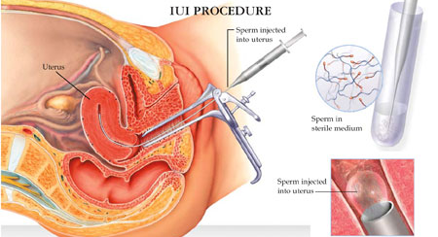

Slide 3
Introduction
Why should IUI be used as an intervention to resolve fertility problems?
When and how should IUI be used as an intervention to resolve fertility problems?

Slide 4
The rationale of IUI
Only 0.1% of spematozoa placed in the upper vagina were present in the cervical canal 1 h after inseminantion (Settlage et al. (1973)
Only 1 in every 14 million motile sperm deposited in the vagina reached the site of fertilization in the oviduct.
The rationale of IUI was to increase this gamete density at the site of fertilisation even when sperm or cervical mucus abnormalities are present.

Slide 5
In order to improve the quality and outcome of IUI procedures, there is a need for simple, inexpensive, reliable and safe sperm preparation techniques that isolate and select sperm cells with intact functional and genetic properties, including normal morphology, minimal DNA damage and intact cell membranes with functional binding properties (World Health Organization, 2010).

Slide 6
Seminal fluid acts as a transport medium for sperm, prostaglandins, ions and anti-oxidants.
Cells other than spermatozoa are also present in the ejaculate, including epithelial cells from the urinary tract, prostate cells, spermatogenic cells and leucocytes.
Reactive oxygen species, either produced by the different germ cells or by leucocytes, can be detrimental for the fertilizing potential of the spermatozoa (Aitken and Clarkson, 1987; Aitken and De Iuliis, 2010).
The seminal plasma also contains decapitation factor(s) that need to be removed for complete capacitation of the spermatozoa (Mortimer, 2000)

Slide 7
This process of capacitation is essential for both fertilization in vivo or in vitro, and hence spermatozoa to be used in IUI must be separated from the seminal plasma and its decapacitating factors.
Preparation of human semen samples should also result in the removal of non-viable spermatozoa, leucocytes and/or bacteria, and other sources of contamination.
Donor sperm is mainly cryopreserved and kept in quarantine for at least 6 months to prevent the transfer of infectious diseases.
Thawed sperm is mostly used for IUI as compared to intracervical insemination, as supported by older evidence (Besselink et al., 2008).

Slide 8
IUI in a historical perspective
After the first description of spermatozoa by Antoni van Leeuwenhoek and his assistant Johannes Ham in 1678 it took more than 100 years before the first IUI (in canine) was reported by Lazzaro Spallanzani in 1784 (Kremer, 1979;Moll, 2006).
This insemination resulted in the birth of three puppies 62 days later (Belonoschkin, 1956; Zorgniotti, 1975).
Before this, in 1770, John Hunter described the first case of human intravaginal insemination because of severe hypospadias.
In the mid-1800s J. Marion Sims reported on 55 intravaginal inseminations. Only one pregnancy occurred, which is probably explained by the fact that Sims believed that ovulation occurred during menstruation.
The first reports on human IUI originated from Guttmacher (1943) and Kohlberg (1953a, 1953b). This represents the start of a new era in assisted reproduction.

Slide 9
IUI in a historical perspective
Dr Jerome K. Sherman (1953) introduced a simple method of preserving human sperm using glycerol and reported the first successful human pregnancy with frozen sperm in 1953.
Due to the hostile climate for donor insemination (DI) at the time, nearly a decade passed before the first successful birth from frozen sperm was announcement in public (Sherman, 1964)

Slide 10
The renewed interest in sperm washing procedures owing to the introduction of IVF could be regarded as one of the most important milestones in the history of IUI (Steptoe and Edwards, 1978).
Sunde et al. (1988) reported the data of a European collaborative report on IUI describing 127 births in 20 clinics as a result of IUI with pretreated sperm.
In 1989 the results of the first prospective controlled trials were published describing the value of IUI in case of cervical hostility and male factor infertility (Friedman et al., 1989; te Velde et al, 1989).

Slide 11
The evidenced-based value of IUI as a treatment for cervical hostility, male factor and unexplained infertility was first described in 2004 (Cohlen, 2005).
Recent reports of Bensdorp et al.(2015) and Tjon-Kon-Fat et al. (2015) have shown that according to the results of a prospective multicentre trial, IUI–OS is recommended as the most cost-effective strategy for mild male factor or unexplained infertility with a poor prognosis of becoming pregnant with normal coitus (Bensdorp et al., 2015; Tjon-Kon-Fat et al., 2015).

Slide 12
Insemination of semen in humans was originally developed to help heterosexual couples to become pregnant in case of severe male factor infertility or of a physical or psychological nature, however, insemination with homologous semen nowadays is most commonly used for unexplained and mild male factor infertility.
In the previous century, DI was mainly used for male infertility caused by azoospermia or very low sperm count and for inherited genetic diseases linked to the Y- chromosome.
At present, DI is commonly used for individual women who desire a pregnancy.

Slide 13
Indications
Unexplained infertility/ mild endometriosis
Cervical factor infertility
Mild male factor
Disability (physical or psychological) preventing vaginal sexual intercourse
Conditions that require specific consideration in relation to methods of conception (such as after sperm washing in a couple where the male is HIV positive)

Slide 14
Mild male factor infertility:
Severe hypospadias
retrograde ejaculation
neurologic impotence
sexual dysfunction
oligospermia
low ejaculate volumes
asthenospermia
Sperm autoantibodies

Slide 15
Globalization of IUI
Despite the lack of IUI registration or incorporation of IUI procedures reported within IVF/ICSI registries in most countries, it is possible to assume that IUI is one of the, if not the, most popular methods of assisted reproduction worldwide, for different reasons.
Since IUI is a simple and non-invasive technique, it can be performed without expensive infrastructure resulting in IUI becoming the only treatment for male and unexplained infertility in resource-poor countries where IVF is either not available or not accessible for the majority of the population, owing to high costs (Ombelet et al., 2008).
These factors are responsible for a high couple compliance in IUI programmes when compared to IVF (Homburg, 2003)

Slide 16
Differences in multiple pregnancy rates
Unacceptable high multiple pregnancy rates (MPR) after IUI with OS treatment are described; this can most often be attributed to uncontrolled use of gonadotrophins for OS prior to insemination. Kohlberg (1953a, 1953b).
Using data from the National ART Surveillance System (NASS) of the Centres for Disease Control and Prevention, it was shown that from 2004 onwards non-IVF fertility treatments including ‘OS and IUI’ became the most highly associated treatment procedure with triplet and higher-order births in the USA (Kulkarni et al., 2013).
The 2011 European data mentioned a mean twin pregnancy rate of 9.7% and a 0.6% triplet pregnancy rate after IUI with homologous semen. However, these European data have to be compared with 18.6% twins and 0.6% triplets for IVF which includes ICSI (Kupka et al., 2016).

Slide 17
Lack of registration
Owing to the lack of registration of IUI and linkages to maternal health outcomes, data on indications, success rates and complications associated with IUI are scarce and in most countries not available or incomplete.
For example, data on ART generated from European national registries by ESHRE have been published since 2004, describing various ART outcomes since the year 2000.
However, IUI data were not collected by ESHRE until 2009, with the first publication including IUI data in the year 2013 (Ferraretti et al., 2013).
Fresh IVF (135 621 reported cycles) and ICSI (266084 reported cycles) resulted in a multiple delivery rate of 20.2%. Although incomplete, the data on 162 843 reported IUI cycles showed an 8.3% delivery rate per cycle with a multiple delivery rate of 11.1%.

Slide 18
Even now the delivery rate in the European register for the year 2011 was 21.7% per aspiration for IVF (130324 cycles) ,19.9% per aspiration for ICSI.
In the same year (2011) the delivery rate
was 8.3% for IUI using homologous semen (174 390 cycles) and 12.2% for IUI with donor semen (41 151 cycles) (Kupka et al., 2016).
Cumulative pregnancy rate after three or more IUIs were not often reported in the registries, with only a few research articles reporting on the value of IUI from a point of view of cost-effectiveness (Goverde et al., 2000; Philips et al., 2000).

Slide 19
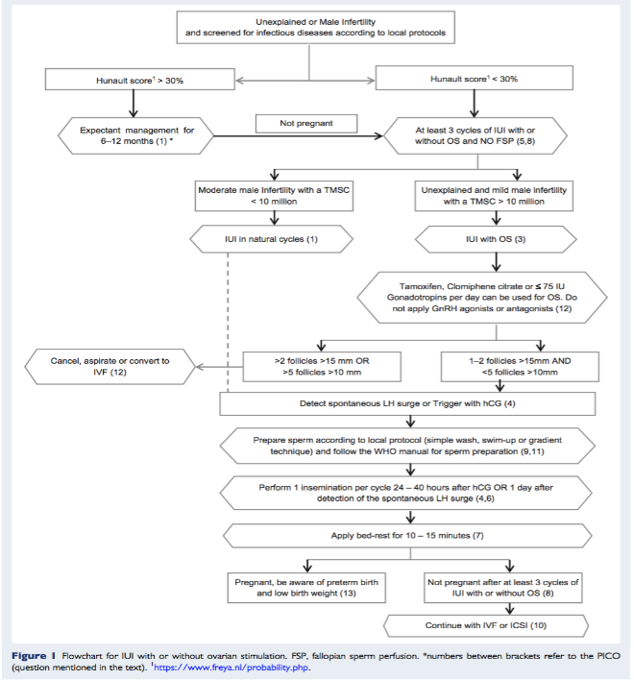

Slide 20
Question 1: What are the indications for IUI versus intercourse or expectant management in infertile couples and when should treatment be initiated?
In couples with unexplained infertility with a prognosis of becoming pregnant without assistance within the next 12 months (estimate >30%), IUI could be postponed for at least 6 months.
In couples with solely a poor sperm quality in the male partner, it is not recommended either for or against use of IUI.
In couples with unexplained infertility, IUI in natural cycles should not be offered although this recommendation is based on one trial only.

Slide 21
Unexplained infertility and IUI
The evidence for IUI in unexplained infertility was analysed by a Cochrane systematic review (Veltman-Verhulst et al., 2012). It was found that IUI alone does not seem to improve live birth rates significantly in natural cycles [odds ratio (OR) = 1.60, 95% CI: 0.92–2.78] but this conclusion was based upon one trial only. Although this one
trial by Bhattacharya et al. (2008) was graded as high quality, the findings should preferably be confirmed in other randomized trials.

Slide 22
Male infertility and IUI
IUI for male infertility is still under debate.
One of the major problems in male subfertility is the lack of validated definitions and strict cut-off values of sperm parameters to make a clear distinction between mild, moderate and severe male infertility.
A Cochrane systematic review by Bensdorp et al. (2007) analysed IUI (with or without OS) in patients with male infertility. Since there was no harmonized definition, all studies with various definitions of male infertility were included. The authors of this review concluded that there was insufficient evidence to recommend for or against IUI (with or without OS) in male infertility, mainly because large high quality randomized trials are lacking (Bensdorp et al., 2007).

Slide 23
A recently published large RCT showed us that IUI–OS is non-inferior to IVF in couples with unexplained and mild male infertility, defined as a total motile sperm count (TMSC) of 3–10 million. However, the number of included couples in this study with mild male infertility was relatively low (only 10% of total inclusions) (Bensdorp et al., 2015). Therefore, we were not able to recommend for or against IUI in couples with solely poor sperm quality.

Slide 24
Cervical factor infertility and IUI
A Cochrane systematic review by Helmerhorst et al. (2005) concluded that IUI with or without OS is not an effective treatment of cervical factor infertility (Helmerhorst et al., 2005).
Although more recent studies were published on this subject, most clinicians no longer support performing post-coital testing as part of a fertility check- up. Therefore, cervical factor is less often diagnosed, however, it is recognized that good practice indicates that for heterosexual couples where the male partner refuses semen analysis (e.g. for personal or cultural reasons) the post-coital test can be used to suggest that further evaluation of male factor infertility is indicated (evidence-based consensus to support this draft recommendation is reviewed by the diagnosis and management).

Slide 25
Research gaps
With the lack of high quality randomized trials investigating the effectiveness of IUI in male infertility, the question whether IUI should be applied in male infertility remains.
Furthermore, a clear and generally accepted definition of mild, moderate or severe male infertility, terms often used in IUI studies, is missing.
Ideally, the results of the trial by Bhattacharya et al. (2008) regarding IUI in unexplained infertility should be confirmed.

Slide 26
Question 2: When is OS required in an IUI cycle?
In couples with unexplained infertility with a prognosis of becoming pregnant without assistance within the next 12 months (estimate >30%), IUI could be postponed for at least 6 months.
In couples with unexplained infertility and men with a TMSC above 10 million, IUI should be combined with OS to improve live birth rates.
In couples with unexplained infertility and men with a TMSC > 10 million and a prognosis of spontaneous pregnancy <30% within a year, it is recommended that IUI plus OS are the treatments of first choice.

Slide 27
The rationale of OS is to achieve multifollicular growth. Van Rumste et al. (2008) showed that multifollicular growth resulted in significantly higher pregnancy rates compared to monofollicular growth (15 versus 8.4%). Compared to one dominant follicle, pregnancy rates increased by a further 5, 8 and 8% when two, three or four dominant follicles were present, respectively (van Rumste et al., 2008).

Slide 28
Cohlen et al. conducted a RCT comparing IUI with or without OS in male infertility. In couples with a TMSC < 10 million, OS did not improve pregnancy outcome, while it did in couples with a TMSC > 10 million (high level of evidence) (Cohlen et al., 1998).
For unexplained infertility, the Cochrane systematic review of Veltman-Verhulst et al. (2012) showed us that IUI without OS does not positively influence pregnancy outcomes. Adding OS to IUI significantly increases live birth rates in couples with unexplained infertility (OR = 2.07, 95% CI: 1.22–3.50, n = 396).
However, when there is still a reasonable chance of becoming pregnant through normal intercourse (Hunault score 30–40%) (Hunault et al., 2004, 2005), expectant management for at least 6 months should be the first option because in these good prognosis couples, IUI in cycles with OS does not improve live birth rates significantly [relative risk (RR) = 0.85, 95% CI: 0.63–1.1, n = 253] (Veltman-Verhulst et al., 2012). Furthermore, OS is a well-known risk factor for (high order) multiple pregnancy as described above.

Slide 29
Recently the results of the TUI study were presented at ESHRE 2017, where IUI–OS cycles with clomiphene citrate were randomly compared to expectant management in couples with unexplained infertility and a Hunault score below 30% (Farquhar et al., 2017). This trial showed that IUI–OS significantly increased cumulative live birth rates compared to expectant management (OR with 95% CIs: 3.4, 1.7–6.8). It remains unclear whether this positive effect is due to the OS, the insemination or the combination of both.

Slide 30
Another additional, more recent article was identified and screened to be relevant (Bensdorp et al., 2015). Bensdorp et al. (2015) conducted a RCT in which they analysed the cost-effectiveness between three cycles of IVF with single embryo transfer (SET), six cycles of IVF in a modified natural cycle (MNC) and six cycles of IUI–OS in patients with unexplained or mild male infertility with a Hunault score <30%. Couples with a pre-wash TMSC above 10 million were classified as unexplained infertility, while a TMSC between 3 and 10 million was classified as mild male infertility. Birth rates of a healthy child in the IVF–SET group, the IVF–MNC group and the IUI–OS group were 52, 43 and 47%, respectively (RR = 1.1 [95% CI: 0.9 1–1.34] comparing IVF–SET to IUI–OS, and RR = 0.91 [95%CI: 0.73–1.14] comparing IVF–MNC to IUI–OS).
MPR per ongoing pregnancy were 6, 5 and 7%, respectively (Bensdorp et al., 2015). Some have discussed whether the noninferiority design applied was appropriate for this randomized trial.

Slide 31
Research gaps
Now that it has become clear that IUI–OS is a first line treatment option for mild male and unexplained infertility, the question arises whether IUI, with or without OS, is beneficial for moderate male infertility as well. Furthermore, as mentioned above, a clear definition of mild or moderate male infertility is mandatory.

Slide 32
Question 3: What is the influence of sperm quality on IUI outcome? Can we define threshold levels for successful IUI?
It is not possible to define clear lower cut-off levels of pre- or post- wash sperm parameters below which IUI should be withheld.

Slide 33
A recent systematic review and meta-analysis clearly presents the lack of robust evidence for clear lower cut-off levels of sperm parameters in IUI treatment.
Based on very low quality of evidence, a TMSC > 1 million and a morphology > 4% are of possible prognostic value, in such a case that below these cut-off levels IUI should be withheld (Ombelet et al., 2014).
Van Weert et al. (2004) found the post- wash TMSC to be predictive for non-pregnancy but the lower cut-off levels varied tremendously between 0.8 and 5 million (van Weert et al., 2004).
We, therefore, could not define clear lower cut-off levels of pre- or post-wash sperm parameters below which IUI should be withheld.

Slide 34
Research gaps
Because the lower cut-off level of semen parameters below which IUI is no longer cost-efficient has not be clearly identified, a randomized trial comparing IUI with either conventional IVF or IVF/ICSI to define these lower cut-off levels is required before any conclusion can be drawn.

Slide 35
Question 4: When is the best timing of insemination in an IUI cycle? What is the optimal method of timing in natural or stimulated IUI cycles?
Providers can determine the method of triggering in IUI stimulated with gonadotrophins as there is no evidence to recommend for or against a method.
Providers can determine the method of timing IUI in natural cycles (no ovarian stimulation) as there is no evidence to recommend for or against a method.
If a HCG injection is used, single IUI can be performed any time between 24 and 40 h after HCG injection without compromising pregnancy rates.
IUI in a natural (not ovarian stimulated) cycle should be performed 1 day after LH rise.

Slide 36
The timing of insemination is one of the most important factors influencing the outcome of IUI (Cantineau et al., 2014).
There are various methods for timing IUI of which LH testing or monitoring follicle growth by ultrasound combined with HCG injection are the most applied methods.
In IUI–OS, HCG injections are most often used to trigger ovulation when the dominant follicle(s) reaches a mean diameter of ~18 mm.
In IUI in natural cycles, LH testing is the most applied method for timing. Less frequently used methods for timing are administration of a GnRH agonist or recombinant LH for triggering ovulation.

Slide 37
In a RCT of Kyrou et al. (2012) spontaneous triggering of ovulation was associated with significantly higher ongoing pregnancy rates compared with administration of HCG in patients undergoing IUI in natural cycles. They concluded that use of LH for timing ovulation might be the best way to maximize the probability of pregnancy for patients undergoing IUI (Kyrou et al., 2012).
On the other hand, a recent Cochrane systematic review was identified that had analysed the methods of timing in infertile women (Cantineau et al., 2014). They found no significant difference in live birth rates between HCG injection or LH surge (OR = 1.0, 95% CI: 0.06–18, one trial, n = 24), urinary HCG or recombinant HCG (OR = 1.17, 95% CI: 0.68–2.03, one trial, n = 284) or HCG versus GnRH agonist (OR = 1.04, 95% CI: 0.42–2.6, three trials, n = 104 women).
Regarding the method of timing, it is concluded that there is insufficient evidence to advise one method over another. The quality of the evidence was graded from low to moderate because of suspected imprecision (Cantineau et al., 2014).

Slide 38
Regarding the actual timing of the insemination after HCG administration, randomized trials were not able to detect significant differences in clinical pregnancy or live birth rates between various time frames that range from 24 to 48 h (Claman et al., 2004; AboulGheit, 2010; Rahman et al., 2011). It was therefore concluded that a more flexible approach (IUI between 24 and 40 h after HCG) will not com- promise pregnancy rates. The quality of the evidence was graded as moderate because of suspected imprecision.
A large well-designed RCT by Blockeel et al. (2014) showed that IUI in natural cycles should be performed 1 day after detection of the spontaneous LH surge. Clinical pregnancy rates were significantly higher when IUI was performed after 1day when compared with women undergoing IUI after 2 days (19.7 versus 11.1%, RR = 1.78, 95% CI: 1.11–2.88) (Blockeel et al., 2014). The analysis, however, was performed on a per cycle level. When analysing the results per participant, results were no longer significant, probably due to the limited number of included participants. The quality of the evidence is therefore graded as moderate.

Slide 39
Question 5: What is the value of fallopian sperm perfusion compared to IUI?
The intervention fallopian sperm perfusion (FSP), when compared to IUI, should not be the treatment of choice.

Slide 40
With regard to FSP, a technique that ensures the presence of higher sperm densities in the Fallopian tubes at the time of ovulation, the recommendation of this PICO is clear. Based on a recent Cochrane systematic review (Cantineau et al., 2013), without any more recent papers identified, the review was not able to show a beneficial effect of FSP on live birth rates per couple compared to IUI (OR = 0.94, 95% CI: 0.59–1.49), therefore, a draft recommendation is that IUI is the treatment of choice and the quality of this evidence was graded as high.

Slide 41
Question 6: What is the optimal number of inseminations per cycle?
In both unexplained and male infertility there is insufficient evidence that the intervention, a double IUI, within the same cycle will lead to better pregnancy rates than a single IUI within a cycle.
Women undergoing IUI should be offered a single insemination per cycle.

Slide 42
An assumption can be made that increasing the number of inseminations per cycle from one to two (or more) might increase the probability of a pregnancy in IUI treatment since more spermatozoa may be present at the moment of ovulation.
One Cochrane systematic review and two additional relevant systematic reviews were identified after a systematic search. One additional RCT not included in one of these systematic reviews was also identified. The Cochrane systematic review (Cantineau et al., 2003) found a significant difference in favour of double insemination (OR = 1.8, CI 95%: 1.4–2.4) in heterosexual couples with unexplained or male infertility. This observed effect is largely due to the contribution of one study with a weight of 66.5%; however, this study yielded an unclear risk of bias because allocation concealment was not mentioned.
Another systematic review (Zavos et al., 2013) compared single versus double insemination in male infertility. This review showed a significant benefit of double IUI in male infertility but, again, this effect was largely due to the same dominant study.

Slide 43
A third systematic review (Polyzos et al., 2010) analysed double versus single insemination in unexplained infertility. This meta-analysis showed that double IUI does not result in significantly higher pregnancy rates compared with single IUI in women with unexplained infertility. This was confirmed by a more recent RCT by Rahman et al. (2010).
The overall quality of evidence from systematic reviews was graded as moderate, mainly because of the dominating effect of one study, which did not clearly described allocation concealment.
Based upon our review it can be concluded that there is insufficient evidence for a beneficial effect of double insemination in couples with unexplained infertility. Yet, in the case of male infertility, there might be a positive effect. However, this was only proven by one study with an unclear risk of bias. We therefore provide a draft recommendation that women undergoing IUI should be offered a single insemination per cycle.

Slide 44
Research gaps
The number of inseminations per cycle is not well defined. Future large prospective cohort studies or randomized trials for each indication separately might help clinicians to advise couples or individuals about the number of inseminations per cycle.

Slide 45
Question 7: Is there a benefit of bed rest after IUI?
Women undergoing IUI, should have 10–15 min of bed rest after an insemination.

Slide 46
Studies on the intrauterine behaviour of spermatozoa have shown that spermatozoa already reach the Fallopian tubes within 5–10 min after insemination (Suarez and Pacey, 2006).
After vaginal intercourse, a large percentage of the semen is lost by ‘flow back’ and no more than 1% of the spermatozoa are retained in the female reproductive tract.
Thus, an assumed hypothesis is that immobilization in supine position after IUI could prevent direct loss of a large percentage of the spermatozoa and this action will improve fertility outcomes.

Slide 47
A systematic search resulted in the identification of two relevant articles. Saleh et al. (2000) randomized 95 heterosexual couples to either direct mobilization after IUI or immobilization in supine position for 10 min. Groups were rather unbalanced with 40 couples in the mobilization group and 55 couples in the immobilization group. After three cycles, pregnancy rates per couple were significantly higher in the immobilization group. No information on live birth rates was reported (Saleh et al., 2000).

Slide 48
Custers et al. (2009) performed a well-designed RCT in 391 heterosexual couples. They randomized between immobilization in a supine position for 15 min (n = 199) or immediate mobilization (n = 192) after IUI. Live birth rates after three cycles were significantly higher in the immobilization group: 27 versus 17%, respectively (RR = 1.6, 95% CI: 1.1–2.4) (Custers et al., 2009). Recently, results of a large RCT comparing immobilization for 15min versus direct mobilization were published. In total, 498 patients with either unexplained or mild male infertility were included. No significant difference in cumulative ongoing pregnancy rate was found (RR = 0.81, 95% CI: 0.63–1.02) (van Rijswijk et al., 2017). Pooling the data of the last two studies mentioned here showed a non-significant difference between mobilization and immobilization (OR = 1.00, 95% CI: 0.74–1.33) (Fig. 2). However, a sub-observational design of the studies. Based on this moderate quality evidence, a draft recommendation was developed to perform at least three cycles of IUI. There is insufficient evidence to recommend a maximum number of IUI treatment cycles.

Slide 49
The data of van Rijswijk et al. (2017) were not yet available at the time of the WHO guideline consensus meeting. Following the existing data at that time, immobilization for 10–15 min after IUI was determined to be an evidence-based draft recommendation. The overall quality of the evidence was considered to be moderate.

Slide 50
Question 8: What is the ultimate number of consecutive IUI cycles per couple/woman in which pregnancy rates still increase significantly?
In couples with an indication for IUI at least three consecutive IUI cycles should be performed.
There is insufficient evidence to recommend a maximum number of IUI treatment cycles.

Slide 51
The number of IUI cycles per patient is an important item to discuss when starting IUI treatment. An important factor to take into account is the pregnancy chances of additional IUI cycles. Three to
six cycles of IUI has become common practice worldwide and the INeS-trial from Bensdorp et al. (2015) showed us that six cycles of IUI–OS is still cost-effective compared to direct IVF in patients with unexplained and mild male infertility (Bensdorp et al., 2015).
But is there evidence to perform more cycles? Two relevant studies were found: Custers et al. (2008) and Aboulghar et al. (2001).

Slide 52
Custers et al. (2008) performed a retrospective cohort study among 3714 women that had undergone 15 303 treatment cycles. Analysis was limited up to the ninth treatment cycle (15 245 cycles). There were 935 ongoing pregnancies, resulting in a mean ongoing pregnancy rate of 5.6% per cycle. The ongoing pregnancy rates were relatively high in the first two cycles, with 7.4 and 7.0%, respectively, compared with ~5% in higher order cycles. The cumulative clinical pregnancy rate after three cycles was 18%, which increases to 30 and 41% after six and nine cycles, respectively (Custers et al., 2008). Aboulghar et al. (2001) conducted an observational prospective study in 594 women with unexplained infertility.
All participants had one to three cycles of treatment and 91 participants underwent four to six cycles of IUI–OS after failing to achieve pregnancy in the first three cycles. The clinical pregnancy rate per cycle was significantly higher in the first three cycles compared to the second three cycles (P < 0.001) first three cycles compared to the second three cycles (P < 0.001) (Aboulghar et al., 2001).
The overall quality of the evidence was graded as low to moderate mainly because of the retrospective and observational design of the studies. Based on this moderate quality evidence, a draft recommendation was developed to perform at least three cycles of IUI. There is insufficient evidence to recommend a maximum number of IUI treatment cycles.

Slide 53
Research gaps
The number of IUI cycles that couples or single women should be offered is not well defined. Future large prospective cohort studies or randomized trials for each indication might help clinicians to advise couples or individuals when to switch to IVF.

Slide 54
Question 9: Which semen preparation technique used yields the best results (in terms of pregnancy rates) for IUI?
According to the available evidence, it is not possible to recommend any semen preparation technique over another (swim-up, gradient, wash and centrifugation).

Slide 55
Currently, there are three semen preparation techniques that are routinely used worldwide:
a simple dilution and washing technique,
a swim-up technique and
use of density gradient centrifugation.
Whether one of these techniques is preferable was the subject of a Cochrane systematic review (Boomsma et al., 2007). Only one additional article was identified related to this subject, which has not yet been included in this Cochrane systematic review (Karamahmutoglu et al., 2014). The Cochrane systematic review analysed five RCTs comparing two or three techniques with each other. Heterogeneity concerning included indications might be suspected since they vary widely over the five studies or were not described clearly.
The review found no significant difference in pregnancy rates among semen preparation techniques: swim up versus gradient technique (OR = 1.57, 95% CI :0.74–3.32); swim up versus wash and centrifugation (OR = 0.41, 95% CI: 0.41–1.10) or gradient technique versus wash and centrifugation (OR = 1.76, 95% CI: 0.71–5.44).

Slide 56
Karamahmutoglu et al. (2014) randomized 223 couples with unexplained and mild male infertility to either the swim up technique or the gradient technique. They found a significantly higher ongoing pregnancy rate per patient after the gradient technique compared to swim up: 23.4 versus 10.7%, respectively (P < 0.05). A subgroup analysis revealed that this difference was significant only in couples with unexplained infertility (Karamahmutoglu et al., 2014).

Slide 57
The overall quality was graded as low across all studies because of the suspected clinical heterogeneity, unclear descriptions of randomization and allocation in almost all included studies, and a low number of couples in the relevant comparisons.
Therefore, according to the available evidence it was not possible to recommend any semen preparation technique over another (swim-up, gradient, wash and centrifugation).

Slide 58
Research gaps
It remains unclear which semen preparation technique is superior (expressed as live birth rate per couple) in case of either unexplained or male infertility, therefore, a multi-center randomized trial comparing various techniques is recommended.

Slide 59
Question 10: What is the cost-effectiveness of IUI versus IVF/ICSI?
In couples with unexplained infertility and men with a TMSC of >10 million and a prognosis of a pregnancy without assistance <30% within a year, at least three cycles of IUI–OS is the most effective option.

Slide 60
The goal of research on cost-effectiveness is to maximize health outcomes with a minimum use of resources. As costs linked to fertility care in many countries are not covered by government or insurance companies, the relative cost-effectiveness of fertility treatments is a very important consideration (Moolenaar et al., 2014).
Health care systems can become burdened by high costs associated with premature infants who are born from multiple gestations as a result from unregulated fertility treatments (Chambers and Ledger, 2014). Therefore, cost- effectiveness studies in fertility are important not only to the individual and family but also to health care systems and society.

Slide 61
Moreover, the outcome most often reported is the cost per delivery of at least one child and this outcome parameter does not include the substantial costs of caring for premature infants owing to the high rates of multiple gestations.
On the other hand, there is the potential to consider twins as perhaps eliminating the need for future fertility treatments for some couples or individuals.
However, this comes with a clear understanding of the maternal and perinatal morbidity and mortality outcomes of twin pregnancies in a local context.
All of these factors have to be considered when studying the cost-effectiveness of IUI and IUI–OS.

Slide 62
Many retrospective cohort cost-effectiveness studies have compared IUI, IUI–OS and conventional IVF in couples and individuals with differing causes of infertility.
Most large cohort or randomized studies from individual centres have found IUI alone or IUI–OS to be the most cost-effective first line therapy for heterosexual couples with infertility linked to cervical factor, endometriosis, unexplained infertility and relatively mild male factor infertility (Van Voorhis et al., 1997; Guzick et al., 1998; Goverde et al., 2000), but the retrospective designs make it difficult to draw firm conclusions.

Slide 63
For male factor infertility several studies have been identified that support the concept of threshold values for sperm parameters below which IUI becomes significantly less effective (Ombelet et al., 2014; Moolenaar et al., 2015). Moolenaar et al. (2015) studied the cost-effectiveness of interventions for male infertility according to the TMSC.
A computer- simulated cohort of infertile women with a partner with a pre-wash TMSC of 0–10 million was investigated. They compared IUI with and without OS, conventional IVF and IVF/ICSI. Live birth rate was the main outcome parameter. Study results showed that above a pre-wash TMSC of 3 million, IUI is less costly than conventional IVF, and below a pre- wash TMSC of 3 million IVF/ICSI is less costly. However, these findings need to be confirmed in a large randomized trial.

Slide 64
Contradictory results are published concerning the cost-effectiveness of IUI in heterosexual couples with unexplained infertility (Guzick et al., 1998; Goverde et al., 2000; Pashayan et al., 2006; van den Boogaard et al., 2014; Wordsworth et al., 2011).
A multi-centre RCT from Scotland (graded as high quality evidence) compared the out- comes of 6 months of natural cycle IUI, clomiphene citrate stimulation followed by normal intercourse and expectant management in couples with 2 years of unexplained infertility (Bhattacharya et al., 2008). Live birth rates were not significantly different with 32/193 (17%) for expectant management, 26/192 (14%) for clomiphene citrate- intercourse and 43/191 (23%) for natural cycle-IUI. The authors recommended that IUI–OS should be the subject of future trials for unexplained infertility.

Slide 65
Most of the large retrospective cohort studies on cost- effectiveness tend to become ‘dated’ as both costs and outcomes change over time. It is well known that IVF clinical pregnancy rates have increased steadily over time and high order multiple births have declined, as there has been increased emphasis on the value of transferring less embryos. These changes have made conventional IVF a more attractive option from a cost-effective point of view when com- pared to IUI or IUI–OS. van Rumste et al. (2014) stated in an economic analysis comparing IVF with elective transfer of a single embryo (eSET) with IUI–OS that when IVF–eSET would result in an ongoing pregnancy rate of more than 38%, IVF would be the preferred treatment (van Rumste et al., 2014).
Only a few prospective randomized trials have compared natural cycle IUI, IUI–OS and conventional IVF.

Slide 66
In couples with male factor and unexplained infertility, Goverde
et al. (2000) compared three treatment arms; IUI alone, HMG–IUI
and conventional IVF, each performed for up to six cycles. The costs
in this study were calculated through 12 weeks of pregnancy and
neglecting the high costs associated with multiple gestations.
According to this study, IUI was as effective as IVF, and IUI–OS did not yield higher pregnancy rates when compared with natural cycle IUI. They conclude that IUI was the most cost-effective first line therapy for the infertile heterosexual couple. Furthermore, IUI was better tolerated by couples while IVF was associated with a higher drop-out rate (Goverde et al., 2000). A big criticism against this study was an extremely low IVF pregnancy rate of 12.2% per cycle, a value that is clearly out-dated. Even after careful monitoring and using low doses of FSH (75 IU/day) the MPR was 27% in the IUI–OS arm demonstrating the risky nature of this treatment.

Slide 67
A significant increase in pregnancy rates has been observed with IVF and IVF/ICSI during the last decade, however, similar increases have not been reported with IUI treatments. If the singleton delivery rate per cycle can be improved, IVF or IVF/ICSI may become the favoured first line treatment for most causes of infertility (van Rumste et al l., 2014). On the other hand it might be that a better selection of

Slide 68
Research gaps
Clear definitions of mild or moderate male infertility should be established before randomized trials can be started to define lower threshold levels of sperm parameters below which IUI with or with- out OS is no longer cost-effective and IVF or IVF/ICSI should be the first line treatment option.

Slide 69
Question 11: How can you prevent infections in an IUI laboratory?
Good practice point: Couples and individuals undergoing IUI and males providing semen samples for IUI should be screened for infectious agents based on local, regional and national standards and regulations.

Slide 70
In this era of semen preparation, infection is a lesser problem especially when managed in higher income settings. In some lower and middle-income countries and settings prevention of infections remains a critical issue.
It is generally recommended that couples and individuals undergoing IUI and/or males providing semen samples for IUI should be screened for infectious agents based on local, regional and national standards and regulations.
Furthermore, facilities for performing semen preparation for IUI should meet the criteria of the WHO laboratory safety manual for reducing the risk of infection.
Studies are lacking concerning the prevention and transmission of viral diseases in IUI treatment and thus these guidelines are therefore based upon best practice, guidelines associated with prevention of sexually transmitted infections, and local regulatory guidelines (good practise point).

Slide 71
Research gaps
We recommend to compare various sperm preparation techniques in multi-center randomized trials both for success rates concerning the elimination of transmission of infectious diseases to both partners, and to offspring (Zafer et al., 2016).

Slide 72
Question 12: How can you prevent multiple pregnancies and OHSS in an IUI programme?
In order to prevent high rates of multiple gestation pregnancies in IUI–OS, IUI should be withheld when more than two dominant follicles >15 mm or more than five follicles >10 mm at the time of HCG injection or LH surge are present.
When gonadotrophins are used in IUI, regiments with 75 IU or lower should be used because higher doses have similar pregnancy rates but increase multiple pregnancy rates.
Clomiphene citrate or tamoxifen are acceptable alternatives to low dose gonadotrophins for low multiple pregnancy and birth rates and with lesser costs, although at a lower live birth rate than with gonadotrophins.

Slide 73
Addition of GnRH agonist to gonadotrophins in IUI–OS is not recommended because there is no increase in pregnancy rate despite increased multiple pregnancy rates and increased costs.
Good practice point: As an alternative to cycle cancellation, aspiration of excess follicles at the time of HCG injection or LH surge might be additional options for reducing the risk of multiple pregnancy in IUI–OS.

Slide 74
The most common side effects of IUI in cycles with OS are mul-
tiple pregnancies and ovarian hyperstimulation syndrome (OHSS).
Multiple pregnancies carry increased risks of pregnancy complications
and diminished neonatal outcome, such as preterm delivery, growth
retardation and pre-eclampsia. High MPRs are mainly caused by mul-
tifollicular growth following OS. Measures to prevent multiple preg-
nancies can be divided into primary and secondary measures. Primary
measures include attempting to prevent the growth of more than
two to three dominant follicles, as showed by van Rumste et al.
(2008) in a systematic review and meta-analysis including 14 studies
(11599 IUI cycles) (moderate quality of evidence). Multifollicular
growth resulted in significantly higher pregnancy rates compared to
monofollicular growth (15 versus 8.4%). Compared with one dominant follicle, pregnancy rates increased by a further 5, 8 and 8%, respectively, when two, three or four dominant follicles were pre- sent. Subsequently, the risk of multiple pregnancies after two, three and four dominant follicles increased, at 6, 14 and 10%, respectively (van Rumste et al., 2008).

Slide 75
Another primary measure to prevent multiple pregnancies is to apply the appropriate drug and doses, and to individualize the doses when possible. Clomiphene citrate (100 mg per day for 5 days) or tamoxifen are acceptable alternatives to low dose gonadotrophins for low multiple birth rates and also result in lower costs, although at a lower live birth rate (Cantineau et al., 2007) (moderate quality of evi- dence). In this systematic review of Cantineau et al. (2007), signifi- cantly higher pregnancy rates were found with gonadotrophins compared to anti-oestrogens (OR = 1.8, 95% CI 1.2–2.7, n = 556, moderate quality of evidence). Two more recent high quality evi- dence RCTs confirmed the outcomes of the Cochrane systematic review. In these trails, compared to clomiphene citrate, gonadotro- phins showed significantly higher live birth rates and comparable, rela- tively low MPRs of between 3.6 and 12.5% (Erdem et al., 2015; Peeraer et al., 2015).

Slide 76
The Cochrane systematic review concluded also that there is no
benefit in using Letrozole compared to clomiphene citrate (pregnancy
rate per couple: OR = 1.2, 95% CI: 0.64–2.1) based upon moderate
quality evidence. High level evidence shows that when gonadotrophins
are used in IUI, regiments with 75 IU or lower should be used as higher
doses have similar pregnancy rates while increasing MPRs (Cantineau
et al., 2007; Erdem et al., 2015; Peeraer et al., 2015). Currently an
ongoing large multi-centre trial is attempting to identify factors that might
predict ovarian response with low dose gonadotrophin stimulation and thus might help to individualize stimulation doses in the future
13 PRORAILS study, NCT01662180). Based upon moderate quality evi- dence, addition of GnRH agonist or antagonist is not recommended for our draft evidence-based guideline, because there is no increase in preg- nancy rate despite increased MPRs and costs (Cantineau et al., 2007). Cycles should be closely monitored by regular vaginal ultrasounds and when more than two to three follicles larger than 15 mm, or when more

Slide 77
than five follicles larger than 10 mm are seen, secondary measures can be advocated (moderate quality of evidence) (van Rumste et al., 2008). Of course, cycles can be cancelled and heterosexual couples should be advised to abstain from unprotected intercourse. As an alternative to cycle cancellation, aspiration of excess follicles at the time of HCG injec- tion or LH surge, or conversion to IVF, might be additional options for reducing the risk of multiple pregnancy (good practice point). Finally, multifetal reduction can be proposed when a multiple pregnancy is

Slide 78
multifetal reduction can be proposed when a multiple pregnancy is observed (Dodd et al., 2015). However, multifetal reduction should be prevented at all costs with the above-mentioned measures for preven- tion of multiple pregnancies with IUI (good practice point).

Slide 79
retardation and pre-eclampsia. High MPRs are mainly caused by mul-
tifollicular growth following OS. Measures to prevent multiple preg-
nancies can be divided into primary and secondary measures. Primary
measures include attempting to prevent the growth of more than
two to three dominant follicles, as showed by van Rumste et al.
(2008) in a systematic review and meta-analysis including 14 studies
(11599 IUI cycles) (moderate quality of evidence). Multifollicular
growth resulted in significantly higher pregnancy rates compared to
monofollicular growth (15 versus 8.4%). Compared with one domin-
ant follicle, pregnancy rates increased by a further 5, 8 and 8%, stimulation in IUI programmes. Many randomized trials comparing
OHSS is very rare in IUI–OS treatment because the aim of the stimulation protocol should be two to three dominant follicles (van Rumste et al., 2008). Regular ultrasound monitoring should identify any hyper-response early, such that HCG to induce ovulation can be withheld to avoid OHSS. With an adequate programme to prevent multiple pregnancies, OHSS should be rarely encountered.

Slide 80
Research gap
There is still debate regarding the mos cost-effective drug for mild stimulation in IUI programmes. Many randomized trials comparing gonadotrophins with clomiphene citrate or letrozole have been pub- lished but the results are contradictory and often these trials are of (very) low quality. A large multi-center trial comparing gonadotro- phins with clomiphene citrate is ongoing in the Netherlands (SUPER trial NTR4057) and might be able to answer the question as to which strategy is the most cost-effective when addressing side effects and maternal and neonatal morbidity, and mortality associated with multiple pregnancies.

Slide 81
Question 13: Is there a different perinatal outcome for IUI pregnancies and how does this perinatal outcome differ from normal coitus and IVF/ICSI pregnancies?
Individuals with infertility undergoing treatment with IUI–OS should be informed about a possible increased risk for preterm birth and low birth weight in singletons and twin pregnancies when compared to pregnancies in fertile couples not requiring assistance. (IVF/ICSI outcome comparisons are assessed in the IVF/ICSI prioritized guideline.)

Slide 82
Nuojua-Huttunen et al. (1999) using the data obtained from the Finnish Medical Birth Register, IUI treatment did not increase obstetric or perinatal risks compared with matched pregnancies through normal coitus or IVF pregnancies (Nuojua-Huttunen et al., 1999). Wang et al. (2002) examined preterm birth in 1 015 IUI/artificial insemination by donor (AID) singletons compared to 1 019 IVF/ICSI and 1 019 medically unassisted singletons. Singleton IUI/AID births were ~1.5 times more likely to be born preterm than medically unassisted singletons, whereas the IVF/ICSI group were 2.4 times more likely to be born preterm. They found no significant difference in the risk of preterm birth for IUI with partner or donor semen (7.0 versus 7.5%, respectively) (Wang et al., 2002).

Slide 83
In a retrospective cohort study, Gaudoin et al. (2003) described a poorer perinatal outcome of singletons born to infertile mothers through OS–IUI compared to matched medically unassisted pregnancies within the Scottish national cohort.
The difference in perinatal outcome was caused by a higher incidence of prematurity and low-birthweight infants. The poor perinatal outcome of singletons after OS–IUI was associated with low birthweight, but only when IUI was
performed with partner’s semen and not with donor semen (Gaudoin et al., 2003).
In a matched case–control study, De Sutter et al. (2005) did not observe a difference in pregnancy outcome in IUI versus IVF gestations (De Sutter et al., 2005).

Slide 84
Two large cohort studies comparing the perinatal outcome after
OS and/or IUI with medically unassisted pregnancies or IVF/ICSI
pregnancies were performed in Flanders, Belgium (Ombelet et al.,2006). Data were obtained from the Study Centre for Perinatal Epidemiology of Flanders. In the first study the outcome from 661 065 births could be investigated. All women were matched for maternal age, parity, foetal sex, plurality, place and year of birth.
A significantly higher incidence of extreme prematurity (<32 weeks), very low birthweight (<1500g), stillbirths and perinatal death for OS–IUI singletons could be observed.
Twin pregnancies resulting from OS–IUI showed a higher rate of neonatal mortality, assisted ventilation and respiratory distress syndrome when compared to medically unassisted twin pregnancies.

Slide 85
In the second study (Ombelet et al., 2016) 1 039 415 singletons and 39 041 twins were available for analysis. Following logistic regression analyses, it was shown that IVF/ICSI singletons had a significantly worse outcome when compared to OS–IUI and medically unassisted pregnancies for almost all investigated perinatal parameters. OS singletons were also significantly disadvantaged for birthweight and pre-
maturity when compared to pregnancies obtained through normal coitus. The outcome of twin pregnancies was similar for the threegroups unless only unlike-sex twins were studied separately.
Among this subgroup, IVF/ICSI carried a higher risk for low birthweight when compared to medically unassisted pregnancies.

Slide 86
In a retrospective cohort study, Poon also observed that perinatal outcomes after IUI/clomiphene citrate pregnancies represent an intermediate risk between IVF/ICSI and pregnancies obtained through normal coitus (Poon and Lian, 2013).
A national cohort study in Denmark on 6338 singletons born after IUI showed an increased risk of adverse perinatal outcomes compared with children born after normal coitus. Stimulation with clomiphene citrate was associated with higher risk of small for gestational age compared with natural cycle IUI (Malchau et al., 2014).

Slide 87
The reason why perinatal health problems occur more frequently after IUI is still unknown, but can be explained by the procedures itself, the endocrine changes caused by OS medication or the underlying reason for infertility (Simpson, 2014).
In a structured review Pinborg et al. (2013) concluded that infertility is a major risk factor for adverse perinatal outcome for singletons, and even in the same mother an ART singleton has a poorer outcome than the non-ART sibling (Pinborg et al., 2013). This could mean that factors related to the hormone stimulation and/or ART methods per se may play a role.

Slide 88
Both OS–IUI and IVF/ICSI are associated with an increased risk for multiple pregnancies.
It has been shown that spontaneous reduction of multiple pregnancies causes a higher risk for adverse obstetric and perinatal outcome compared to pregnancies without spontaneous reduction. More than 10% of IVF/ICSI singletons are the result of a vanishing twin, and the poorer perinatal outcome of singletons born to infertile mothers 10% of IVF/ICSI singletons are the result of a vanishing twin. Survivors of a vanishing co-twin have a higher risk for prematurity and low birthweight compared to singletons from single gestations, the higher the gestational age at foetal demise, the higher the risk for the surviving co-twin (Pinborg et al., 2007). This phenomenon can explain, at least partly, the worse peripregnancies born without medical assistance.

Slide 89
Other prognostic factors influencing IUI success
Female age:
is the most relevant predictor of the probability of clinical pregnancy in IUI treatment and moderate quality evidence-based data show that a sharp decline of IUI success rate is observed in women over the age of 40 years, which is presumably related to oocyte quality (Yarde and Broekmans, 2014).
In heterosexual couples with unexplained infertility, IUI treatment should be limited to women with female age under 40 years, although IUI may be encouraged to continue up to 42 years when donor sperm is used (Veltman-Verhulst et al., 2012).
Whether IVF or ICSI should be recommended as a first line therapy when the female is in her late 30s or above 40 years of age is still debatable and more studies are needed to examine the cost-effectiveness of such an approach (Yarde and Broekmans, 2014).

Slide 90
Male age:
seems to have no profound effect when the female partner or sperm recipient is younger than 35 years but a synergistic adverse
effect seems to exist when the woman is older than 35 years and the
man as well (Mathieu et al., 1995).
A possible explanation may be a decline in sperm quality with increased male age, especially for semen volume, sperm motility and sperm morphology, but not for sperm count (Kidd et al., 2001).
Therefore, men in a heterosexual relationship (or identified as sperm donor) with a female partner above 35 years should be informed that increasing paternal age (40 years and above) has a potential negative impact on IUI success rates (De Brucker and Tournaye, 2014).
Moreover, oxidative stress-induced mitochondrial DNA damage and nuclear DNA damage in aging men may put them at a higher risk for transmitting multiple genetic and chromosomal defects (Desai et al., 2010).

Slide 91
In a structured review Ombelet et al. (2014) investigated which sperm parameter in the native and washed semen sample influences success rates after IUI. Their search indicated a lack of prospective studies, a lack of standardization in semen testing methodology and a huge heterogen- eity of patient groups and IUI treatment strategies. The review identified an urgent need for more and better prospective cohort trials investigating the predictive value of semen parameters on IUI success rates.

Slide 92
The four sperm parameters most frequently examined were:
inseminating motile count after washing: cut-off value between 0.8
and 5 million; sperm morphology using strict criteria: cut-off value
>4% normal morphology; total motile sperm count in native sperm
sample: cut-off value of 5–10 million; and total motility in native sperm sample: threshold value of 30%.

Slide 93
S/A
Several studies support the concept of threshold values for sperm parameters below which IUI becomes significantly less effective. Most important are sperm morphology with a threshold value of 4% (Van
Waart et al., 2001; Ombelet et al., 2014) and the TMSC either in the ejaculate (an average of 10 million total motile sperm in at least two samples) or in the post-wash inseminating motile count (between 0.8 and 5 million motile sperm) (van Weert et al., 2004; Ombelet et al., 2014). When using these threshold values, a poor sensitivity for predicting pregnancy but high specificity for predicting failure to become pregnant with IUI could be observed.

Slide 94
ET
Ultrasound parameters can also be used to provide important information on egg quality and endometrial receptivity that will optimize the chances of success in an IUI programme. However, robust evidence is lacking and the role of Doppler assessment in the ovaries and endometrium needs to be studied in future randomized trial (Bhal et al., 2001; Nargund et al., 2014).
Endometrial thickness is another important factor predicting endometrial receptivity. It has been shown that endometrial thickness in stimulated IUI cycles is lower than in IVF cycles and is lower in cycles stimulated with clomiphene citrate compared with natural non-stimulated cycles (Randall and Templeton, 1991).
A recent systematic review and meta-analysis on pre-ovulatory endometrial thickness in IUI treatment (n = 3846) showed that women treated with clomiphene citrate had a significantly thinner endometrial thickness than women treated with gonadotrophins [n = 383, mean difference endometrial thickness and pregnancy rates (MD: 0.51, 95% CI: −0.05 to 1.07). (Veltman-Verhulst et al., 2012)

Slide 95
However, pooling of seven relevant studies (n = 1525) did not reveal an association between endometrial thickness and pregnancy rates (MD: 0.51, 95% CI: −0.05 to 1.07). Also, after a sensitivity analysis, the results remained nonsignificant. The authors therefore concluded that endometrial thickness is not a good prognostic factor for IUI treatment success (low to moderate quality of evidence)(Weiss et al., 2017).

Slide 96
BMI
Studies on the influence of the BMI and obesity on IVF success rates are contradictory. In a population-based cohort study Petersen et al. (2013) showed that an increased female and male BMI, both independently and combined, negatively influenced live birth rates after IVF treatments (Petersen et al., 2013). In another prospective cohort study, weight status did not influence fecundity among heterosexual couples of weight on IUI outcome remains unclear. Contradictory results were published in two retrospective analyses investigating the influence of BMI on IUI success: in one study a BMI of 25 kg/m2 or more in the while in the second study a BMI of <25 kg/m2 was positively correlated with clinical pregnancy rates after IUI (Yavuz et al., 2013)

Slide 97
In most studies, it seems that a woman’s BMI is not a determining factor for success rate after IUI although obese women require higher doses of medication.
Once medication is adjusted to overcome the weight effect, the success rate is comparable for obese and normal weight women (Dodson et al., 2006; Souter et al., 2011; Isa et al., 2014; Petrozza et al., 2014; Thijssen et al., 2017a, 2017b).
In addition, an underweight BMI. However, the advice to patients should be focused not only on ensuring optimal treatment outcomes, but also promoting the best obstetrical outcomes because a high BMI is undoubtedly associated with adverse obstetrical and perinatal outcome (Petrozza et al., 2014).

Slide 98
Smoking
Studies on the influence of the smoking status on IUI success rates are almost non-existent. It was shown that female smokers undergoing IUI–OS need significantly more gonadotrophins than non-smokers in order to achieve a comparable clinical pregnancy rate (Farhi and Orvieto, 2009).
However, smoking was not significantly associated with a chance of becoming pregnant after secondary analyses of data from a prospective, randomized, multi-center ‘Assessment of Multiple Intrauterine Gestations from Ovarian Stimulation’ (AMIGOS) clinical trial (Hansen et al., 2016). However, focus would need to be placed on obstetrical and perinatal outcome because of the detrimental effects of smoking.

Slide 99
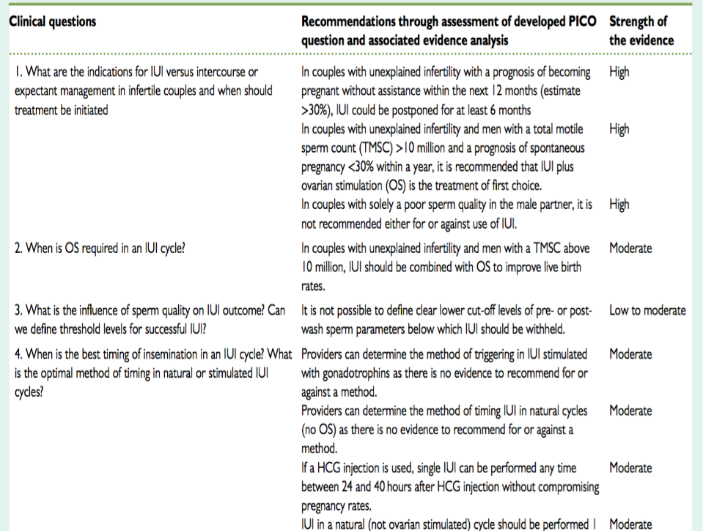

Slide 100
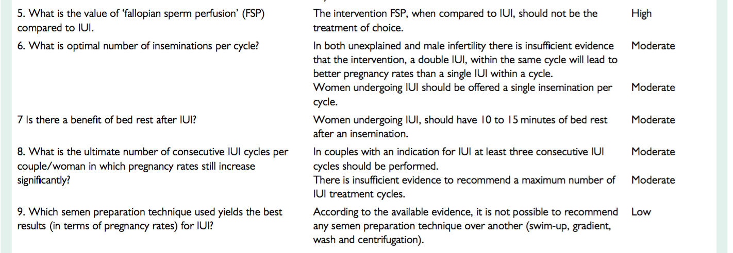

Slide 101
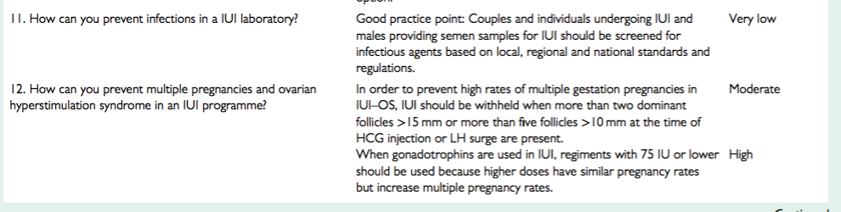

Slide 102
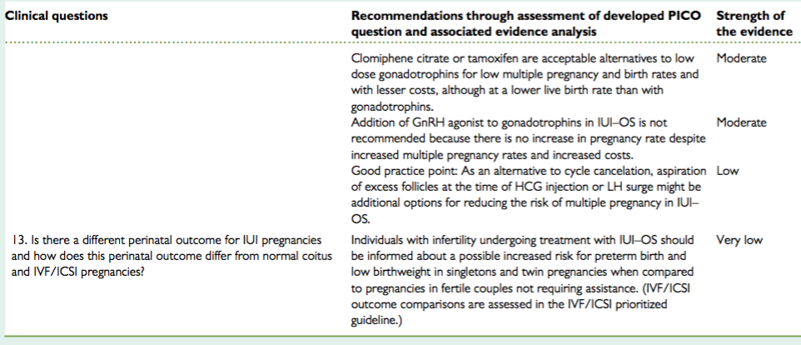

Slide 103
Complications of intrauterine insemination
Related to IUI procedure
Trauma
Infection
Bleeding
Pain/cramping

Slide 104
Related to COS
Multiple pregnancy
Monitoring
Cost
OHSS

Slide 105
Remote
Ectopic pregnancy
Abortion
Pelvic inflammatory disease
Psychological

Slide 107
Prognostic factors for intrauterine insemination
1-Pre-cycle (non-modifiable)
Age of female
• BMI
• Duration of infertility
• Infertility aetiology
• Single or multiple factors
• Number of IUI cycles

Slide 108
2-During IUI cycle
Stimulated or natural
Ovarian stimulation: CC/letrozole/Gn
Type of Gn: recombinant versus urinary
Prevention of premature LH surge: use of GnRH analogues
Mono-follicular/multi-follicular
Endometrial thickness

Slide 109
Ovulatory trigger
Timing of IUI: ovulation, semen collection, preparation, and insemination
Semen parameters
Semen preparation method
Number of inseminations
Easy or difficult IUI
Type of catheter

Slide 110
3-Post-IUI
Abstinence
Immobilisation
Luteal phase support

Slide 111
WHO 2010
Fifth edition (30 years from 1st edition, 1980)
Reference range is derived from 4500 SA characterizing semen quality of fertile men whose partner had time to pregnancy of 12 months or less
No high value reference range is given as it is not considered detrimental to fertility
The WHO 2010 criteria is a guideline to improve semen analysis and sperm preparation, not obligatory

Slide 112
WHO 2010
Parameter | Lower Reference Limit
Semen volume (ml) | 1.5
Sperm concentration (10⁶/ml) | 15
Total sperm number (10⁶/ejaculate) | 39
Progressive motility (PR, %) | 32
Total motility (PR +NP, %) | 40
Vitality (live sperms, %) | 58
Sperm morphology (NF, %) | 4
pH* | >/=7.2
Leucocyte* (10⁶/ml) | <1
MAR/Immunobead test* (%) | <50

Slide 113
Normal values from WHO manuals, editions 2- 4 and lower reference limits from new 5th WHO manual (2010)
Semen parameter | WHO edition and year
 | 2nd - 1987 | 3rd - 1992 | 4th - 1999 | 5th - 2010
Volume (ml) | 2.0 | 2.0 | 2.0 | 1.5
Sperm concentration (10⁶/ml) | 20 | 20 | 20 | 15
Total sperm count (10⁶) | 40 | 40 | 40 | 39
Motility (% progressive) | 50 | 50 | 50 | 32
Vitality (% live) | 50 | 75 | 75 | 58
Morphology (% normal) | 50 | 30 | (15) | 4
Cooper, 2007 (ESHRE campus meeting)

Slide 114
For the diagnosis of male subfertility, the total motile sperm count (TMSC) can be calculated from the semen analysis: volume (ml) × concentration (10*6/ml) × progressive motility (%)
Three crude groups of male subfertility:
Mild male subfertility with a TMSC > 3 × 10*6
Moderate male subfertility with a TMSC 1–3×10*6
Severe male subfertility with a TMSC < 1 × 10*6
If male subfertility is diagnosed, semen preparation should be part of the fertility work-up to establish the so-called, postwash TMSC.
In the mild and moderate group, IUI can be considered if the postwash TMSC lies between 0.8×10*6 and 5×10*6 motile spermatozoa. This implicates that in the moderate male subfertility group IUI can seldom be performed, because there is an approximate loss of motile spermatozoa of 70% with preparation.
The amount of motile spermatozoa after preparation depends on the preparation technique used.

Slide 115
Sperm preparation
The semen is a mixture of motile and dead spermatozoa with cells, cellular debris and sometimes micro-organisms present.
A variety of methods have been developed to separate the motile sperms from the ejaculate. The most common methods are washing and centrifugation which has been shown to cause some damage to the sperm.
Simple sperm wash
Swim up
Gradient
All preparations should done in a laminar flow for sterility [Dale & Elder, 1997].
The clean sperm suspension is used for IUI, IVF and ICSI and certain special sperm tests.

Slide 116
Simple wash
This method is used if the semen sample is very poor. It mainly removes seminal plasma from the sperms.
One volume of semen is placed in a 15 ml test tube and diluted with 2 volume of culture medium. The tube is gently inverted twice to mix the components.
The tube is then centrifuged at 250-300g for 5-7 min.
The supernatant is removed and the pellet is re-suspended in 2 ml of culture medium.
The centrifugation is repeated at 250-300g for 5-7 min and the supernatant removed. About 0.4 ml of media is added to the final sperm pellet for re-suspension.
The sample is suited for intra-cervical insemination

Slide 117
Swim up method
This technique relies on the ability of the sperms to swim. This method is suitable for semen with high to moderate motility.
Semen is diluted with 1:2 ratio of culture medium and centrifuged at 250-300g for 5-7 min.
The supernatant is removed leaving the pellet.
Pipette 0.8-1 ml of media into a new test tube. Carefully layer the semen pellet beneath the media.
Stand at 37º for 45-60 min. Placement of tube at 45ºangle creates a larger surface area for sperms to swim-up.
Carefully take up the top 0.5-0.6 ml without disturbing the lower layer and transfer into a new test tube.
To concentrate the sperms, pooled several tubes and centrifuged at 250-300g for 5-7 min. The supernatant is removed and the resultant pellet re-suspended in 0.4 ml of media.

Slide 118
Gradient systems
Gradient systems use solutions with a higher density than semen to separate the debris, cells, micro-organisms and non-motile sperms from the motile ones.
Among the dense solutions used are colloidal silica (Percoll, Puresperm), poly-sucrose (Ficoll, Ixaprep) and other dense solutions (Optiprep, Nycodenz).
All could be obtained commercially
Centrifugal force is applied to enable the motile sperms to swim from a less dense seminal fluid into a denser solution.
Cellular debris and non-motile microorganisms will be trapped at the interphase between the two solutions
Select more normal sperms than swim up method.
Recovery may be poor in viscous semen and severe teratozoospermia (small heads but good swimmers

Slide 119
Ovulation disorders, presenting as menstrual disturbance, are the cause of infertility in around 25% of couples who have difficulty conceiving.
The World Health Organization (WHO) categorises ovulation disorders into three groups:
Group I ovulation disorders are caused by hypothalamic pituitary failure.
This category includes conditions such as hypothalamic amenorrhea and hypogonadotrophic hypogonadism. Typically, women present with amenorrhoea (primary or secondary) which is characterised by low gonadotrophins and oestrogen deficiency.
Approximately 10% of women with ovulation disorders have a group I ovulation disorder.

Slide 120
Treatment of WHO Group I ovulation disorders depends on the diagnosis.
Treatment options include:
lifestyle interventions (normalising weight and exercise)
pulsatile gonadotrophin-releasing hormone (GnRH) (‘GnRH pump’)
gonadotrophins (human menopausal gonadotrophin [hMG]).

Slide 121
Group II ovulation disorders are defined as dysfunctions of the hypothalamic-pituitary ovarian axis.
This category includes conditions such as polycystic ovary syndrome and hyper prolactinaemic amenorrhoea.
Around 85% of women with ovulation disorders have a group II ovulation disorder.
Options for treatment include:
weight loss
medical treatment
second-line treatments including laparoscopic ovarian diathermy (LOD) and injectable gonadotrophin ovulation induction
assisted conception (usually in vitro fertilisation [IVF]).

Slide 122
In women with WHO Group II ovulation disorders receiving first-line
treatment for ovarian stimulation:
Advise women with WHO Group II anovulatory infertility who have a BMI of 30 or over to lose weight .
Inform them that this alone may restore ovulation, improve their response to ovulation induction agents, and have a positive impact on pregnancy outcomes.
Offer women with WHO Group II anovulatory infertility one of the following
treatments, taking into account potential adverse effects, ease and mode of use, the woman’s BMI, and monitoring needed:
clomifene citrate or
metformin* or
a combination of the above.

Slide 123
For women who are taking clomifene citrate, offer ultrasound monitoring during at least the first cycle of treatment to ensure that they are taking a dose that minimizes the risk of multiple pregnancy.
For women who are taking clomifene citrate, do not continue treatment for longer than 6 months.
Women prescribed metformin* should be informed of the side effects associated with its use (such as nausea, vomiting and other gastrointestinal disturbances).

Slide 124
In women with WHO Group II ovulation disorders who are known to be resistant to clomifene citrate:
For women with WHO Group II ovulation disorders who are known to be resistant to clomifene citrate, consider one of the following second-line treatments, depending on clinical circumstances and the woman’s preference:
laparoscopic ovarian drilling or combined treatment with clomifene citrate and metformin* if not already offered as first-line treatment or gonadotrophins.

Slide 125
Women with polycystic ovary syndrome who are being treated with gonadotrophins should not be offered treatment with gonadotrophin-releasing hormone agonist concomitantly because it does not improve pregnancy rates, and it is associated with an increased risk of ovarian hyperstimulation

Slide 126
The use of adjuvant growth hormone treatment with gonadotrophin-releasing hormone agonist and/or human menopausal gonadotrophin during ovulation induction in women with polycystic ovary syndrome who do not respond to clomifene citrate is not recommended because it does not improve pregnancy rates
The effectiveness of pulsatile gonadotrophin-releasing hormone in women with clomifene citrate-resistant polycystic ovary syndrome is uncertain and is therefore not recommended outside a research context.

Slide 127
Group III ovulation disorders are caused by ovarian failure.
Around 5% of women with ovulation disorders have a group III ovulation disorder.
Women with ovulatory disorders due to hyperprolactinaemia should be offered treatment with dopamine agonists such as bromocriptine.
Consideration should be given to safety for use in pregnancy and minimising cost when prescribing.
Women who are offered ovulation induction with gonadotrophins should be informed about the risk of multiple pregnancy and ovarian hyperstimulation before starting treatment.
Ovarian ultrasound monitoring to measure follicular size and number should be an integral part of gonadotrophin therapy to reduce the risk of multiple pregnancy and ovarian hyperstimulation

Slide 128
Future development
IUI will remain an effective first-line treatment in
unexplained infertility and mild male factor infertility, as well as the
use of donor sperm in same sex female couples and single women, if
we succeed in increasing the delivery rate per cycle without increas-
ing the risk for complications such as a higher MPRs and increased risk for OHSS.

Slide 129
A well-controlled mild OS with gonadotrophins aiming for two
dominant follicles is the most effective strategy when performing IUI for unexplained infertility, minimal to mild endometriosis and mode- rate to mild male factor infertility.
A standardized methodology for IUI taking into account evidence-
based data on how to perform IUI as described in this paper will
likely increase IUI singleton pregnancy rates worldwide. Other meth-
ods to increase the delivery rate per IUI cycle will be a better selec-
tion of patients who have a reasonable prognosis with IUI. The
evidence has identified several factors that might influence IUI out- come as presented and will require further confirmation by well- designed and adequately powered randomized trials.

Slide 130
A recent study reported a negative effect of human papilloma virus (HPV) positivity in women on clinical pregnancy rates following IUI (Depuydt et al., 2016). On the other hand, a reduction in medically unassisted and assisted cumulative pregnancy rates, and an increase in miscarriage rates are related to the presence of HPV sperm. The exact mechanism by which sperm infection is able to impair fertility remains unclear, and more studies are urgently needed (Foresta et al., 2015; Garolla et al., 2016). If confirmed, these results could change the clinical and diagnostic approach to infertile couples and HPV-positive women and men would, for example, not be recommended to receive IUI as a first-line treatment. Furthermore, it is unknown if HPV positivity has an effect on pregnancy rates following IVF or IVF/ICSI.

Slide 131
In a prospective multi-centre cohort study in France it was shown
that the time interval from the end of sperm preparation to IUI in the
range of 40–80 min has a potential positive effect on pregnancy rate,
while not requiring the investment of supplemental resources (Fauque et al., 2014).

Slide 132
Pre-washing the catheter with culture medium prior to IUI seem to increase the success rate per cycle and could be recommended in
Good Laboratory Practice Guidelines, as is already the case for embryo transfer catheters (Pont et al., 2012).
In a prospective cohort study Duran et al. (2002) showed that
sperm DNA fragmentation and age of the man were the only two parameters that were able to predict IUI outcome. No samples with >12% of sperm having DNA fragmentation have resulted in a preg- nancy (Duran et al., 2002).

Slide 133
It is clear that more studies are needed examining the influence of
certain infections, sperm DNA abnormalities and other (unknown) factors on IUI outcome results. More evidence-based research is also needed to optimize IUI outcome in terms of a better selection of couples or individual women who are the best candidates for IUI, therefore, these practices and appropriate strategies are not pro- vided as additions to the draft guidelines yet.

Slide 134
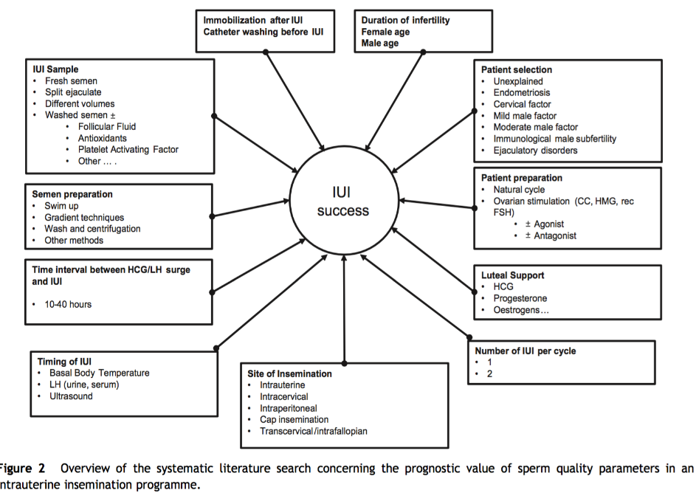

Slide 135
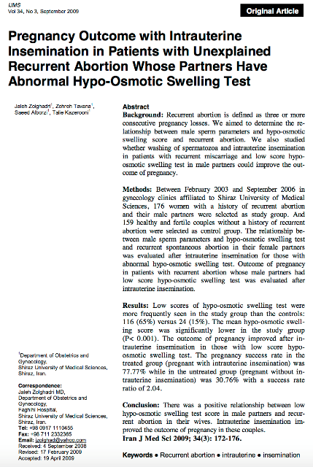

Slide 136
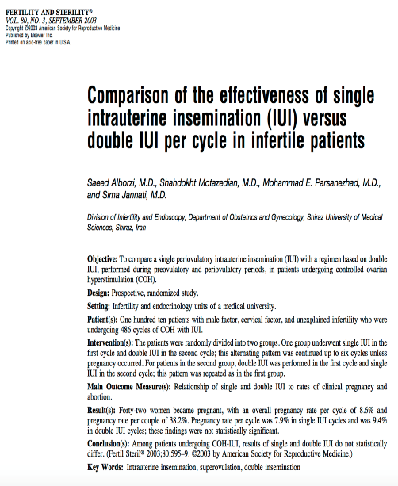

Slide 137
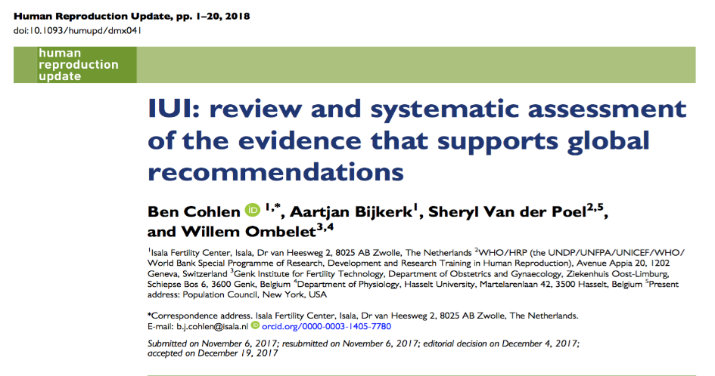
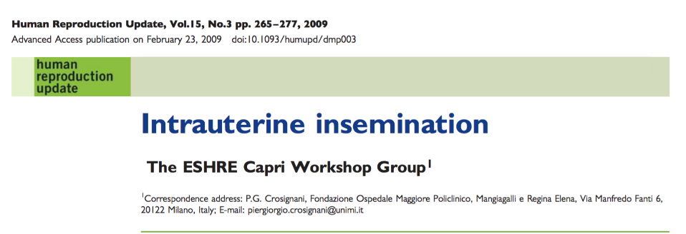

Slide 138
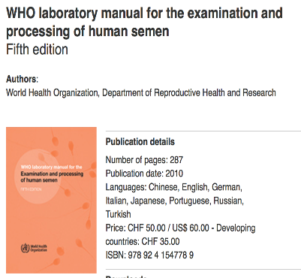
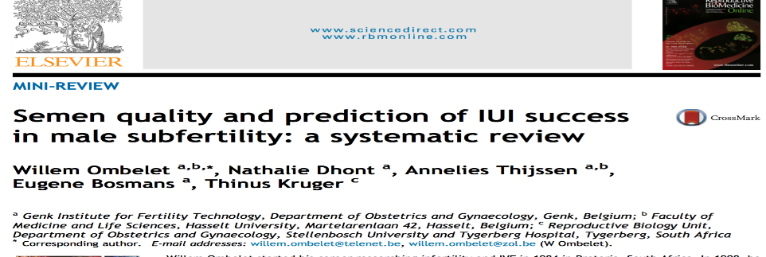

Slide 139
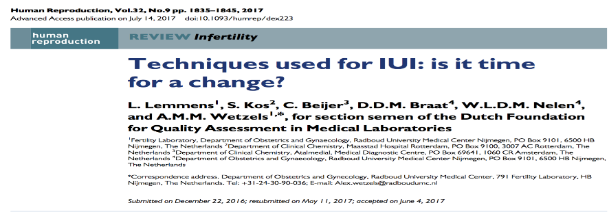
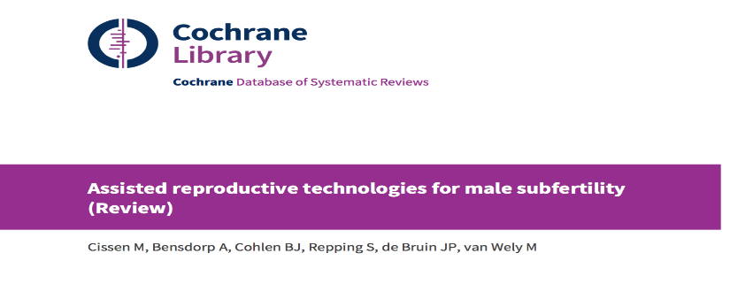

Slide 140
