Slide 1
Intrauterine growth restriction

Slide 2
DEFINITIONS
Fetal growth restriction is a major cause of perinatal morbidity and mortality and may be associated with long-term consequences for the infant.
Intrauterine growth restriction (IUGR) is defined as the failure of the fetus to achieve its genetic growth potential in utero and implies that one or more of the pathological processes described below are limiting fetal growth.
In contrast, small for gestational age (SGA) is defined as a fetus or baby with growth parameters below a defined centile for gestational age (usually the 10th centile(

Slide 3
These babies are usually small due to constitutional factors and are usually associated with normal placental function.
There is considerable overlap between these two definitions: an IUGR baby is usually SGA, but not necessarily so and not all SGA babies are IUGR. A distinction between the two is important clinically as they have different causes and implications and often require different management.

Slide 4
ETIOLOGIES AND RISK FACTORS FOR INTRAUTERINE GROWTH RESTRICTION
Maternal
Hypertensive disease
Pregestational diabetes
Cyanotic cardiac disease
Autoimmune disease
Restrictive pulmonary disease
High altitude (>10,000 feet)
Tobacco/substance abuse
Malabsorptive disease/malnutrition
Multiple gestation

Slide 5
Fetal
•
Teratogenic exposure
•
Fetal infection
•
Genetic disorders
•
Structural abnormalities

Slide 6
Placental
•
Primary placental disease
•
Placental abruption and infarction
•
Placenta previa
•
Placental mosaicism

Slide 7
The diagnosis of FGR is based on discrepancies between actual and expected sonographic biometric measurements for a given gestational age.
Traditionally, it has been defined as <10th percentile weight for gestational age on a singleton growth curve, as this establishes the diagnosis as being small for gestational age (SGA).

Slide 8
In our practice, when a fetus<10th percentile weight for gestational age is identified, we monitor fetal growth and fetal physiology over time.
A normal growth trajectory, normal Doppler velocimetry of the umbilical artery, and normal amniotic fluid volume suggest a constitutionally small fetus or minimal fetal impact from uteroplacental insufficiency.

Slide 9
Characteristics that support a diagnosis of a constitutionally small fetus include modest smallness (ie,
estimated weight between the 5th and 10th percentiles),
normal growth velocity across gestation,
normal physiology (ie,
normal amniotic fluid volume and
umbilical artery Doppler),
abdominal circumference growth velocity above the lowest decile, and
appropriate size in relation to maternal characteristics (height, weight, race/ethnicity), which have a major influence on fetal growth potential.

Slide 10
Determining the cause
●Fetal survey – A detailed fetal anatomic survey should be performed in all cases since approximately 10 percent of FGR is accompanied by congenital anomalies and 20 to 60 percent of malformed infants are small for gestational age .
Anomalies associated with FGR include
omphalocele,
gastroschisis,
diaphragmatic hernia,
skeletal dysplasia, and
some congenital heart defects.

Slide 11
A fetal echocardiogram is indicated if results of an expert ultrasound examination suggest any uncertainty that the heart is normal.

Slide 12
Fetal genetic studies:
● – Fetal genetic studies are indicated in any of the following settings because of the increased risk of an abnormality:
•Early (<24 weeks), (<5th percentile), symmetrical FGR.
•Major fetal structural abnormalities.
•No structural abnormalities but presence of soft ultrasound markers associated with an increased risk of aneuploidy, such as thickened nuchal fold/choroid plexus cyst and abnormal hand positioning.

Slide 13
Ultrasound examination has high sensitivity for identifying trisomy 18, as high as 100 percent, when performed by an experienced ultrasonographer at 19 to 20 weeks of gestation in a fetus with multiple structural anomalies characteristic of the syndrome.

Slide 14
Although the finding of symmetrical FGR prior to 24 weeks of gestation is associated with a high risk of aneuploidy, this is no longer the case later in gestation. After 24 weeks, the author does not screen for fetal genetic abnormalities if anatomy is normal and FGR is asymmetric since the yield would be low, the etiology is most likely a maternal or placental disorder, and pregnancy termination is generally not an option.

Slide 15
●Work-up for infection – When infection is suspected clinically because of maternal history, physical examination or fetal ultrasound findings, maternal serum should be examined for seropositivity (and evidence of acute infection if positive).
Infections associated with FGR include cytomegalovirus, toxoplasmosis, rubella, and varicella. Amniotic fluid DNA testing can also be performed for specific infections, when indicated by the clinical setting.

Slide 16
Sonographic markers for fetal infection are often nonspecific, but include echogenicity and calcification of the brain and/or liver, and hydrops.
Malaria in pregnancy can also cause FGR.

Slide 17
Assessment for inherited thrombophilic disorders is not recommended, as evidence for an association between the inherited thrombophilias and FGR is weak .
However, antiphospholipid syndrome, an acquired thrombophilia, is clearly associated with FGR.

Slide 18
PREGNANCY MANAGEMENT
The following discussion applies to pregnancy management of FGR in structurally and chromosomally normal fetuses. Most of these cases are caused by uteroplacental insufficiency.

Slide 19
Serial ultrasound evaluation of
(1) fetal growth velocity ,
(2) fetalbehavior (biophysical profile [BPP]), and
(3) impedance to blood flow in fetal arterial and venous vessels (Doppler velocimetry) represent the key elements of fetal assessment and guide pregnancy management decisions.
The purpose is to identify those fetuses that are at highest risk of in-utero demise and neonatal morbidity who may benefit from preterm delivery.

Slide 20
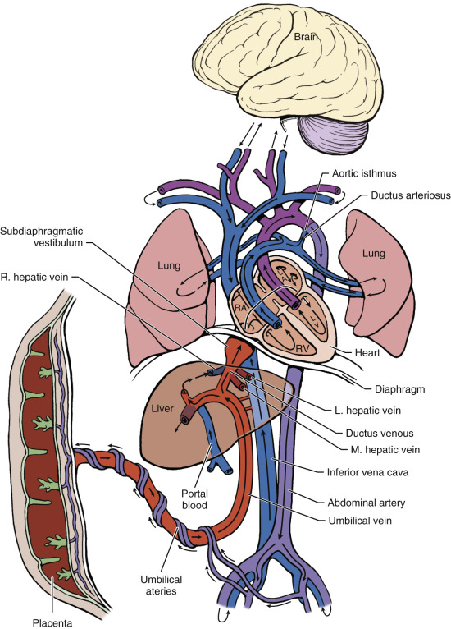
Schematic Presentation of the Fetal Circulation.

Slide 21
This figure illustrates the serial partitioning of nutrient- and oxygen-rich blood reaching the fetus via the umbilical vein.
The first partition at the level of the ductus venosus distributes the majority of umbilical venous blood to the liver.
Umbilical venous blood that continues toward the heart is partitioned toward the left ventricle (LV) at the foramen ovale.
This blood supplies the brain and upper part of the body via the brachiocephalic circulation and the myocardium via the coronary circulation.

Slide 22
A minor proportion of blood from the right ventricle (RV) supplies the lungs, and the remainder continues through the ductus arteriosus toward the aorta.
At the aortic isthmus bloodstreams coming from the aorta are partitioned based on the relationship of blood flow resistance in the brachiocephalic and subdiaphragmatic circulations.
Although net forward flow is maintained under physiologic conditions, diastolic flow reversal occurs when brachiocephalic resistance falls and/or subdiaphragmatic (placental) resistance rises.
Finally, the major proportion of descending aortic blood is partitioned at the umbilical arteries to return to the placenta for respiratory and nutrient exchange.

Slide 23
The general sequence of Doppler and biophysical changes in FGR is:
●A reduction in umbilical venous flow is the initial hemodynamic change. Venous flow is redistributed away from the fetal liver and towards the heart. Liver size decreases, causing a lag in fetal abdominal circumference, which is the first biometric sign of FGR.
●Umbilical artery Doppler index increases (diminished end-diastolic flow) due to increased resistance in the placental vasculature.

Slide 24
●Middle cerebral artery Doppler index decreases (increased end-diastolic flow), resulting in preferential perfusion of the brain (brain-sparing effect).
●Increasing placental vascular resistance results in absent and then reversed end-diastolic flow in the umbilical artery..

Slide 25
●As cardiac performance deteriorates due to chronic hypoxia and nutritional deprivation, absent or reversed end-diastolic flow in the ductus venosus and pulsatile umbilical venous flow may develop. These can be preterminal events.
Near the end of this sequence, biophysical changes usually become apparent: The nonstress test becomes nonreactive, the BPP score falls, and late decelerations accompany contractions.

Slide 26
However, the cardiovascular (Doppler) and behavioral (BPP) manifestations of fetal deterioration in FGR fetuses can occur largely independent of each other, resulting in discordant Doppler and BPP findings.

Slide 27
Ambulatory monitoring:
— Women with pregnancies complicated by FGR may maintain normal activities and are usually monitored as outpatients.
There are no data on which to base indications for hospitalization.
We and other experts consider hospitalization for selected women who need daily or more frequent maternal or fetal assessment (eg, daily BPP score because of reversed diastolic flow).

Slide 28
Hospitalization provides convenient access for daily fetal testing and allows prompt evaluation and intervention in the event of decreased fetal activity or other complications, but there is no evidence that hospitalization or bed rest improves fetal growth or outcome.

Slide 29
Fetal weight assessment
Serial sonograms are obtained at two- to four-week intervals to ascertain the growth velocity; the longer end of this range is appropriate for the fetus with mild FGR (eg, EFW near the 10th percentile, normal amniotic fluid volume, normal Doppler findings),
with a shorter interval for the fetus with features of moderate or severe disease (eg, EFW ≤5th percentile, oligohydramnios, abnormal Doppler findings).

Slide 30
We prefer the BPP as it evaluates both acute and chronic fetal physiologic parameters, is relatively easy to perform, and fetal death within one week of a normal test score is rare .
If the nonstress test is used, amniotic fluid volume assessment should also be performed weekly.
Chronic placental insufficiency results in both FGR and oligohydramnios and observational studies have reported that pregnancies complicated by FGR and oligohydramnios have a modestly increased risk of perinatal mortality .

Slide 31
Frequency BPP:
If Doppler indices are normal, this provides strong evidence of fetal wellbeing, especially in the absence of risk factors for, or signs of, uteroplacental insufficiency.

Slide 32
In all other cases of FGR, nonstress tests and BPPs are performed at least weekly.
When FGR is associated with oligohydramnios, preeclampsia, decelerating fetal growth, severe growth restriction, increasing umbilical artery Doppler index, or other concerning findings, we increase testing to twice per week (eg, two BPPs, two nonstress tests, or one NST and one BPP).
For fetuses with absent or reversed diastolic flow, testing is performed daily because these fetuses can deteriorate rapidly.

Slide 33
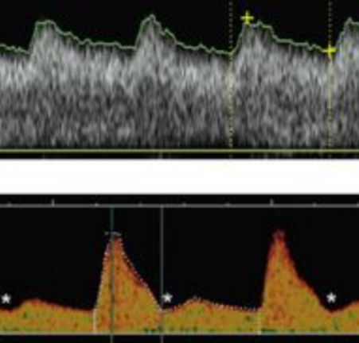
(A) This flow-velocity waveform was obtained at 24 weeks’ gestation and shows high diastolic flow velocities. Such a flow pattern indicates successful trophoblast invasion. (B) The second waveform shows lower diastolic velocities and an early diastolic notch . This flow pattern is reflective of increased blood flow resistance in the spiral arteries and downstream placental vascular bed. Persistence of notching beyond 24 weeks’ gestation is associated with an increased risk of fetal growth restriction and/or hypertensive disorders of pregnancy.

Slide 34
Doppler velocimetry
— Doppler velocimetry of the umbilical artery is a good tool for fetal assessment in FGR when the etiology is placental dysfunction related to progressive obliteration of the villus vasculature.
Placental vascular changes lead to fetal hemodynamic changes that can be evaluated by umbilical artery Doppler.

Slide 35
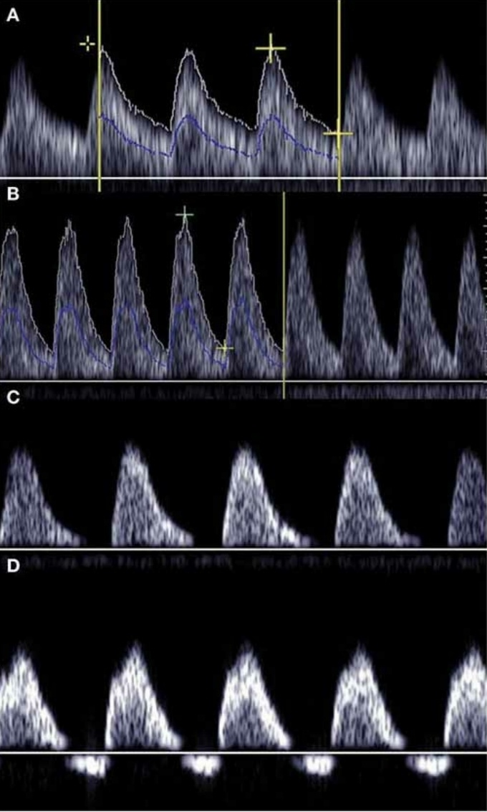

Slide 36
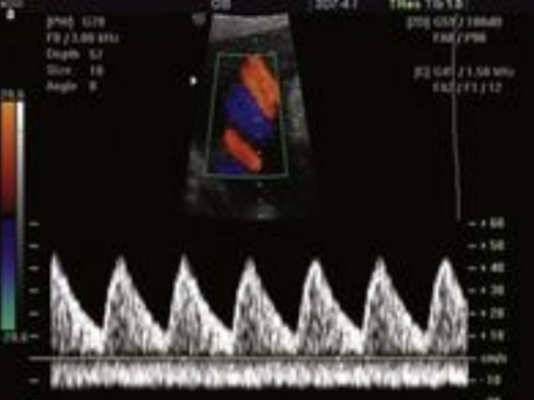

Slide 37
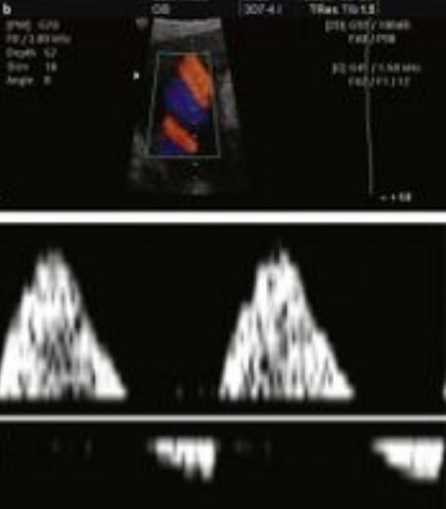

Slide 38
Umbilical artery — Doppler velocimetry of the umbilical artery is the primary surveillance tool for monitoring pregnancies in which FGR is suspected
Normal diastolic flow is infrequently associated with significant perinatal morbidity or mortality and is strong evidence of fetal well-being, thus this finding provides support for delaying delivery when it is important to achieve further fetal maturity.

Slide 39
Abnormal Doppler was defined as a pulsatility index >95th centile or absent/reversed end-diastolic flow.
When 30 percent of the villous vasculature ceases to function, an increase in umbilical artery resistance leading to reduced end-diastolic flow is consistently seen and is a weak predictor of adverse outcome .
When 60 to 70 percent of the villous vasculature is obliterated, umbilical artery diastolic flow is absent or reversed and fetal prognosis is poor .
Reversed diastolic flow is associated with poorer neonatal outcomes than absent diastolic flow.

Slide 40
We perform weekly Doppler velocimetry of the umbilical artery upon diagnosis of FGR.
If consecutive Doppler results are normal, we decrease the frequency of Doppler examination to two-week intervals. The two-week interval is reasonable for the fetus with estimated fetal weigh ≥5th percentile, normal growth velocity, normal amniotic fluid volume, and no maternal risk factors for placental dysfunction.

Slide 41
The Society for Maternal-Fetal Medicine suggests umbilical artery Doppler studies every one to two weeks initially, and if normal, the interval between examinations can be lengthened .

Slide 42
If umbilical artery diastolic flow is present but decreased (pulsatility index >95th percentile), we perform weekly Doppler evaluation to look for progression to absent or reversed flow.
Absent or reversed end-diastolic flow in the umbilical artery can be a sign of impending fetal cardiovascular and metabolic deterioration.
If either of these abnormal patterns is identified, delivery should be considered .

Slide 43
The decision to deliver in this setting is based on gestational age as long as daily nonstress or BPP testing is normal.
The absence of abnormal flow patterns in the ductus venosus has been used to support the decision to extend such a pregnancy, and may enable the pregnancy to be prolonged for as long as two weeks; however, clinical use of this test is controversial .

Slide 44
Ductus venosus — Doppler interrogation of the ductus venosus provides information about the hemodynamic status of the fetus.
Flow in the venous circulation is forward and uniform in normal fetuses. Changes in the venous circulation in the growth-restricted fetus, including absent or reversed flow in the ductus venosus (absent or reversed a wave) or pulsatile umbilical venous flow, are late findings, generally occurring approximately two weeks after changes are observed in the arterial circulation.

Slide 45
With progressively increasing umbilical arterial resistance, fetal cardiac performance can become impaired and central venous pressure increases, resulting in reduced diastolic flow in the ductus venosus and other large veins.
Vasodilatation of the ductus venosus further diverts nutrient and oxygen rich blood to the heart but enhances retrograde transmission of atrial pressure.
The ductus venosus resistance index increases, ultimately with loss of the a wave. An absent or reversed ductus venous a-wave indicates cardiovascular instability and can be a sign of impending acidemia and death .

Slide 46
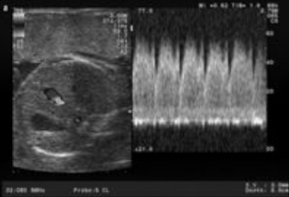

Slide 47
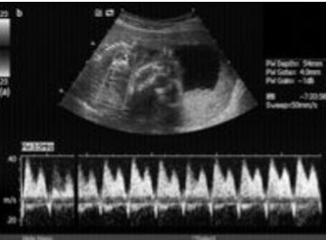

Slide 48
Although the use of venous Doppler interrogation remains largely investigational , an increasing number of maternal-fetal medicine specialists, including the author, are using this tool to avoid very preterm delivery in fetuses with absent or reversed end-diastolic arterial flow in the umbilical artery and reassuring antepartum fetal testing (nonstress test, BPP). In these pregnancies, the absence of abnormal flow patterns in the ductus venosus has been used to support the decision to extend the pregnancy to 32 to 34 weeks, if the nonstress test and BPP remain reassuring.

Slide 49
Middle cerebral artery — Doppler interrogation of the middle cerebral artery (MCA) also provides information about the hemodynamic status of the fetus.
The fetal brain in uncomplicated pregnancies has a high resistance circulation. With progressive hypoxia, blood flow increases to compensate for the decrease in available oxygen (brain-sparing effect).
This results in a reduction in the Doppler parameters used to assess blood flow through the MCA: the peak systolic to end-diastolic blood flow velocity ratio (S/D), resistance index, and pulsatility index .
Subsequent normalization of the indices may occur when the autoregulatory response becomes dysfunctional .

Slide 50
Cerebroplacental ratio — The cerebroplacental Doppler ratio (CPR) is the MCA pulsatility index (or resistance index) divided by the umbilical artery pulsatility index (or resistance index).
A low CPR indicates fetal blood flow redistribution (brain sparing) and was most predictive of perinatal death in a meta-analysis of studies of CPR in suspected FGR (pooled sensitivity and specificity of 93 and 76 percent, respectively)

Slide 51
Adverse outcome was a composite of intraventricularhemorrhage, periventricular leukomalacia, hypoxic ischemic encephalopathy, necrotizing enterocolitis, bronchopulmonary dysplasia, sepsis, and death.
CPR was most useful for predicting adverse neonatal outcome when the umbilical artery Doppler pulsatility index was >95th centile.

Slide 52
The additional finding of an abnormal CPR in these cases improved the prediction of an adverse neonatal outcome to a level similar to that found with absent or reversed umbilical artery end-diastolic flow.
An abnormal CPR has also been associated with abnormal fetal growth velocity , an increased risk for neonatal intensive care unit admission, urgent cesarean delivery for fetal distress after 37 weeks, independent of fetal weight .

Slide 53
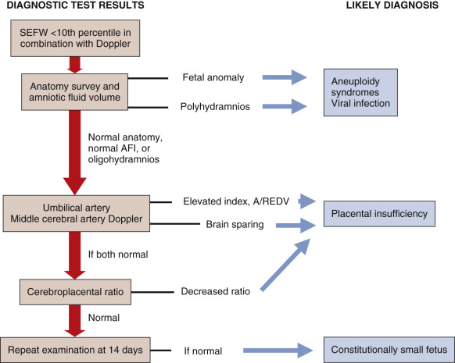

Slide 54
Antenatal corticosteroids:
— Ideally, a course of antenatal corticosteroids is given in the week before preterm delivery is anticipated. Timing is estimated based on multiple factors, including the severity of FGR, Doppler findings, comorbid conditions, and rate of deterioration in fetal status.
Three studies observed that growth-restricted fetuses with absent end-diastolic flow often show transient improvement in blood flow after glucocorticoid administration .

Slide 55
Fetuses that did not show increased end-diastolic flow appeared to have poorer neonatal outcomes.
The reason sicker fetuses are unable to mount a vascular response to glucocorticoid administration is unclear.
One action of glucocorticoids is to enhance the tropic effect of catecholamines on heart muscle. It is hypothesized that inotropy does not improve in sicker fetuses because they have impaired cardiac wall compliance.

Slide 56
Maternal interventions
— There is no convincing evidence that any intervention in healthy women improves the growth of growth-restricted fetuses. Numerous approaches have been tried in small randomized trials, including maternal nutritional supplementation, oxygen therapy, and interventions to improve blood flow to the placenta, such as plasma volume expansion, low-dose aspirin, bed rest, and anticoagulation .

Slide 57
Antihypertensive therapy of hypertensive gravidas does not improve fetal growth .
In smokers, an intensive smoking cessation program may be of value and has other pregnancy and health benefits.

Slide 58
Timing delivery:
— There is little consensus about the optimum time to deliver the growth-restricted fetus.
We time the delivery of the growth-restricted fetus based on a combination of factors, including gestational age, Doppler ultrasound of the umbilical artery, BPP score, ductus venosus Doppler, and the presence or absence of risk factors for, or signs of, uteroplacental insufficiency.
.

Slide 59
The goal is to maximize fetal maturity and growth while minimizing the risks of fetal or neonatal mortality and short-term and long-term morbidity.
The greatest challenge related to timing of delivery is in the preterm fetus<32 weeks of gestation.
Morbidity and mortality related to preterm delivery is relatively high before 32 weeks , and between 26 and 29 weeks of gestation each day in utero has been estimated to improve survival by 1 to 2 percent

Slide 60
Our approach:
●Abnormal ductus venosus Doppler – We delivery these pregnancies immediately.
●Reversed diastolic flow ≥32 weeks of gestation – We deliver these pregnancies immediately.
●Absent diastolic flow ≥34 weeks of gestation – We deliver these pregnancies immediately.
●Reversed diastolic flow <32 weeks of gestation or absent diastolic flow <34 weeks of gestation, regardless of the presence or absence of oligohydramnios –

Slide 61
In these patients, we perform daily BPP scoring in an attempt to delay delivery until 32 weeks (if reversed flow) or 34 weeks (if absent flow) as long as the BPS remains normal. If the BPP or ductus venous Doppler becomes abnormal, we delivery these pregnancies immediately.
If a course of antenatal corticosteroids has not been administered yet, it is given upon diagnosis of reversed or absent diastolic flow.

Slide 62
●Decreased diastolic flow (pulsatility index >95th percentile) – This is a weak predictor of fetal death.
We perform a BPP two times per week and deliver these fetuses at term or when the BPP becomes abnormal. Delivery at 37 to 38 weeks is reasonable if umbilical artery flow is decreased and risk factors for, or signs of, uteroplacental insufficiency are present, such as oligohydramnios, preeclampsia or hypertension, renal insufficiency, fetal growth arrest, estimated weight <5th percentile, or prior birth of a small for gestational age infant.

Slide 63
●Normal umbilical artery Doppler – This provides strong evidence of fetal well-being, especially in the absence of risk factors for, or signs of, uteroplacental insufficiency. We deliver these fetuses at 39 to 40 weeks of gestation.

Slide 64
Delivery should not be delayed beyond 40 weeks of gestation.
The risk of intrauterine fetal demise significantly increases at term, particularly as the severity of FGR increases. As an example, in a retrospective cohort study, the risk of intrauterine fetal death at 39 weeks was estimated as
32 per 10,000 ongoing pregnancies for fetal weight <3rd percentile,
23 per 10,000 ongoing pregnancies for fetal weight <5th percentile,
13 per 10,000 ongoing pregnancies for fetal weight <10th percentile,
and 2 per 10,000 ongoing pregnancies for fetal weight ≥10th percentile

Slide 65
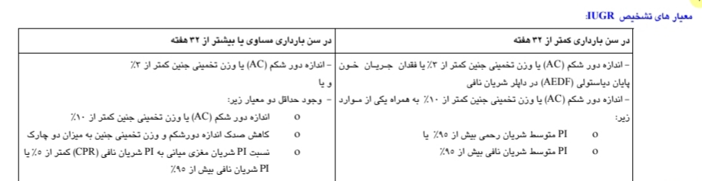

Slide 66


Slide 67
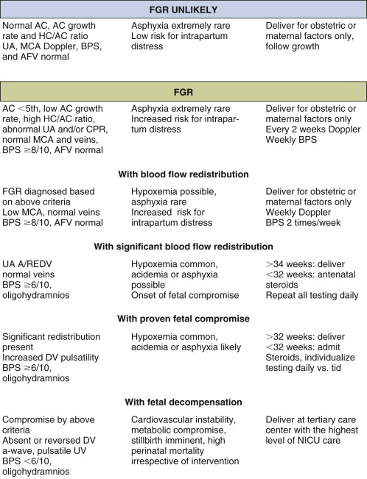

Slide 68
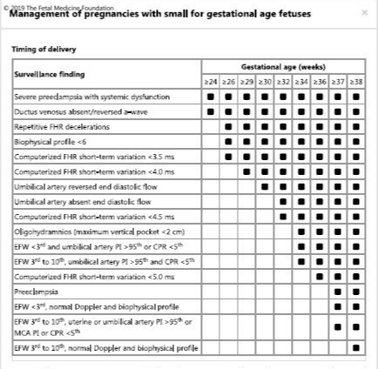

Slide 69
INTRAPARTUM MANAGEMENT :
Growth-restricted fetuses may exist in a state of mild-to-moderate chronic oxygen and substrate deprivation.
Potential consequences include antepartum or intrapartum fetal heart rate abnormalities, passage of meconium with risk of aspiration, and neonatal polycythemia, impaired thermoregulation, hypoglycemia, and other metabolic abnormalities .
Consequently, it is important to optimize the timing of delivery , perform continuous intrapartum fetal monitoring to detect nonreassuringfetal heart rate patterns suggestive of progressive hypoxia during labor, and provide skilled neonatal care in the delivery room .

Slide 70
Umbilical cord blood analysis should be considered as a component of establishing baseline neonatal status.
Cesarean delivery for fetal indications is more common when growth restriction is present. In one study, variable decelerations lasting greater than 60 seconds, with depth greater than 60 beats per minute (bpm) or nadir less than 60 bpm, were more common in the growth-restricted group, while the rates of late decelerations, prolonged decelerations, or bradycardia were similar for both groups

Slide 71
The risk of fetal heart rate abnormalities related to hypoxia is highest among fetuses with abnormal Doppler velocimetry.
In one large series, no fetus with normal Doppler velocimetry was delivered with metabolic acidemia associated with chronic hypoxemia .
Compared with growth-restricted fetuses with normal umbilical artery Doppler ratios, growth-restricted fetuses with a systolic/diastolic ratio >90th percentile for gestational age had significantly lower umbilical artery and vein pH values at birth , an increased likelihood of nonreassuring fetal heart rate patterns, more admissions to the neonatal intensive care unit , and a higher incidence of respiratory distress .

Slide 72
If antenatal testing (nonstress test or biophysical profile) is normal, a trial of labor with continuous intrapartum monitoring is reasonable .
However, the frequency of cesarean delivery for nonreassuring fetal heart rate tracing is increased, given the increased prevalence of chronic hypoxia and oligohydramnios among these fetuses.
For fetuses less than 32 weeks of gestation, magnesium sulfate is given before delivery for neuroprotection. When use of magnesium sulfate was studied specifically in pregnancies with growth-restricted fetuses, a decrease in significant neurodevelopmental impairment and death was observed

Slide 73
RECURRENCE RISK:
There is a tendency to repeat small for gestational age (SGA) deliveries in successive pregnancies .
As an example, a prospective national cohort study from the Netherlands reported that the risk of a nonanomalous SGA birth (<5th percentile) in the second pregnancy of women whose first delivery was "SGA" versus "not SGA" was 23 and 3 percent, respectively

Slide 74
Furthermore, uteroplacental insufficiency may manifest in different ways in different pregnancies. Growth restriction, preterm delivery, preeclampsia, abruption, and stillbirth can all be sequelae of impaired placental function.

Slide 75
Prevention in subsequent pregnancies :
In subsequent pregnancies, we address any potentially treatable causes of FGR (eg, cessation of smoking and alcohol intake, chemoprophylaxis and mosquito avoidance in areas where malaria is prevalent, balanced energy/protein supplementation in women with significant nutritional deficiencies) .
Avoiding a short or long interpregnancy interval may also be beneficial.

Slide 76
Low-dose aspirin may be effective when FGR is secondary to preeclampsia since aspirin appears to reduce the risk of developing preeclampsia in women at moderate to high risk of developing the disorder.
Anticoagulation with unfractionated heparin or low-molecular weight heparin does not reduce the risk of recurrent placenta-mediated late pregnancy complications, such as growth restriction.

Slide 77
In a 2016 meta-analysis using individual patient data from randomized trials of low-molecular-weight heparin (LMWH) therapy versus no LMWH for women with any prior placenta-mediated pregnancy complications, the intervention did not significantly reduce the incidence of the primary composite outcome (early-onset or severe preeclampsia, small for gestation age infant [SGA] <5th percentile, abruption, pregnancy loss ≥20 weeks of gestation).

Slide 78
These data support avoidance of anticoagulation in women with previous placenta-mediated disease, given the lack of clear benefit and potential risks of anticoagulation, cost, and inconvenience.
Dietary changes and supplements, antihypertensive therapy of hypertensive women, beta-mimetics, and bedrest do not prevent FGR .

Slide 79
Efforts to prevent FGR have been disappointing. Low-dose aspirin has been extensively evaluated as a possible preventive agent for placental dysfunction.
However, although the use of aspirin in the second trimester has been found to be safe, initiation of therapy this late in pregnancy does not improve placental function or long-term outcome and may carry the risk of placenta abruption in women with established placental dysfunction.
Only women who start aspirin before 16 weeks’ gestation derive a 50% to 60% reduction in the relative risk for development of preeclampsia or FGR.

Slide 80
In 1997, a meta-analysis demonstrated a significant reduction in the frequency of FGR when low-dose aspirin (50 to 100 mg/day) was used. Higher doses (100 to 150 mg/day) were significantly more effective in preventing FGR than lower doses (50 to 80 mg/day).
Based on the ASPRE trial, it appears that aspirin works best in patients with significant risk factors for FGR and that the therapeutic optimal window to commence aspirin therapy lies between 12 and 16 weeks’ gestation when branching angiogenesis of the placenta is ongoing.

Slide 81
Although the overall safety of aspirin has been documented in a large patient population, concerns about a possible association with abdominal wall defects have been raised with administration in the early first trimester.
Therefore we suggest deferral of indicated therapy until completion of organogenesis at 12 weeks’ gestation. Selected patients who present in the second trimester may still derive benefit from aspirin, and patients should be counseled on an individualized basis.
Aspirin can be discontinued at 34 to 36 weeks’ gestation because of the theoretical risk for bleeding at delivery and during regional anesthesia that may outweigh the benefits of continued use.

Slide 82
Biochemical markers
Routine screening for chromosomal abnormalities using serum markers is currently used in many countries. In the presence of normal chromosomes, several of these markers have been associated with an increased risk of pregnancy complications including IUGR. A raised human chorionic gonadotrophin, alpha-fetoprotein and inhibin and a low pregnancy-associated placental protein A (PAPP-A) and estriol have all been associated with IUGR and other obstetric complications ⁶⁶ . Their role in screening a high-risk population for both IUGR and pre-eclampsia needs to be investigated further.

Slide 83
Maternal Serum Analytes
At least four hormone/protein markers measured in the maternal sera during the early second trimester are associated with subsequent FGR. These include serum estriol, human placental lactogen, human chorionic gonadotropin (hCG), and α-fetoprotein (AFP). Elevated maternal serum α-fetoprotein (MSAFP) and elevated hCG levels in the second trimester are considered markers of abnormal placentation and have been associated with an increased risk for FGR. ⁴⁹ Most studies conclude that a single, unexplained elevated value of 2 to 2.5 multiples of the median (MoM) raises the risk of growth restriction 5-fold to 10-fold.

Slide 84
Several first-trimester serum analytes associated with early abnormalities in placenta angiogenesis and development have been identified. These show significant differences in their distribution among pregnancies at risk of developing early-onset preeclampsia or FGR prior to 34 weeks’ gestation.
Of these markers, a decrease in the pregnancy-associated plasma protein A (PAPP-A) or the placental growth factor (PlGF) has shown the most consistent predictive performance. The advantage of PAPP-A is the commercial availability as part of the first-trimester screen for aneuploidy. In this setting a decrease in the PAPP-A to less than 0.8 MoM is associated with an increased risk for subsequent placental dysfunction.

Slide 85
Integrated Approach to Screening
Several markers reflect early failure of normal placental development in the first trimester.
One marker is abnormal maternal cardiovascular adaptation to pregnancy, which results in a delay in the physiologic drop of mean arterial blood pressure (BP).
Deficient trophoblast invasion is associated with a slower than anticipated drop in uterine artery blood flow resistance, and placental expression of analytes that relate to normal development is altered.
When these markers are considered in isolation, their prediction of subsequent placental dysfunction is inaccurate.

Slide 86
Therefore an integrated screening algorithm has been developed that uses multiple independent risk factors that include a prior history of preeclampsia, maternal first-trimester body mass index, BP, uterine artery PI, and the PAPP-A level (MoM).
This combined model is capable of predicting early-onset preeclampsia or FGR with 80% to 90% sensitivity and a 5% to 10% false-positive rate.
Although the predictive accuracy of this algorithm needs to be confirmed in a variety of population settings, this approach offers the important advantage of early stratification of risk with potential for intervention.

Slide 87
Case report:
1)خانمی 39 ساله حاملگی اول حدود 12 هفته حامله که در ازمایشات غربالگری میزان Papp a =0/3 دارد.در ازمایش NIPT ,ریسک کم خطر است.به چه موردی در این بیمار باید دقت شود؟

Slide 88
2) خانمی 36 ساله حاملگی اول که اکنون بر اساس سونوگرافی NT 33 هفته حامله است.در سونوگرافی اخیر سن حاملگی حدود 27 هفته و 4 روز بوده.و میزان AC 28 هفته است.
اقدامات لازم در این مریض چه می باشد؟

Slide 89
در مورد مریض قبلی بعد از انجام سونوگرافی داپلر متوجه absent بودن موج پایان دیاستولی شریان نافی شدیم.
اقدامات لازم به نظر شما چه میباشد؟
زمان مناسب ختم کی می باشد؟

Slide 90
3) خانمی 37 ساله با سن حاملگی 23 هفته بر اساس سونوگرافی NT مراجعه کرده است در بررسی فوندال مادر حدود 20 هفته است.
اقدامات لازم چه می باشد؟

Slide 91
در بررسی سونوگرافی جدید مریض قبلی سن حاملگی حدود 19 هفته بوده ودور شکم 18 هفته و4 روز تخمین زده شده است.
اقدامات تشخیصی لازم چه میباشد؟

Slide 92
4) خانمی 22 ساله با سن حاملگی 30 هفته بر اساس زمان قاعدگی و سونوگرافی های اوایل مراجعه کرده است .در سونوگرافی اخیر سن حاملگی 26 هفته با دور شکم 26 هفته و 5 روز است.
اقدام بعدی چه می باشد؟

Slide 93
بعد از انجام سونوگرافی داپلر تصویر زیر دیده میشود
اقدام بعدی چه میباشد؟

Slide 94
زمان ختم مناسب مریض قبلی چه موقع میباشد؟
چه اقداماتی و با چه فواصلی در مورد این مریض مدنظرتان است؟
روش ختم ارجح از نظر شما چه میباشد؟

Slide 95
5) خانم 15 ساله با حاملگی 19هفته که در ازمایشات غربالگری مرحله دوم
AFP;2/5 MOM
BHCG:2/3
در بررسی آنومالی اسکن موردی یافت نشد.با توجه به جواب ازمایشات درخواست NIPT شده بود که LOW RISKگزارش شده بود.
در مورد عواقب حاملگی و اداره حاملگی ایشان چگونه می اندیشید؟

Slide 96
6) خانمی G3P2L2 38 ساله حامله 14 هفته مراجعه کرده است.
فرزند اول در سن حاملگی 39 هفته وبا وزن 2200 و فرزند دوم در سن حاملگی 38 هفته و 2 روز با وزن 2300 متولد شده اند.
توصیه های لازم در این بیمار چه میباشد؟

Slide 97
7)خانمی 40 ساله G2P1 با سن حاملگی 33 هفته مراجعه کرده است. در بررسی و معاینه فوندال حدود 30 هفته دارد.
قدم بعدی چیست؟

Slide 98
در سونوگرافی بیومتری سن جنین معادل 30 هفته و 2 روز است
در بررسی Acحدود 29 هفته و 6 روز است.
در بررسی ها داپلرشریان نافی و MCA نرمال است.
در بررسی BPP;8میباشد و اندکس مایع حدود 4 میباشد.
اقدام بعدی چیست؟

Slide 99
8) خانمی 28 ساله G1 با سن حاملگی 36 هفته که در بررسی سونوگرافی صدک وزن 1% و AC حدود 2 درصد دارد.
در بررسی داپلر شریان نافی و MCA نرمال گزارش شده است.
در بررسی میزان مایع و BPPنرمال است.
در مورد زمان ختم و اقدامات لازم چه توصیه ای دارید؟

Slide 100
9) خانمی 35 ساله G2P1سن حاملگی 13 هفته مراجعه کرده است .حاملگی اول در سن حاملگی 37 هفته و 6 روز به دنبال پارگی کیسه اب زایمان کرده است و حاصل آن نوزاد با وزن 2250 بوده است.
در بررسی سونوگرافی غربالگری.عدد NT;2 و در رنج نرمال گزارش شده است.
در بررسی داپلر شرایین رحمی ناچ دوطرفه دیده می شود.
چه توصیه ای دارید؟

Slide 101
10) خانمی 42 ساله با سن حاملگی 26 هفته و 4 روز بر اساس سونوی اوایل مراجعه کرده است.
در بررسی فوندال حدود 22 هفته به دست میخورد.
در بررسی ییومتری سن حاملگی حدود 22هفته و 5 روز و میزان AC حدود 23هفته است.
در بررسی داپلر جریان شریان نافی و داکتوس موج زیر دیده میشود.

Slide 103
اقدامات و توصیه های لازم چیست؟

Slide 104
11) در مریض قبلی اگر در بررسی داپلر بعدی موج داکتوس به صورت زیر دیده شود اقدام لازم چه میباشد؟

Slide 105
11) در مریض قبلی اگر در بررسی داپلر بعدی موج داکتوس به صورت زیر دیده شود اقدام لازم چه میباشد؟

Slide 106
12) خانمی 28 ساله G2P1 با سن حاملگی 37 هفته و 2 روز در بررسی سونوگرافی وزن جنین در صدک 7 درصد محاسبه شده است
در بررسی BPPنرمال است.
در بررسی ها داپلر شریان نافی و MCA و رحمی نرمال است.
میزان مایع نرمال است.
توصیه لازم چه میباشد و زمان مناسب ختم حاملگی؟

Slide 107
13) خانمی 20 ساله حاملگی اول با سن حاملگی 37 هفته و 1 روز که در بررسی ها صدک وزن 6 درصد دارد.
در بررسی داپلر شریان نافی و MCA نرمال است.
در بررسی شریان رحمی ناچ دوطرفه و افزایش در Piدیده میشود.
توصیه های لازم چه میباشد؟

Slide 108
14) خانمی 32 ساله حاملگی اول با سن حاملگی 32 هفته با سونوگرافی بیومتری که سن حاملگی بر اساس پارامترها حدود 29 هفته تخمین زده شده مراجعه کرده است.
در بررسی ها داپلر شریان نافی ابسنت دیده میشه
میزان مایع نرمال است.BPPنرمال است.
توصیه بعدی چیست؟

Slide 109
درادامه بررسی مریض قبلی درخواست موج داکتوس میشه که در بررسی داپلر موج داکتوس ونوزوس > P95 دیده میشود.
توصیه واقدام لازم؟

Slide 110
15) خانمی 44 ساله G3P2L2 با سن حاملگی 34 هفته و 3 روز که در بررسی های سونوگرافیک صدک وزن 4 درصد دارد .
در بررسی داپلرها
داپلرPI شریان نافی >95 th
و CPR<5th
چه اقدامی میتوان انجام داد؟

Slide 112


