Slide 1
Fetal tococardiography
intrapartum

Slide 2
FETUS OXYGENATION
Uterine contractions during labour normally decrease uteroplacental blood flow which results in reduced oxygen delivery to the fetus. Most healthy fetuses tolerate this reduction in flow and have no adverse effects.

Slide 3
The distribution of oxygen to the fetus depends on the delivery of oxygen from the maternal lungs to the uterus and placenta, diffusion from the placenta to fetal blood, and distribution of fetal oxygenated blood to various fetal tissues through fetal cardiovascular activities.
Disturbances in any of these three steps will reduce availability of oxygen to the fetus

Slide 5
The fetal heart rate (FHR) pattern helps to distinguish the former from the latter as it is an indirect marker of fetal cardiac and central nervous system responses to changes in blood pressure, blood gases, and acid-base status
The rationale for intrapartum FHR monitoring is that identification of FHR changes potentially associated with inadequate fetal oxygenation may enable timely intervention to reduce the likelihood of hypoxic injury or death

Slide 6
Asphyxia (hypoxic acidemia) is a condition of impaired gas exchange, which when persistent, leads to progressive hypoxemia, hypercapnia, and metabolic acidosis
These minor changes carry no prognostic significance. Respiratory acidosis, characterized by lowered pH and elevated pCO2 with a normal base deficit, reflects impaired gas exchange for a short duration.
When this occurs, secondary postnatal complications are uncommon, and prognosis is excellent.

Slide 7
Fetal Acid-Base Physiology :
Carbonic acid
organic acids
Carbonic acid (H2CO3) is formed by oxidative metabolism of CO2
The fetus usually rapidly clears CO2 through the placental circulation
When H2CO3 accumulates in fetal blood with no increase in organic acids, results as respiratory acidemia
lactic and β-hydroxybutyric acids
Levels increase with persistent placental exchange impairment and result from anaerobic glycolysis
Organic acids are cleared slowly from fetal blood, accumulating without an increase in H2CO3, results as metabolic acidemia

Slide 8
With more prolonged impairment in gas exchange, compensatory physiological mechanisms are invoked to improve oxygen delivery and counter the production of organic acids.
Metabolic acidosis, defined by lowered pH and base deficit over 12 mmol/L occurs in 2% of deliveries
The majority (75%) of these babies will be asymptomatic and hence have no increased likelihood of long-term sequelae. Others will develop some form of NE; however, NE may also arise from other causes.

Slide 9
The goal of intrapartum fetal surveillance
Detect potential fetal decompensation
allow timely and effective intervention to prevent perinatal/neonatal morbidity or mortality

Slide 10
Intermittent auscultation nice

Slide 11
Intermittent Auscultation in Labor
Intermittent auscultation is the recommended fetal surveillance method during labor for healthy women without risk factors for adverse perinatal outcome
The maternal pulse should be checked during auscultation to differentiate maternal and fetal heart rates
If the fetal heart is technically inaudible so that the fetal heart rate cannot be established, then electronic fetal monitoring should be commenced.

Slide 12
Baseline fetal heart rate
A baseline heart rate is assessed by listening and counting between uterine contractions The greatest accuracy results when the FHR is counted for 60 seconds.
counting after contractions
The normal fetal heart rate is 110 to 160 bpm. Tachycardia (defined as a fetal heart rate above 160 bpm for > 10 minutes)
bradycardia (defined as a fetal heart rate below 110 bpm for> 10 minutes) can be identified

Slide 13
Rhythm
The rhythm (regular or irregular) of the FHR can also be assessed with IA.
A dysrhythmia is said to occur when there is an irregular heart rate not associated with uterine activity
Dysrhythmias are further classified as fast, slow, or irregular
When a dysrhythmia is identified→ultrasound, echocardiography R/O artifact

Slide 14
Heart rate changes
It is possible to detect abrupt increases (accelerations) from the baseline (e.g., during fetal activity) or abrupt/gradual decreases in the FHR
However, there are no data to indicate that the practitioner can distinguish the type of deceleration
Therefore, the deceleration patterns classified visually with EFM cannot be classified with auscultation.

Slide 15
AWHONN:The Association of Women's Health, Obstetric and Neonatal Nurses

Slide 16
Continuous cardiotocography
Do not offer cardiotocography to women at low risk of complications in established labor
Advise continuous cardiotocography if any of the following risk factors are present at initial
assessment or arise during labor:

Slide 17
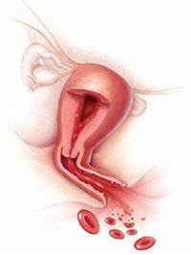
Continuous cardiotocography
1-maternal pulse over 120 beats/minute on 2 occasions 30 minutes apart
2-temperature of 38°C or above on a single reading, or 37.5°C or above on 2 consecutive occasions 1 hour apart
3-suspected chorioamnionitis or sepsis
4-pain reported by the woman that differs from the pain normally associated with contractions
5-the presence of significant meconium (as defined in ongoing assessment)
6-fresh vaginal bleeding that develops in labour

Slide 18
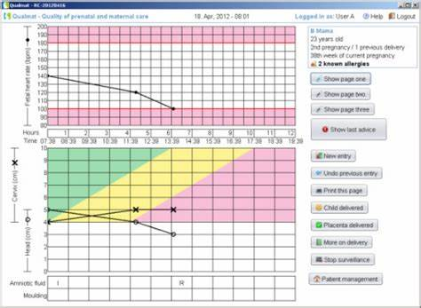
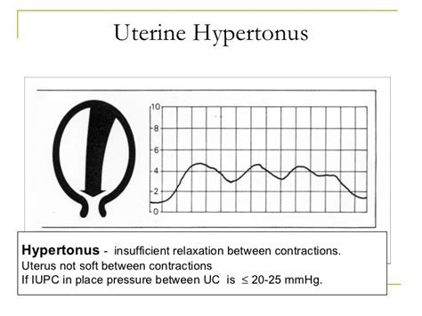
Hypertension: either systolic blood pressure of 140 mmHg or more or diastolic blood pressure of 90 mmHg or more on 2 consecutive readings taken 30 minutes apart, measured between contractions
a reading of 2+ of protein on urinalysis and a single reading of either raised systolic blood pressure (140 mmHg or more) or raised diastolic blood pressure (90 mmHg or more)
Confirmed delay in the first or second stage of labour
Contractions that last longer than 60 seconds (hypertonus), or more than 5 contractions in 10 minutes (tachysystole)
Oxytocin use

Slide 21
Common indications/contraindications for intermittent auscultation
The use of auscultation in pregnancies with risk factors for adverse outcomes is more controversial
Preterm labor and intermittent auscultation
EFM is recommended in preterm fetuses below 36 weeks’ gestation.

Slide 22
Postdates labour and intermittent auscultation
Intermittent auscultation is the preferred method of fetal surveillance for spontaneous labor with no risk factors, up to 41+3 weeks’ gestation.

Slide 23
From 41+3 weeks’ gestation, intermittent auscultation is the preferred method of fetal surveillance provided that NSTs and amniotic fluid volume have been normal
Post-term pregnancy, (> 42 weeks’ gestation), is associated with an increased risk of adverse fetal outcome and EFM is the preferred method of fetal surveillance.

Slide 24
Epidural analgesia and intermittent auscultation
The theoretical concern with epidural analgesia is the risk of maternal hypotension that can cause maternal and fetal circulation problems
RCOG includes epidural analgesia as an indication for continuous EFM
Grant and Halpern recommend using EFM for 30 to 60 minutes following initiation of the epidural to facilitate prompt treatment should FHR decelerations occur

Slide 25
Vaginal birth after Caesarean section and intermittent auscultation
For women attempting VBAC, there is little controversy. All professional recommend continuous electronic fetal monitoring

Slide 26
Admission Fetal Heart Test??
Admission fetal heart tracings are not recommended for healthy women at term in labour in the absence of risk factors for adverse perinatal outcome, as there is no evident benefit
Admission fetal heart tracings are recommended for women with risk factors for adverse perinatal outcome.

Slide 27
Keep recording
make sure that date and time clocks on the cardiotocograph monitor are set correctly label traces with the woman's name, date of birth and
the date and the woman's pulse at the start of monitoring.
develop a system for recording relevant intrapartum events (for example, vaginal examination, fetal blood sampling and siting of an epidural) in standard notes and/or on the cardiotocograph trace.
Keep cardiotocograph traces for 25 years and, if possible, store them electronically

Slide 28
External fetal monitoring
What is the baseline rate?
Describe the variability
Are there accelerations present?
Are there decelerations present?
Are contractions present?
What category is this tracing?
Is this fetal tracing reassuring?

Slide 29
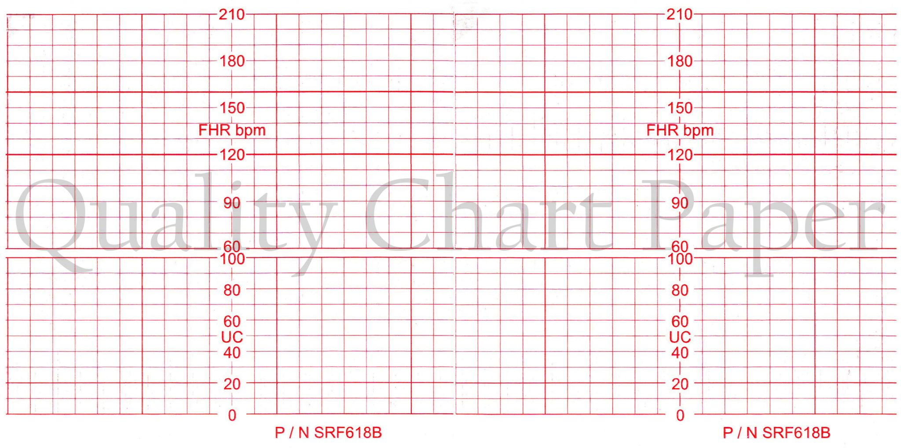
the choice of vertical and horizontal scaling greatly affects the appearance of the fetal heart rate.
30 beats per minute (beats/min or bpm) per vertical cm
3 cm/min chart recorder paper speed

Slide 32
Baseline
In any 10-minute window, the minimum interpretable baseline duration must be at least 2 minutes.
If the baseline fetal heart rate is less than 110 bpm, it is termed bradycardia. If the baseline rate is greater than 160 bpm, it is termed tachycardia.

Slide 33
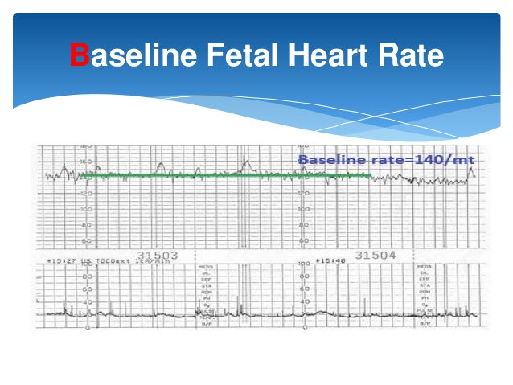

Slide 34
Use the following categorisations for baseline fetal heart rate:
Reassuring→110 to 160 beats/minute
non-reassuring→
100 to 109 beats/minute
161 to 180 beats/minute
Abnormal→
below 100 beats/minute
above 180 beats/minute.
Take the following into account when assessing baseline fetal heart rate: differentiate between fetal and maternal heartbeats baseline fetal heart

Slide 35
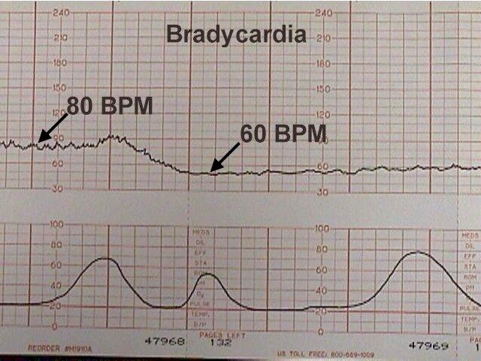

Slide 36
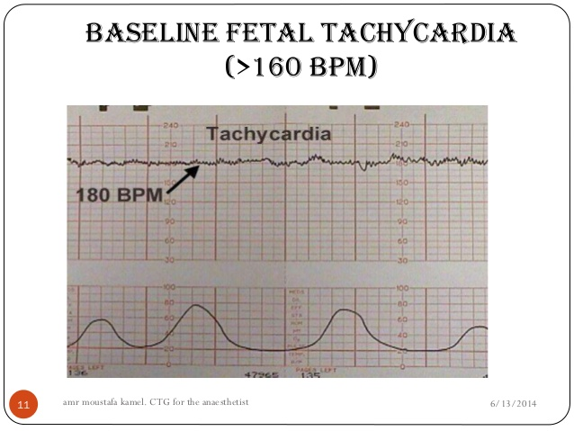

Slide 37
Wandering Baseline. This baseline rate is unsteady and “wanders” between 120 and 160 bpm. This rare finding is suggestive of a neurologically abnormal fetus and may occur as a preterminal event.

Slide 38
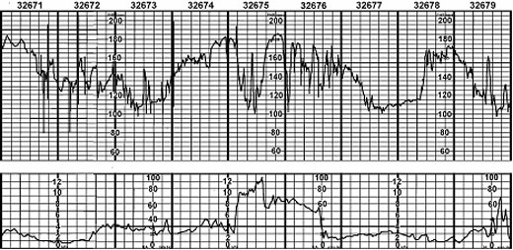

Slide 39
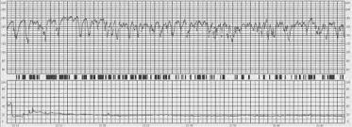
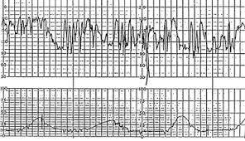
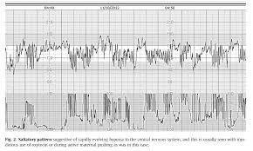

Slide 40
Arrhythmias

Slide 41
Causes of Fetal Tachycardia
Fetal hypoxia
Maternal fever
Hyperthyroidism
Maternal or fetal anemia
Parasympatholytic drugs
 | Atropine
 | Hydroxyzine (Atarax)
Sympathomimetic drugs
Chorioamnionitis
Fetal tachyarrhythmia
Prematurity

Slide 42
Causes of Severe Fetal Bradycardia
Prolonged cord compression
Cord prolapse
Tetanic uterine contractions
Paracervical block
Epidural and spinal anesthesia
Maternal seizures
Rapid descent
Vigorous vaginal examination

Slide 43
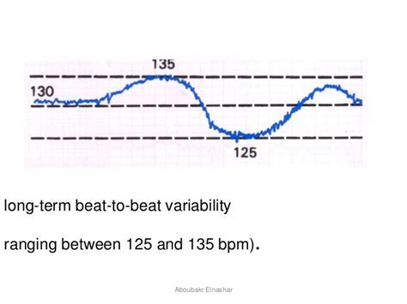
Beat to beat variability
Measured in 10 min
The amplitude is measured peak to trough

Slide 44
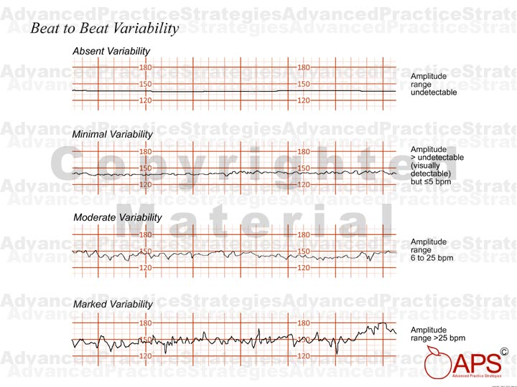

Slide 45
Base line variability
Use the following categorisations for fetal heart rate baseline variability:
reassuring: 6 to 25 beats/minute
non-reassuring:
less than 5 beats/minute for 30 to 50 minutes
more than 25 beats/minute for 15 to 25 minutes
abnormal:
less than 5 beats/minute for more than 50 minutes
more than 25 beats/minute for more than 25 minutes
sinusoidal

Slide 47
Decelerations:
Describe decelerations as 'early', 'variable' or 'late'. Do not use the terms 'typical' and 'atypical' because they can cause confusion
Early decelerations:
In early and late decelerations, the slope of fetal heart rate change is gradual, resulting in a curvilinear and uniform or symmetrical waveform

Slide 49
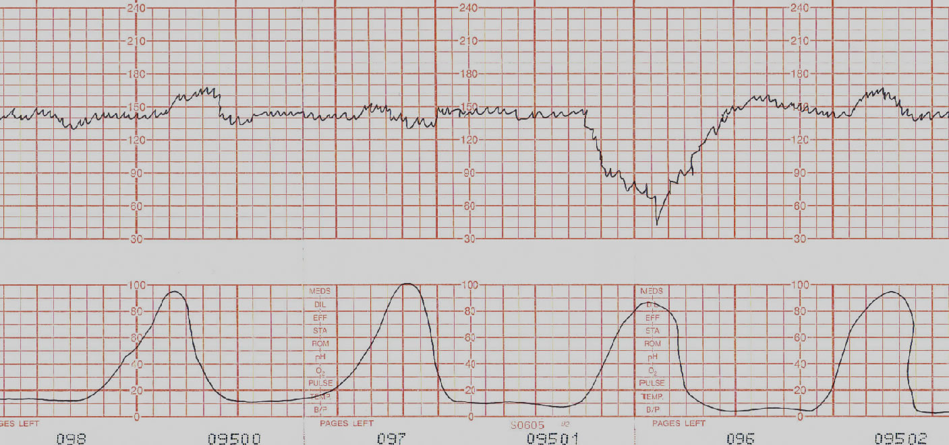

Slide 50
REASONS:
early decelerations are uncommon, benign and usually associated with head compression(dural stimulation) →vagal stimulation
early decelerations with no non-reassuring or abnormal features on the cardiotocograph trace should not prompt further action

Slide 51
early decelerations as those generally seen in active labor between 4 and 7 cm dilatation
the degree of deceleration is generally proportional to the contraction strength and rarely falls below 100 to 110 bpm or 20 to 30 bpm below baseline
Such decelerations are common during active labor and not associated with tachycardia, loss of variability, or other fetal heart rate changes
Importantly, early decelerations are not associated with fetal hypoxia, acidemia, or low Apgar scores.

Slide 56
Although these decelerations are not associated with fetal distress and thus are reassuring, they must be carefully differentiated from the other, nonreassuring decelerations.

Slide 58
Late Deceleration
A late deceleration is a smooth, gradual, symmetrical decrease in fetal heart rate beginning at or after the contraction peak and returning to baseline only after the contraction has ended
A gradual decrease is defined as 30 seconds or more from the onset of the deceleration to the nadir
In most cases, the onset, nadir, and recovery of the deceleration occur after the beginning, peak, and ending of the contraction, respectively.

Slide 59
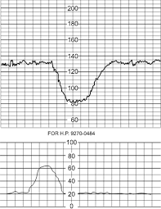
The magnitude of late decelerations is seldom more than 30 to 40 bpm below baseline and typically not more than 10 to 20 bpm. Late decelerations usually are not accompanied by accelerations

Slide 60
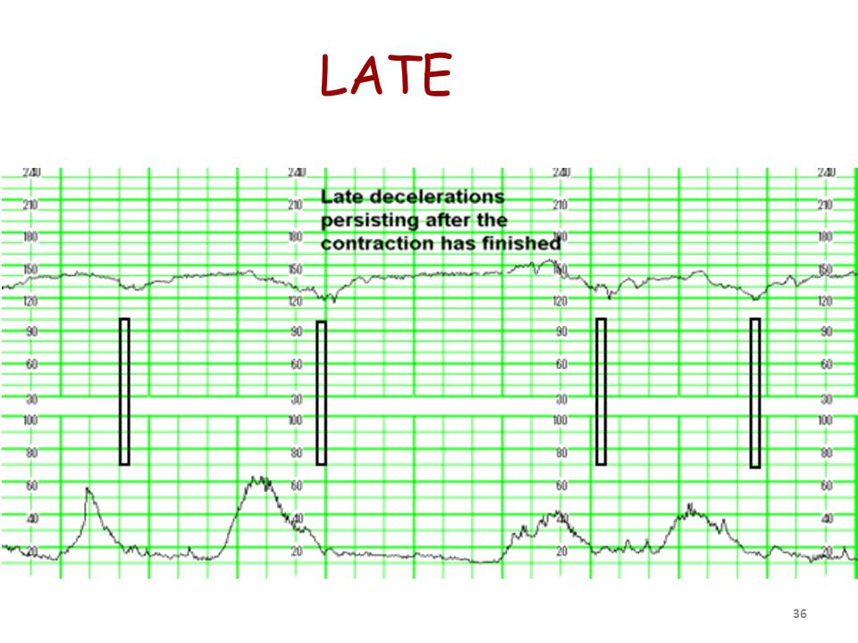

Slide 61
Regardless of the depth of the deceleration, all late decelerations are considered potentially ominous.
A pattern of persistent late decelerations is nonreassuring

Slide 62
Generally, any process that causes maternal hypotension, excessive uterine activity, or placental dysfunction can induce late decelerations.
The two most common causes are hypotension from epidural analgesia and uterine hyperactivity caused by oxytocin stimulation
Maternal diseases such as hypertension, diabetes, and collagen-vascular disorders can cause chronic placental dysfunction
Placental abruption can cause acute late decelerations

Slide 63
Variable Deceleration
Visually apparent abrupt decrease in FHR
An abrupt FHR decrease is defined as from the onset to the FHR nadir of < 30 sec
The decrease in FHR is ≥ 15 bpm, lasting ≥ 15 sec, and < 2 min in duration
When variable decelerations are associated with uterine contraction, their onset, depth, and duration commonly vary with successive uterine contractions
They resemble the letter “U,” “V” or “W” and may not bear a constant relationship to uterine contractions.

Slide 64
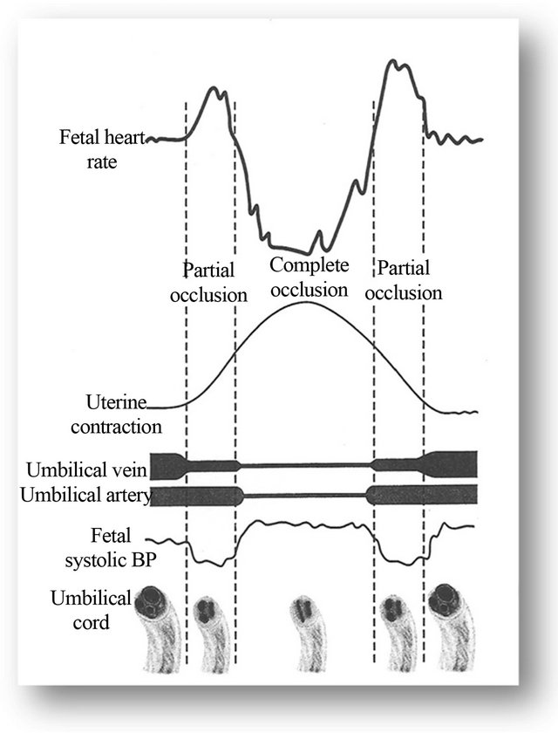
Variable decelerations are caused by compression of the umbilical cord.
Pressure on the cord initially occludes the umbilical vein, which results in an acceleration (the shoulder of the deceleration) and indicates a healthy response This is followed by occlusion of the umbilical artery, which results in the sharp downslope.
Finally, the recovery phase is due to the relief of the compression and the sharp return to the baseline, which may be followed by another healthy brief acceleration or shoulder

Slide 66
concerning characteristics of variable decelerations
They last more than 60 seconds
Fall below 70 beats/min
Have a drop of 60 beats/min below the baseline rate.
reduced baseline variability within the deceleration;
failure to return to baseline
biphasic (W) shape
No shouldering.

Slide 68
According to the American College of Obstetricians and Gynecologists (2013a), recurrent variable decelerations with minimal to moderate variability are indeterminate, whereas those with absent variability are abnormal.

Slide 69
if variable decelerations with no concerning characteristics are observed:
be aware that these are very common,
can be a normal feature in an otherwise uncomplicated labour and birth,
and are usually a result of cord compression
ask the woman to change position or mobilise.
Take into account that the longer and later the individual decelerations, the higher the risk of fetal acidosis (particularly if the decelerations are accompanied by tachycardia or reduced baseline variability).

Slide 72
Prolonged Deceleration
This pattern, is defined as an isolated deceleration greater than 15 bpm lasting 2 minutes or longer but < 10 minutes from onset to return to baseline. Some of the more common causes include cervical examination, uterine hyperactivity, cord entanglement, and maternal supine hypotension.

Slide 73
Epidural, spinal, or paracervical analgesia may induce prolonged deceleration of the fetal heart rate
Other causes of prolonged deceleration include maternal hypoperfusion or hypoxia from any cause, placental abruption, umbilical cord knots or prolapse, maternal seizures including eclampsia and epilepsy, application of a fetal scalp electrode, impending birth, or even maternal Valsalva maneuver

Slide 74
Occasionally, such self-limited prolonged decelerations are followed by
loss of beat-to-beat variability
baseline tachycardia
and even a period of late decelerations, all of which resolve as the fetus recovers.

Slide 79
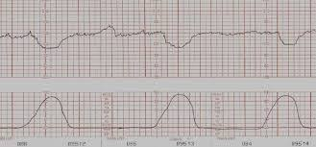

Slide 81
Category 2

Slide 82
Category 2

Slide 83
Category2

Slide 84
Category 2

Slide 85
Category 3

Slide 86
Abnormal:
variable decelerations with any concerning characteristics in over 50% of contractions for 30 minutes(or less if there are any maternal or fetal clinical risk factors)
late decelerations for 30 minutes(or less if there are any maternal or fetal clinical risk factors) acute bradycardia, or a single prolonged deceleration lasting 3 minutes or more
Variable decelerations Regard the following as concerning characteristics of variable decelerations: lasting more than 60 seconds reduced baseline variability within the deceleration failure to return to baseline biphasic (W) shape no shouldering.

Slide 87
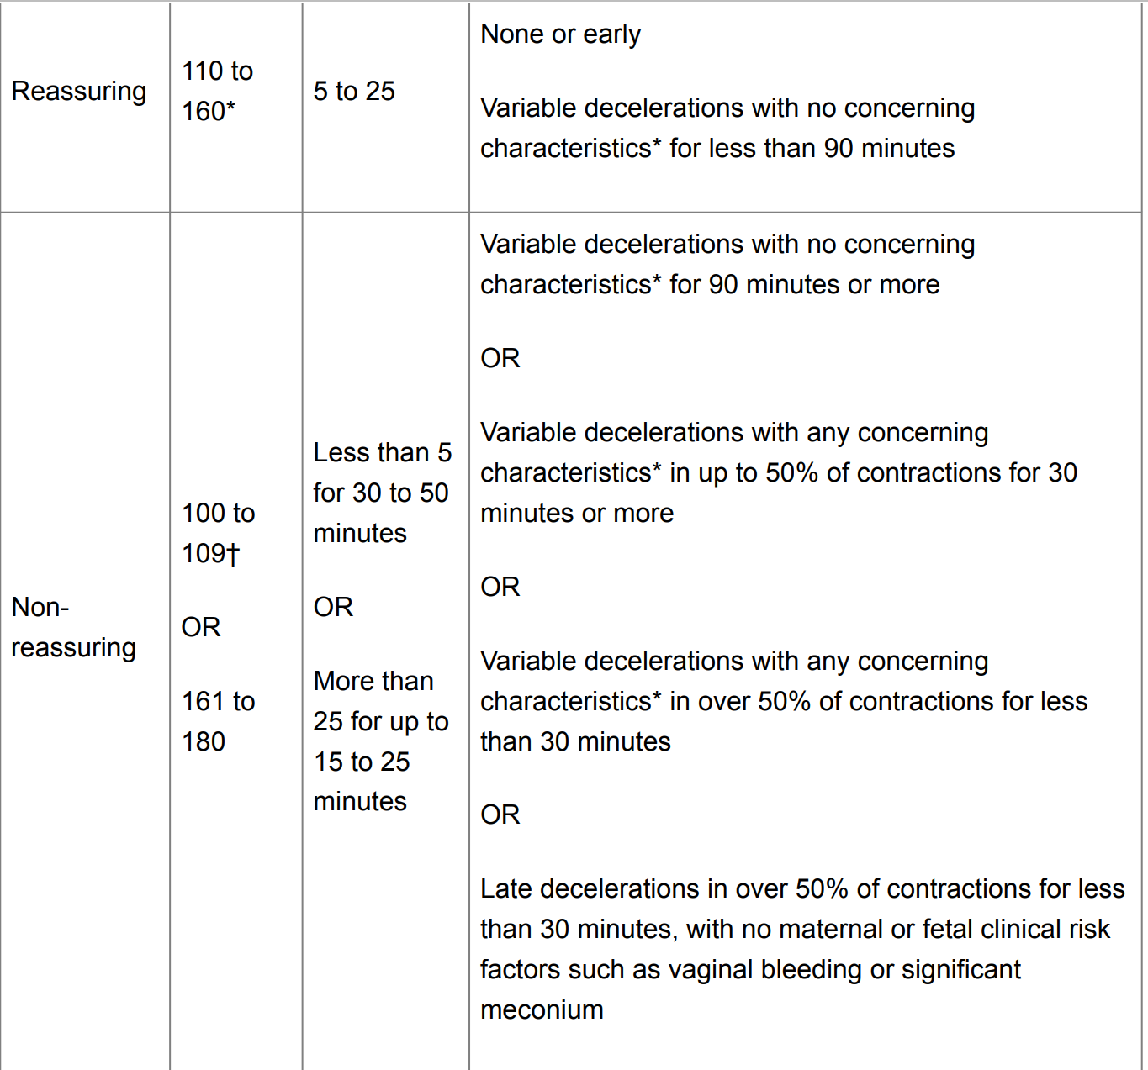

Slide 91
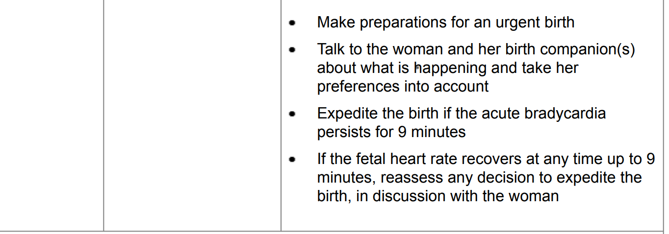

Slide 92
encourage the woman to mobilise or adopt an alternative position (and to avoid being supine)
offer intravenous fluids if the woman is hypotensive
reduce contraction frequency by reducing or stopping oxytocin if it is being used and/or offering a tocolytic drug (a suggested regimen is subcutaneous terbutaline 0.25 mg)

Slide 93
Sign of non acidotic fetus
The presence of fetal heart rate accelerations, even with reduced baseline variability, is generally a sign that the baby is healthy
The absence of accelerations on an otherwise normal cardiotocograph trace does not indicate fetal acidosis.
If digital fetal scalp stimulation (during vaginal examination) leads to an acceleration in fetal heart rate, regard this as a sign that the baby is healthy

Slide 94
Sinusoidal Heart Rate
A true sinusoidal pattern with fetal intracranial hemorrhage, with severe fetal asphyxia, and with severe fetal anemia from Rh alloimmunization, fetomaternal hemorrhage, twin-twin transfusion syndrome, or vasa previa with bleeding
A sinusoidal pattern also has been described with chorioamnionitis, fetal distress, and umbilical cord occlusion

Slide 96
1. Stable baseline heart rate of 120 to 160 bpm with regular oscillations,
2. Fixed or flat short-term variability,
3. Oscillation of the sinusoidal waveform above or below a baseline, and
4. Absent accelerations

Slide 97
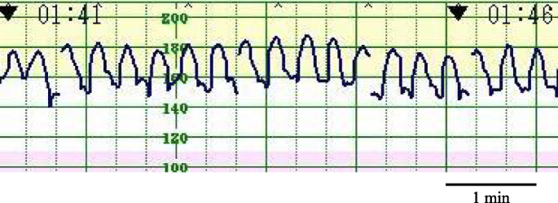

Slide 98
Insignificant sinusoidal patterns have been reported following administration of meperidine, morphine,alphaprodine, and butorphanol

Slide 99
In utero resuscitation
The following general measures for management of category II and III tracings are aimed at improving uteroplacental perfusion and maternal/fetal oxygenation :
VAGINAL EXAM(R/O OF CORD PROLAPS)
●Reposition the patient onto her left or right side
●Administer oxygen (eg, 8 to 10 L/min of oxygen via nonrebreather mask)
●Administer an intravenous (IV) fluid bolus (eg, 500 to 1000 mL of lactated Ringer's or normal saline solution)
●Discontinue uterotonic drugs
●Administer a tocolytic drug (eg, terbutaline 250 mcg subcutaneously)

Slide 100
In utero resuscitation
• Consider amnioinfusion if variable decelerations present
• Reduce maternal anxiety (to lessen catecholamine impact)
• Coach women to modify breathing or pushing techniques

Slide 104
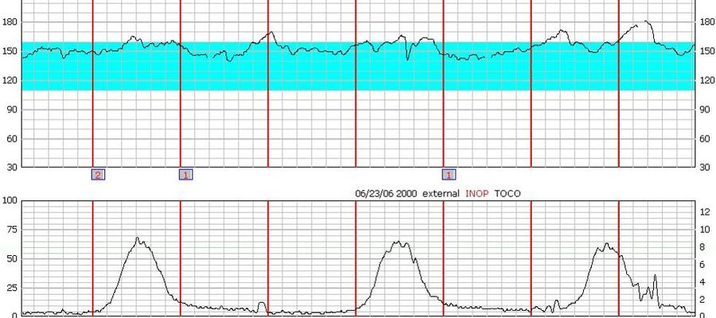
What is the baseline rate?
140
145
150
155
160

Slide 105
Describe the variability.
.ABSENT
.MINIMAL
.MODERATE

Slide 106
Are there accelerations present?
Answer: yes

Slide 107
Are there decelerations present? Are contractions present?
No
regullar

Slide 108
What category is this tracing? Is this fetal tracing reassuring
Category 1
Yes. It is reassuring and reactive

Slide 110
What is the baseline rate? Describe the variability
135
Moderate

Slide 111
Are there accelerations present? Are there decelerations present?
no
variable

Slide 112
Are contractions present? What category is this tracing?
Regular.
Category 2.

Slide 113
Is this fetal tracing reassuring

Slide 114
This tracing is not reassuring and requires intervention
This tracing may be tolerable if delivery is imminent. An amnioinfusion may correct this pattern in earlier labor. Cord compression is the likely etiology.

Slide 116
1. What is the baseline of the FHT?
140
2. Describe the variability.
Minimal.

Slide 117
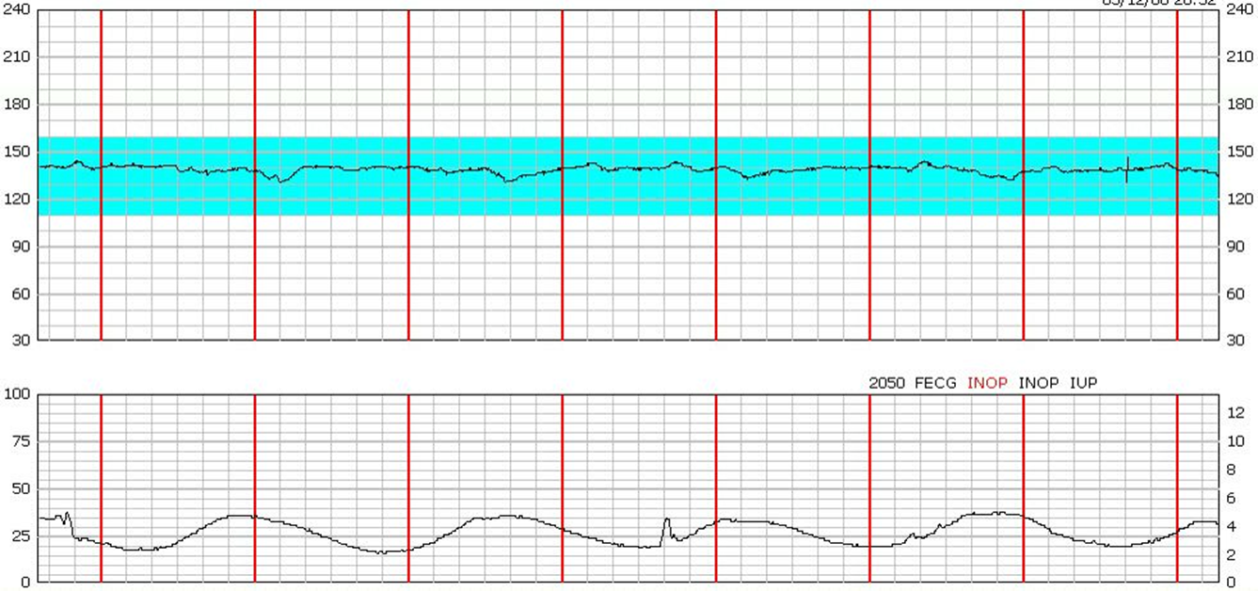
3. Are there accelerations present?
No.
4. Are there decelerations present?
None(maybe late)

Slide 118
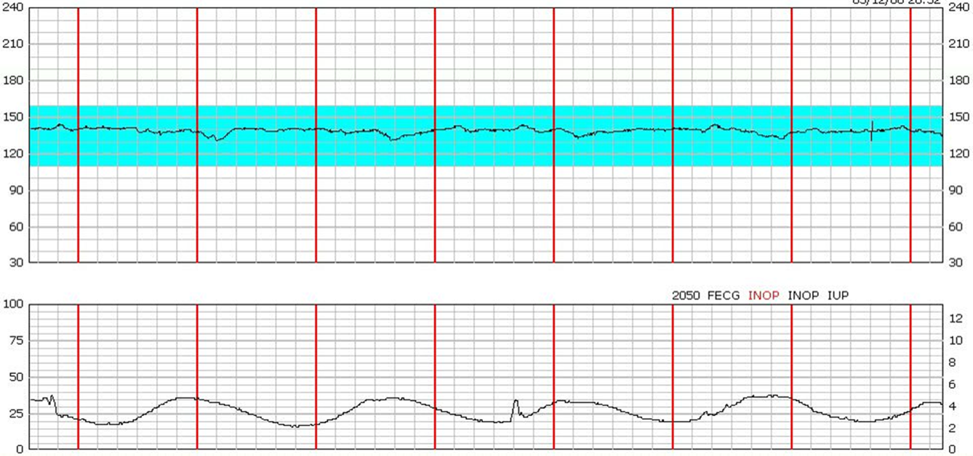
5. Are contractions present?
Hyperstimulation
6. Is this FHT reassuring?
This tracing is nonreassuring and requires intervention

Slide 119
1. What is the baseline of the FHT?
145

Slide 120
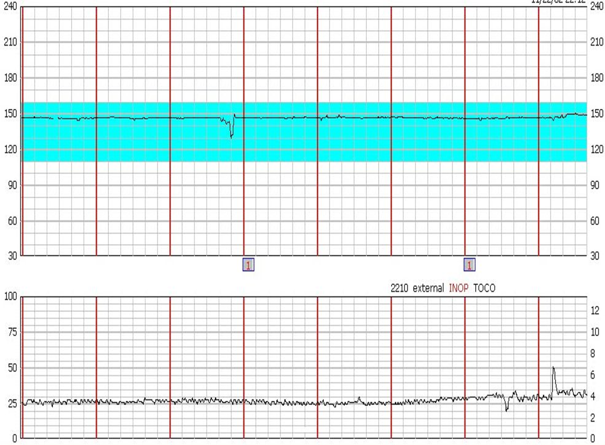
2. Describe the variability
Absent
3. Are there accelerations present?
No

Slide 121
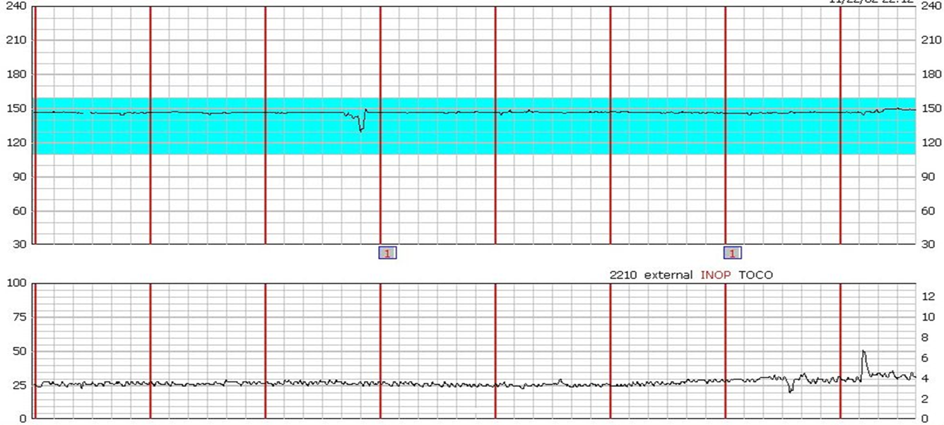
4. Are there decelerations present?
None
5. Are contractions present?
None

Slide 122
6. Is this FHT reassuring?
This tracing is nonreassuring and requires intervention

Slide 124
1. What is the baseline of the FHT?
120
125
130
135
140
2. Describe the variability?
Absent.
Minimal.
Moderate.
Marked.
3. Are there accelerations present?
No.
Yes.
Yes, and the strip is reactive.
4. Are there decelerations present?
None.
Variable.
Early.
Late.
Prolonged.
5. Are contractions present?
None.
Occassional.
Regular.
Hyperstimulation.
6. Is this FHT reassuring?
Yes. It is reassuring and reactive.
It is overall reasurring, but not reactive.
This tracing is nonreassuring and requires intervention.

Slide 125
1. What is the baseline of the FHT?Correct. Remember, the baseline is the average heart rate rounded to the nearest five bpm.
120
125
130
135
140
2. Describe the variability.Correct. Historically, this has been called average variability and it is considered normal in a term fetus.
Absent.
Minimal.
Moderate.
Marked.
3. Are there accelerations present?Correct. There are no accelerations present.
No.
Yes.
Yes, and the strip is reactive.
4. Are there decelerations present?Correct. There are repetitive variables present (with each contraction). These should be further described by their depth and duration (e.g., to 70 bpm lasting up to one minute).
None.
Variable.
Early.
Late.
Prolonged.
5. Are contractions present?Correct. Her contractions are every 3-4 minutes.
None.
Occassional.
Regular.
Hyperstimulation.
6. Is this FHT reassuring?Correct. This pattern may be tolerated only when delivery is imminent. Amnioinfusion may help correct this pattern earlier in labor.
Yes. It is reassuring and reactive.
It is overall reasurring, but not reactive.
This tracing is nonreassuring and requires intervention.

Slide 126
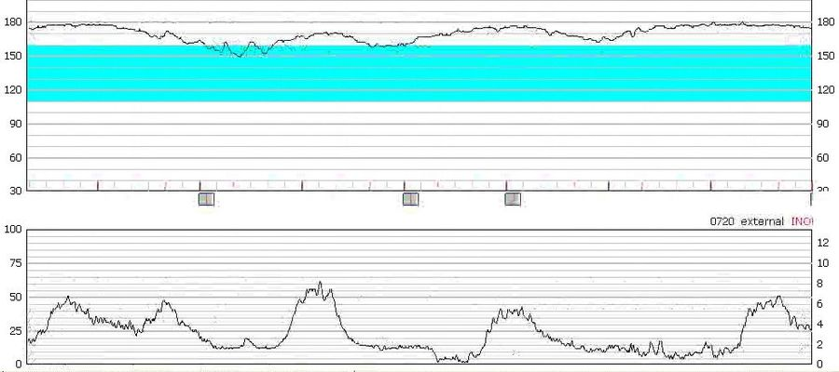
What is the baseline rate?
180

Slide 127
Describe the variability.
minimal

Slide 128
Are the accelerations present: Are there decelerations present?
No
late

Slide 129
Are contractions present?
The contractions are regular and occurring every 2 minutes

Slide 130
What category is this tracing?
Category 2.

Slide 131
Is this fetal tracing reassuring?
This tracing is not reassuring and requires intervention

Slide 132
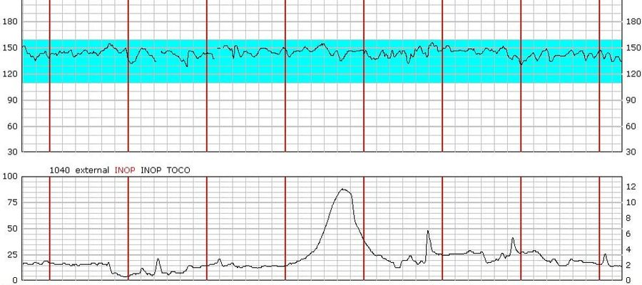
What is the baseline rate?
145

Slide 133
Describe the variability
Moderate

Slide 134
Are there accelerations present? Are there decelerations present?
n
No
None.

Slide 135
Are contractions present?
Her contractions are irregular

Slide 136
What category is this tracing?
Category 1.

Slide 137
Is this fetal tracing reassuring?
It is overall reassuring, but not reactive

Slide 138
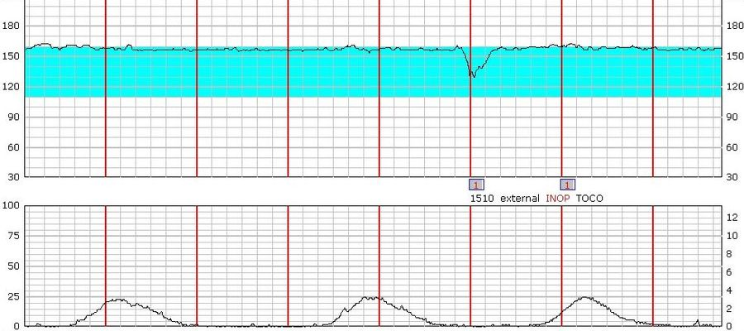
What is the baseline rate?
155

Slide 139
Describe the variability.
Minimal

Slide 140
Are there accelerations present? Are there decelerations present?
No
There is a single variable deceleration present. These should be further described by their depth and duration (e.g., to 130bpm lasting about 25 seconds).

Slide 141
Are contractions present?
Regular

Slide 142
What category is this tracing?
CATEGORY 2
Is this fetal tracing reassuring?
It is overall reassuring, but not reactive

Slide 143
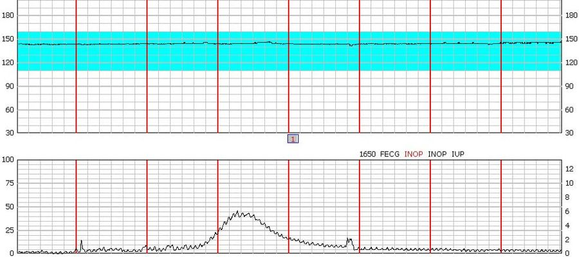
What is the baseline rate?
145

Slide 144
Describe the variability.
Absent

Slide 145
Are there accelerations present? Are there decelerations present?
NO
NO
NO
NO

Slide 146
Are contractions present?
Occasional.

Slide 147
What category is this tracing?
Category 2.
Is this fetal tracing reassuring?
This tracing is not reassuring and requires intervention

Slide 148
Case 1
A 26 year old G1 P0 in gestation weeks 41+3 with normal pregnancy.
10.10 Admitted to labour ward contracting and SROM since 32 hours and clear liquor draining. VE: Cx fully effaced, dilated 6 cm, vx -2.
11.11 Epidural sited on maternal request.
12.30 Oxytocin infusion started. VE: Cx fully effaced, dilated 7 cm, vx -1.
14.30 , vx at 0 station. Maternal temperature 38. 2. One dose of antibiotics given i.v.
15.31 Decision to perform caesarean section after physician assessment.
15.54 Emergency caesarean section. Baby girl with birth weight 4410 g.

Slide 149
Case 1
Apgar score: 9, 10, 10.
Cord gases
pH pCO2 BE
Artery 7.24 8.5 -5.9
Vein 7.32 7.2 -3.1

Slide 150
Case 2
37 year old G 3 P 2. Gest. week 41+0. 2003 SVD. 2004 SVD. Normal pregnancy.
11:20 Admitted to hospital contracting since 06:00. VE: Cx fully effaced, 7 cm dilated, vx -1.
11:43 External CTG trace initiates.
12:58 ARM, clear liquor draining. FSE applied. VE: Cx fully dilated, vx +1.
13:15→NVD Babyboy. Birthweight 3920 g Apgar →0

Slide 151
CASE 2
IUFD
If you have accelerations during every contraction you should always be suspicious that it may be maternal pulse. In this case maternal pulse is registered.

Slide 153
CASE 3
A 25 year old G1 P0 in gestation week 41+6 is admitted to the labour ward in latent phase with backache and mild irregular contractions. Normal pregnancy.
NST on admission →reassuring
VE on admission at 15.00: Cx 1 cm long, 1.5 cm dilated, membranes intact.

Slide 154
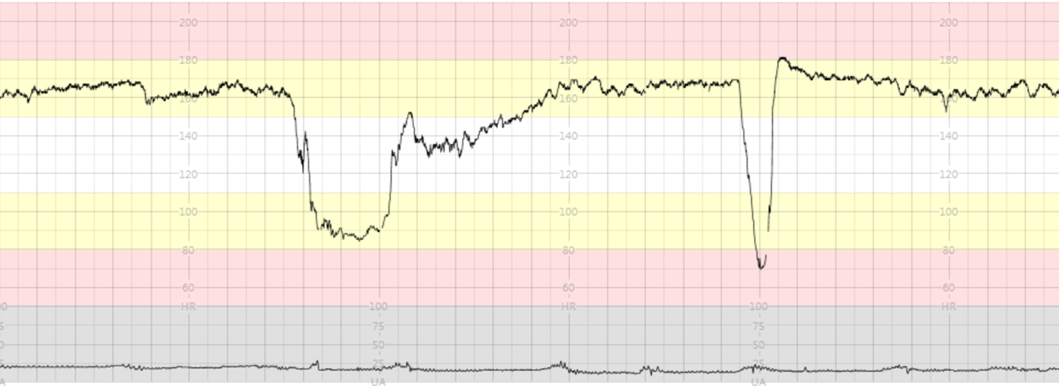
Case 3
VE: Cx fully effaced, dilated 2 cm, vx-2. ARM, meconium stained liquor
Emergency caesarean section. Baby girl. Birth weight 2720 g.

Slide 155
Case 3
Apgar score: 4, 7, 8.
Cord gases
pH pCO2 BE
Artery 6.92 7.2 -13.1
Vein 7.04 6.1 -8.7
Baby admitted to NICU, discharged after 7 days.

Slide 156
Case 4
23 year old G 2 P1. Gest week 41+2. BMI 51.2
Admitted to hospital contracting and SROM
06.30 VE: Cx fully effaced, 5 cm dilated, vx-2
CTG admission test is normal.
7:40 VE: Cx fully effaced, dilated7 cm, vx -2
After 30 min→the same

Slide 157
CASE 4
C/S IS DONE
Baby boy. Birth weight 4 690 g.
Umbilical cord around the neck.
Cord gases
pH pCO2 BE
Artery 7.23 9.7 -7.9
Vein 7.28 8.7 -6.9

Slide 158
CASE 5
A 22 year old G2 P1 in gestation weeks 41+5 with a normal pregnancy
Admission CTG

Slide 159
CASE 5
After fetal scalp stimulation

Slide 160
NVD→ Baby girl 3 450 g.
Apgar score: 9,10,10.
Cord gases
pH pCO2 BE
Artery 7.28 7.9 -3.1
Vein 7.34 6.4 -2.8

Slide 161
CASE 6
A 34 year old G2 P1. Gestation week 39+2. Admitted in spontaneous labour. Normal pregnancy.
SROM with clear liquor and contracting since then.

Slide 162
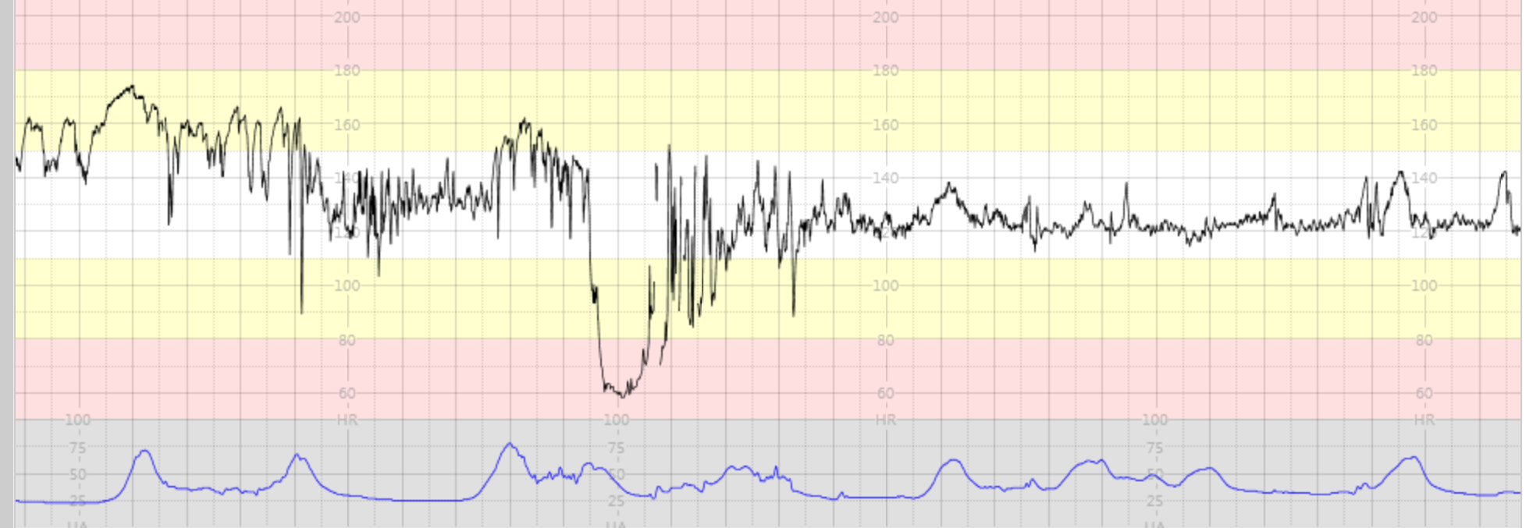
CASE 6
During pushing

Slide 163
CASE 6
NVD→Baby girl born. 4230 g. Apgar 9,10,10
Cord gases
pH BE
Artery 7.31 -3.1
Vein 7.36 -2.3

Slide 164
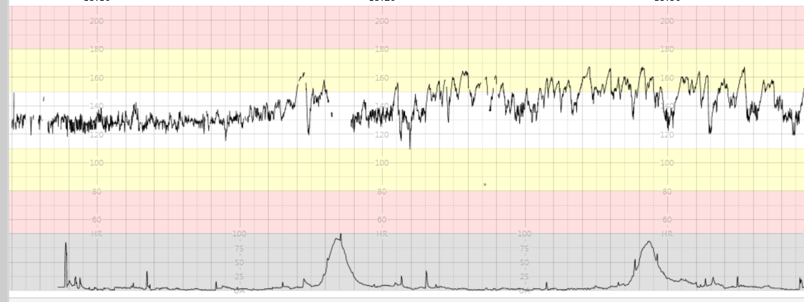
CASE 7
28 year old G 1 P 0. Gest. week 38+3. Normal pregnancy.
12:30 Admitted to hospital due to spotting
Weak contractions. Normal CTG trace. VE: Cx fully effaced, 2 cm dilated, vx -2. Plan: Continous CTG and ARM as soon as possible.
13:25 ARM. Bloodstained liquor draining. VE: Cx fully effaced, dilated 3 cm, vx -1.
16:25 VE: Cx fully effaced, dilated 4 cm, vx -1.
16:56 Sudden pain per abdomen

Slide 165
16:58 Uterus tensed, 200 ml blood clot per vagina.
17:09 Desicion made for Emergency ceaserean section due to preterminal trace

Slide 166
17:20 →Caeserean Section. Abraptio placenta
Babygirl born
Apgar Score 2, 4, 5. Birthweight 3 670 g.
Cord gases
pH pCO2 BE
Artery 6.88 8.2 -15.2
Vein 7.01 7.1 -11.5
Babygirl admitted to NICU

Slide 167
Case 8
32 year old G1 P0. Gestation week 40+4 admitted to hospital in early spontaneous labour. VE on admission at 22.00: Cx fully effaced, 2 cm dilated, vx-2. Normal pregnancy. External CTG tracing is normal on admission

Slide 168
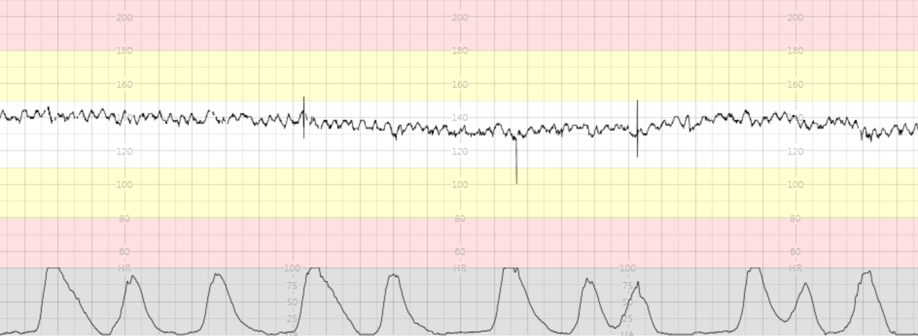
Epidural sited on maternal request.

Slide 169
NVD. Baby girl born.
pseudosinusoidal pattern is a normal pattern and must not be confused with abnormal sinusoidal pattern
Cord gases
pH pCO2 BE
Artery 7.26 8.4 -4.1
Vein 7.31 8.3 -3.2

Slide 170
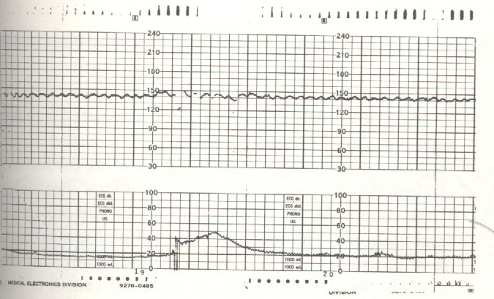
Case 9
A 28 years old patient G 5 p 4+ 0 was admitted in labour at 39½ weeks’
gestation. Her blood group was O positive, without antibodies.
She received pethidine and phenrgan for sedation.

Slide 171
Course and Outcome
Cesarean section was performed due to fetal distress.
Outcome was baby girl weighing 1960 gm with Apgar 1/6 with intrauterine growth restriction.
Umbilical arterial PH was 7.37 and venous 7.41
The infant had intracrebral hemorrhage and died after 5days.

Slide 172
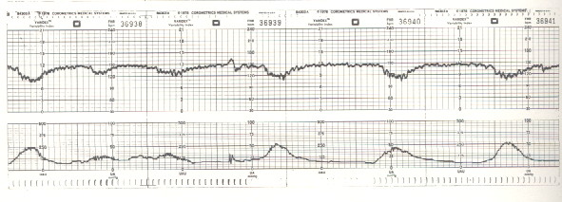
Case 10
A 27 years old G 4 p 3 + 0 was admitted in labour at 41 ½ weeks’
gestation. 15 minutes prior to this recording the cervix was 4cm
dilated with the head at –1 station. Artificial rupture of membranes
was performed and clear liquor drained.

Slide 173
Early decelerations
Actions
Oxygen by facial mask (no)
Change maternal position (no)
Cesarean section (no)
Observe for the development of other types of declarations (yes)
Vaginal examination for progress assessment (no)
Fetal blood sampling (no)
Course and outcome
Progressed to normal vaginal delivery of female infant
weighing 3969 gm. Apgar score was 8/9 at one and five
minutes. The infant followed a normal newborn course.

Slide 174
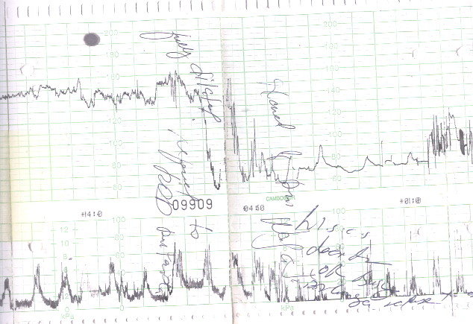
Case 11
A 30 years old G 4 p 3 patient was admitted in labour at 36 weeks’
gestation. She had H/O cesarean section in her second delivery.
One hour prior to this trace, the cervix was 8cm dilated and clear
liquor was draining

Slide 175
Prolonged Deceleration
Actions
Vaginal examination (yes)
Check maternal vital signs (yes)
Fetal blood sampling for PH (no)
Cesarean section (yes)
Oxygen by facial mask (no)
Course and outcome
Rupture uterus was suspected and laparatomy was performed.
There was complete scar dehiscence and the infant was in the
peritoneal cavity. It was male 3.1 00 gmand fresh stillbirth.
The uterus was repaired.

Slide 176
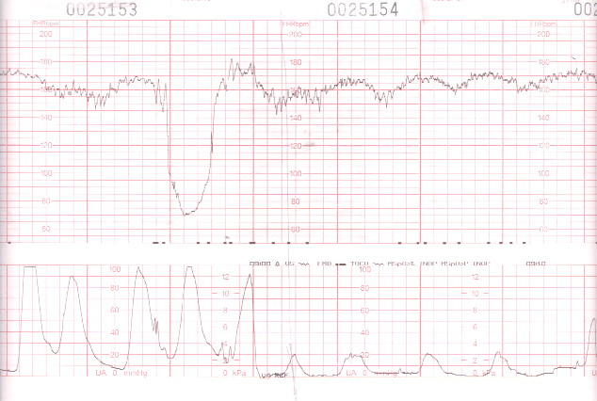
Case 12
A 25 years old primigravid patient, diabetic on diet control with mild pregnancy induced hypertension.Labour was induced at 38 weeks gestation with vaginal prostin. She had spontaneous rupture of membranes 24 hours before this trace and clear liquor drained.

Slide 177
Late Deceleration and Severe Variable Deceleration
Actions
Change maternal position (yes)
Fetal blood sampling (no)
Immediate cesarean section (no)
Exclude cord prolapse (yes)
Wait and review as normal patient (no)
Administration of tocolytics if the pattern continues (yes)
Course and outcome
Cesarean section was performed for failed induction of labour.
Outcome was female infant weighing 3200 gm. Apgar score was
9/10 at one and five minutes.
The infant followed normal newborn outcome.

Slide 178
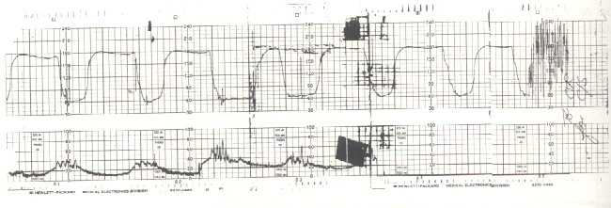
Case 13
A 31 years old patient G 2 p 1 was admitted at 41 weeks of gestation
in active labour. Received pethidine and Phenrgan earlier.
The cervix is 9 cm dilated and meconium stained liquor is draining.

Slide 179
Sinus Tachycardia With Deceleration And No Variability: Mixed Pattern
Actions
Wait and review after 30 minutes (no)
Change the position of the patient (yes)
Immediate cesarean section (yes)
Explain and reassure the patient (yes)
Course and Outcome
Cesarean section was carried out. A baby girl weighing 3898 gm
was delivered from vertex presentation. Apgar score was 1/5
at one and five minutes. The position of the cord was not noted.
The baby had meconium aspiration pneumonitis and was
discharged after 10 days.

Slide 180
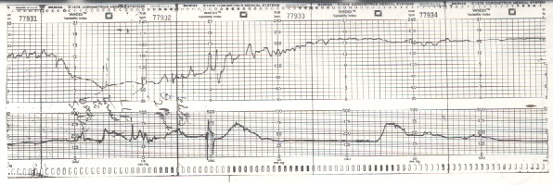
Case 14
A 25 years old patient admitted at 36 weeks of gestation in labour. No sedation is given yet

Slide 181
Rebound Tachycardia
Actions
Facial oxygen (no)
Give sedation (no)
Fetal scalp blood sampling for PH (yes)
Augmentation of labour with syntocinon (no)
Cesarean section (no)
Course and Outcome
After recovery from prolonged deceleration, scalp PH
were 7.28, 7.36 and 7.36.the patient had normal vaginal
delivery of baby girl weighing 2070gm(small for age).
Apgar score was 9/10 at one and five minutes.

Slide 182
Case 15
A 19 years old primigravid patient admitted in labour at 34 weeks.
She had pyelonephritis and chorioamnionitis.
Pethidene was given 90 minutes prior to this trace.

Slide 183
No variability, flat line-unfavorable outcome
Actions
Ultrasound to exclude anomalies (yes)
Fetal vibroacuastic stimulation (yes)
Fetal blood sampling for acid base status (yes)
Observe and review after one hours (no)too late!
Immediate cesarean section (no)
Course and Outcome
The mean of serial fetal blood sampling four times were showing
nonacidotic intrapartum capillary PH of 7.2, so she was allowed to
progress in labour.had Normal vaginal delivery of female weighing
2381 gm. Apgar score was 2/3 at one and five minutes. The newborn
required intubation. It survived and was discharged after 9 days.

Slide 187
What is the baseline of the FHT?
140
Describe the variability
Minimal

Slide 188
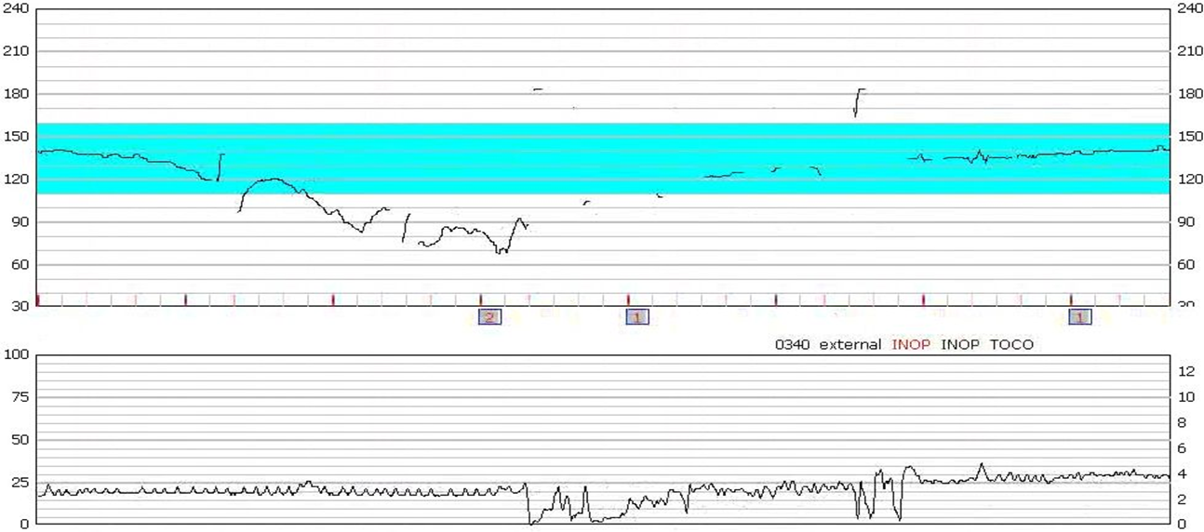
Are there accelerations present?
NO
Are there decelerations present?
Prolonged
Are contractions present?
Increased tonus

Slide 189
Is this FHT reassuring?
This tracing is nonreassuring and requires intervention
Cathegory→
2

Slide 190
Case
24 yo G2P0100
32.4 weeks gestation admitted for HTN
At admission, her fetal tracing had a baseline of 135 with minimal variability, no accelerations, and no decelerations 4 hours ago.
She has received one dose of Betamethasone for fetal lung maturity approximately 3 hours ago.

Slide 191
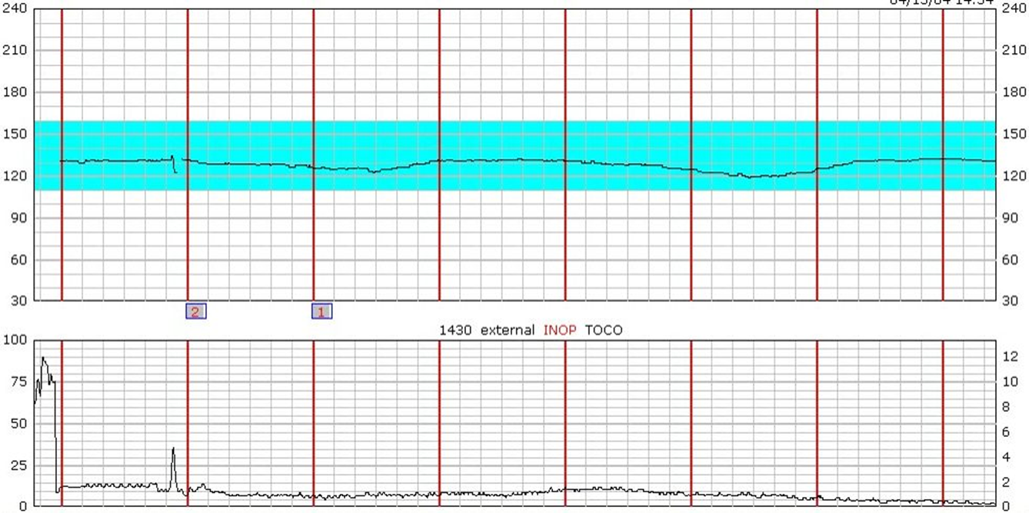
Baseline→
130
Variability→
absent
Acceleration→
NO

Slide 192
Deceleration→
Late
Contraction→
NO
Category→
3
nonreassuring

Slide 193
Case 3
GA is a 31 year old G4P1203 with intrauterine pregnancy at 35.3 weeks presenting with regular uterine contractions and spontaneous rupture of membranes 8 hours ago.
Her medical history is significant for hypothyroidism and one previous cesarean section with two successful vaginal births after cesarean (VBAC).
She has desired a trial of labor in this pregnancy.
V/E→5cm vertex MR -2

Slide 194
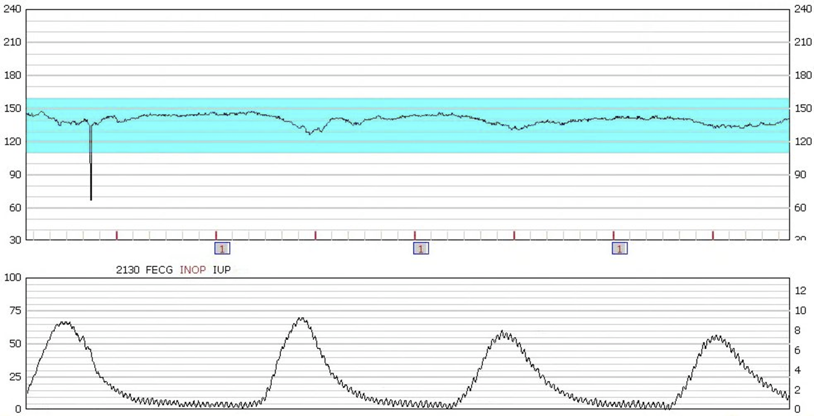
Baseline:
140
Variabilty→
Minimal

Slide 195
Acceleration→
No
Deceleration→
Early
Contraction→
Regullar
Categry→
2

Slide 196
case
a 29 year old G1 at 40.5 who underwent induction of labor secondary to oligohydramnios.
At 4cm dilation, she underwent artificial rupture of membranes and the amniotic fluid was noted to have moderate meconium staining. Her obstetric history has been unremarkable. Currently she is on 12 mu/min of oxytocin. Below is her current fetal tracing:

Slide 197
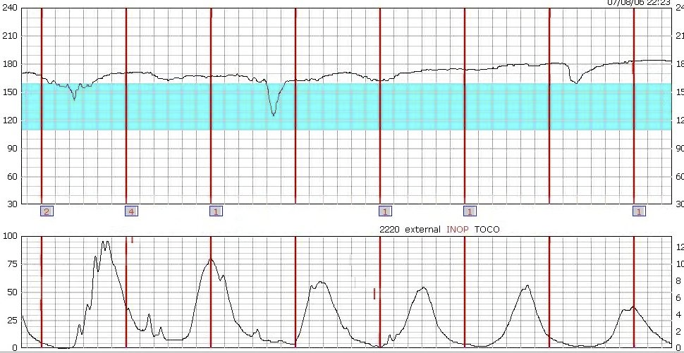
Baseline-->
165
Variability→
Minimal
Acceleration→
No

Slide 198
Deceleration→
Variable
Contraction→
Hyperestimulate
Category→3

